Slide 1
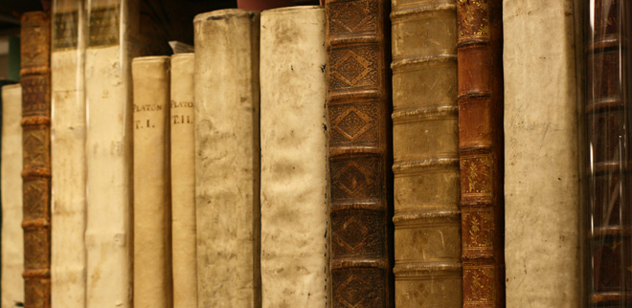
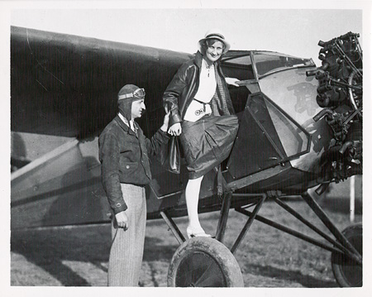
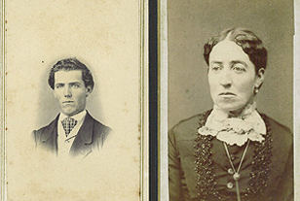
Promoting the Value of Special Collections:
A Subject Librarians’ Approach
Anne Larrivee + Leslie Vega
Edwin A. Link and Marion Clayton Link Collections
Civil War Collections
Notes:
SLIDE 1
When I was a graduate student at the University of South Florida, I had an assistantship in the Library’s Special Collections. It was then that I learned how “special” special collections is for academic libraries. As a subject librarian, I use the knowledge I gained from my previous experience in Special Collections to guide people to unique sets of research collections, I help connect them to unique, sometimes one of a kind resources that lead researchers to new discoveries.
As the Visual Art Librarian at Binghamton University, my colleague Leslie Vega has worked closely with the Special Collections staff to promote and preserve its collections. As the liaison for the Art, Music, and Art History Departments, Leslie consistently encourages her students to visit Special Collections through a variety of methods. The study of archives, rare books and manuscripts, and the assorted collection of “old stuff” that lives within the vaults of Special Collections is vital to humanities research – and yet, unless prompted to visit by their professor, most students do not go to their Libraries’ archive. Especially within the disciplines of Art and Art History, the study of the objecthood of any material, and the primary resources surrounding that material is unquestionably important. There is no digital substitute for looking at a 16th century manuscript or a 1920’s poster from Soviet Russia.

Slide 2
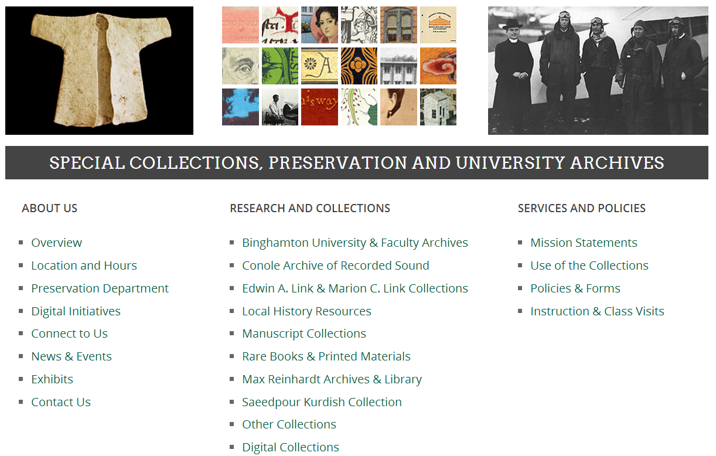
Notes:
SLIDE 2
As you can see from the Binghamton University’s Special Collections homepage, the BU Collections have a lot to offer. Leslie and I as well as other librarians have done our part to direct students to the collections from the reference desk but the question is what else can we do to promote Special Collections? This presentation covers a few of the ways that both Leslie and I have promoted the value of Special Collections and then provides some insight from other SUNY libraries about the way Special Collections directors feel about collaborative opportunities.

Slide 3
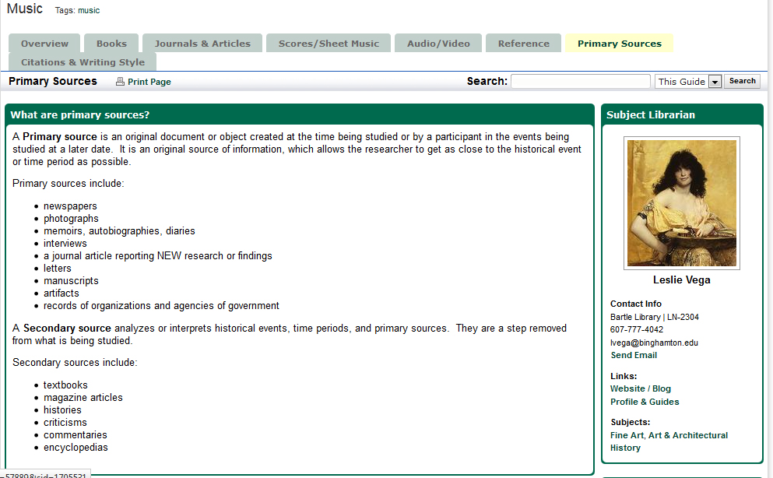
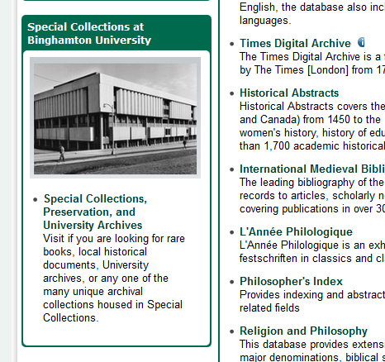
Music + Art Subject Guides | Binghamton University
Notes:
SLIDE 3
On Leslie’s Music LibGuide, there is a page specifically designed to explain what a primary source is, and where to find one. Garnering from past experience with students, many don’t understand what a primary source is. Yet it’s one thing for us as librarians to explain, and quite another to show. The staff at our University’s Special Collections makes it a point to show students the materials they have in the collection, their value, and how they can incorporate such things as oral history tapes, newspapers, historic photographs, and even clothing into their research.

Slide 4
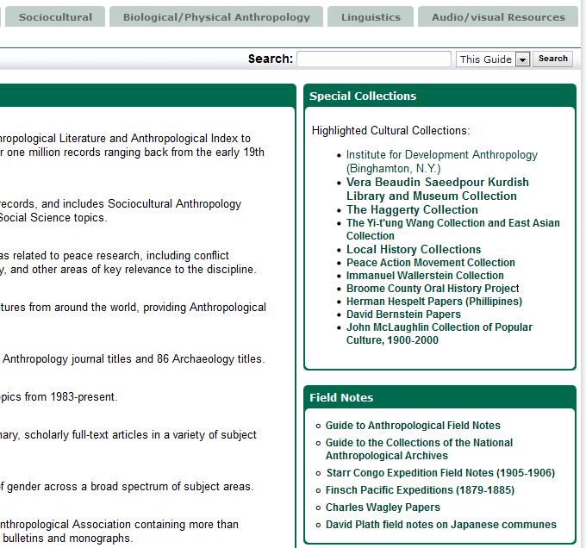
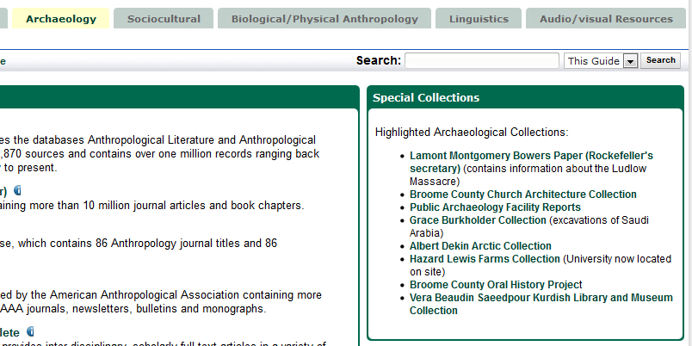
Anthropology Subject Guide | Binghamton University
Notes:
SLIDE 4
You can also see how I’ve highlighted Special Collections on the Anthropology Subject Guide. One of the problems is that students and faculty just don’t have awareness of the collections so in this guide I try to present them with relevant options that they can link to and explore in more detail.

Slide 5
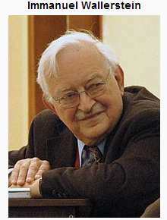
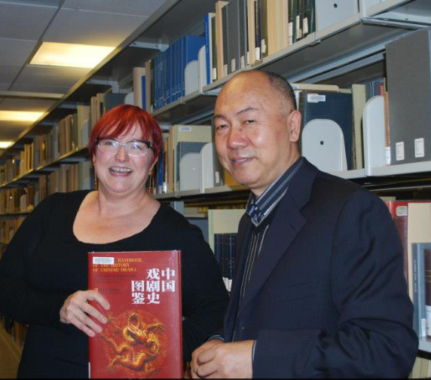
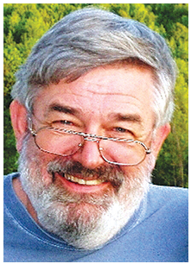
Collections of Interest
 | Immanuel Wallerstein first became interested in world affairs as a teenager in New York City, and was particularly interested in the anti-colonial movement in India at the time…As of 1976, he served as distinguished professor of sociology at Binghamton University (SUNY) until his retirement in 1999. Excerpt from-- http://www.binghamton.edu/libraries/special-collections/researchandcollections/findingaids/uarchives/wallerstein_FA.pdf |  | The Wang Collection was donated to the University Libraries in 2004 by Professor Yi-t'ung Wang, and is the cornerstone of the Asian Collection. The Wang Collection consists of over 4,000 volumes on Chinese history, religion, education, economics, politics, philosophy and literature. The East Asian Collection contains monographs written in Chinese, Japanese and Korean in the areas of history, literature and religion in addition to a Japanese woodblock print collection.
 | This consists of several collections documenting the history of medicine in the Broome County area: Binghamton General Hospital Collection, Broome County Medical Society Records and Reference Library, Wilson Memorial Medical Center Papers (1893-1989), The Dr. Francis Gilroy Papers (1910-2006), Frank Dyer Papers (1900-1950). Excerpt from– http://www.binghamton.edu/libraries/special-collections/researchandcollections/manuscripts.html |  | [Al] Dekin…conducted archaeological research in advance of construction of the Trans-Alaska Oil Pipeline for the University of Alaska, Fairbanks, before joining the faculty at Binghamton in 1976. Well known for his work assessing the archaeological, historical and cultural resources damage caused by the Exxon Valdez oil spill for the U.S. Department of Agriculture Forest Service, Dekin served as director of the Public Archaeology Facility for 11 years. Excerpt from-- http://www2.binghamton.edu/news/inside/news.html?issue=2010feb04&id=3
Notes:
SLIDE 5 &6
Last year I was invited to an introductory anthropology graduate course to discuss the value of using archives in graduate research. I used this class as an opportunity to highlight some of relevant Special Collections that I have listed on my guide. For example we have the personal papers of Immanuel Wallerstein a well-known sociologist/anthropologist who helped develop the World-Systems Theory.

Slide 6
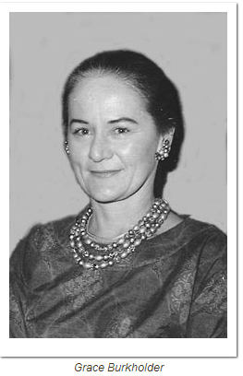
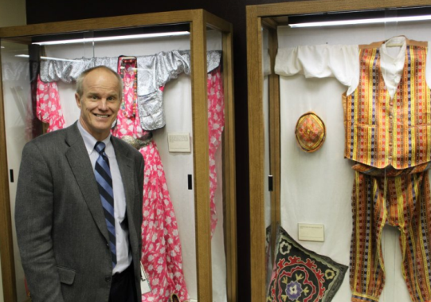
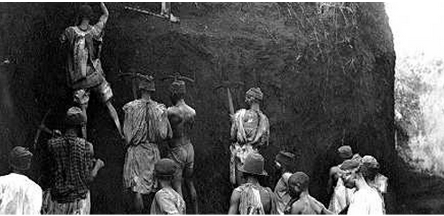
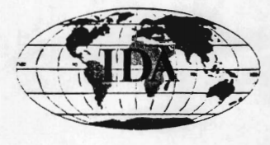
Collections of Interest
 | Vera Beaudin Saeedpour started the Kurdish Heritage Foundation, Kurdish Library and Kurdish Museum all out of her home in Brooklyn, NY in the early 1980s. The evolution of the library/museum is evident through her correspondences with politicians, universities, Kurdish friends, writers, and people of all different backgrounds. Excerpt from-- http://128.226.37.53/index.php?p=collections/controlcard&id=26 |  | Grace Burkholder became famous in the field of Near Eastern archaeology for discoveries she made while serving as a teacher at Aramco during the 1950s and ‘60s. She found pottery from the fifth millennium B.C. that proved the Mesopotamian Ubaid culture extended farther into the Arabian desert than had been known. --excerpt from http://www.aramcoexpats.com/articles/category/community/page/123/
 | The volumes in the Haggerty Collection are concerned with French and, to a lesser degree, other European nations' colonies and spheres of influence in all parts of the world in the period 1500 to 1960. The heart of the collection is material relating to colonial Africa and Asia. There are some 5,000 volumes concerned with North Africa, Sub-Saharan Africa, and, to a lesser extent, Africa in general. Excerpt from-- http://www.binghamton.edu/libraries/special-collections/researchandcollections/haggerty.html#about |  | The Institute for Development Anthropology (IDA) was founded in 1976 by Binghamton University Professor Michael Horowitz with colleagues Professor David Brokensha of Oxford University and Thayer Scudder of the California Institute of Technology. For over twenty years this private non-profit research institute worked in countries throughout South America, the Caribbean, Africa (North Africa and Sub-Saharan countries), the Middle East, Asia, and the Pacific Rim. Except from-- http://www.clir.org/hiddencollections/registry/hc.0370
Notes:
Or Grace Burkholder Collection, which has photographs and notes from one of the first archaeological excavations in Saudi Arabia.

Slide 7
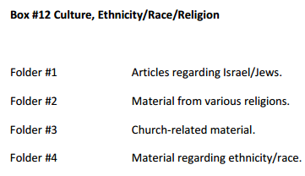
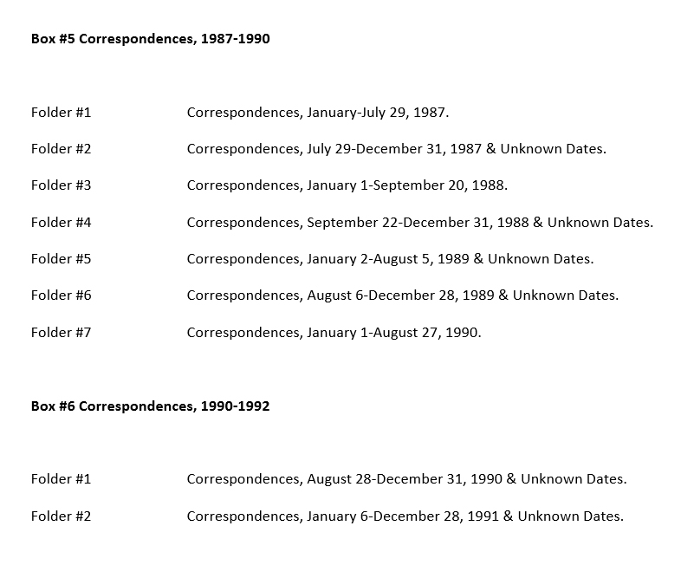
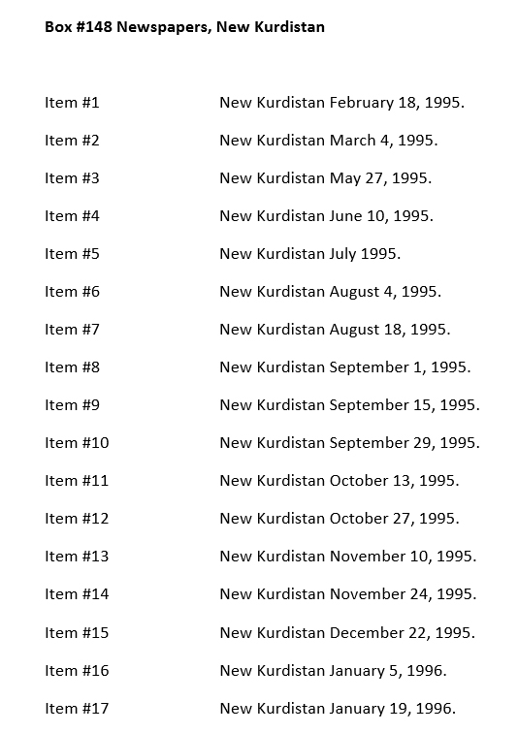
What is a
Finding Aid ?
Instructing Anthropology Courses
171 pages
Vera Beaudin Saeedpour Kurdish Library & Museum Collection Finding Aid
Notes:
SLIDE 7
It’s also important that students and faculty understand how to use and find what they need in the archive. During the same presentation I gave a brief description of how finding aids briefly describe the various objects in the collection. On this slide you’ll see a Finding Aid for the Vera Beaudin Kurdish Collection, This Collection holds contents from what was formerly a small NYC museum. Thus the finding aid not only lists the typical notes, books and photographs, but also clothing and jewelry.

Slide 8
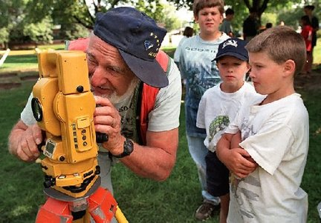
Gordon DeAngelo
Collection
David Lassman/The Post-Standard, file photo, 1998
Gordon DeAngelo (left), a retired landscape architect and amateur archaeologist, shows students how to use a piece of survey equipment at the Salt Museum in Onondaga Lake Park in 1998. Kids were (from left) Michael Payne, 10, of Utica; Matthew Richards, 9, of East Syracuse, and Jacob Johnson, 8, of Granby).
Notes:
SLIDE 8
Gordon DeAngelo, pictured here was a local archaeologist who had spent a lifetime collecting antique guides, catalogs, archaeology books, and other assorted collector’s guides. As you can imagine, sorting through his collection presented some challenges. None of his materials necessitated space in Special Collections. However, I was fortunate to work with the rare books curator to ensure that I wasn’t overlooking any rare materials that belonged in Special Collections.

Slide 9
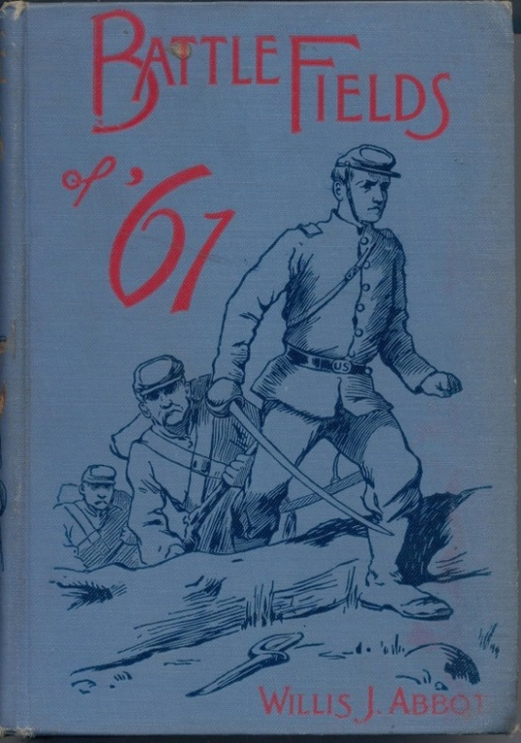
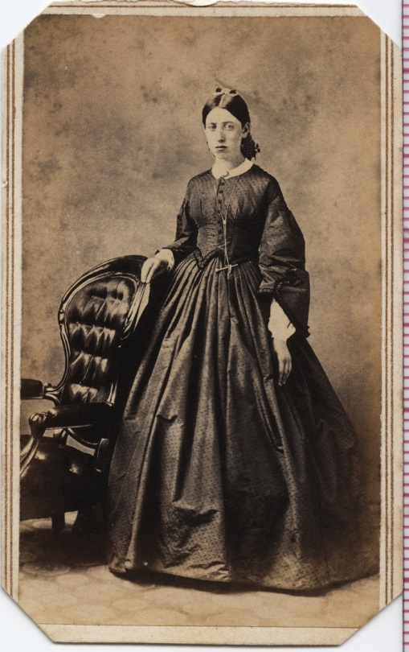
Professional Development
Committee
Brown Bag Lecture
Open to the campus community
Notes:
SLIDE 9
In 2012 I was on the Library Faculty’s Professional Development Committee. One of our responsibilities was to help recruit speakers for Brownbag Lectures. With interest in learning more about our Civil War collection, it was proposed that we ask the local history librarian to discuss some details about the regional history, and the rare books curator to bring in some old books from the Civil War 1860s era. We opened this lecture by making a poster and announcing it in faculty listserv. While we only had a few non-library people in attendance, one of them was a history professor with a focus on the Civil War and this lecture helped spur a new relationship between him and Spec Coll.

Slide 10
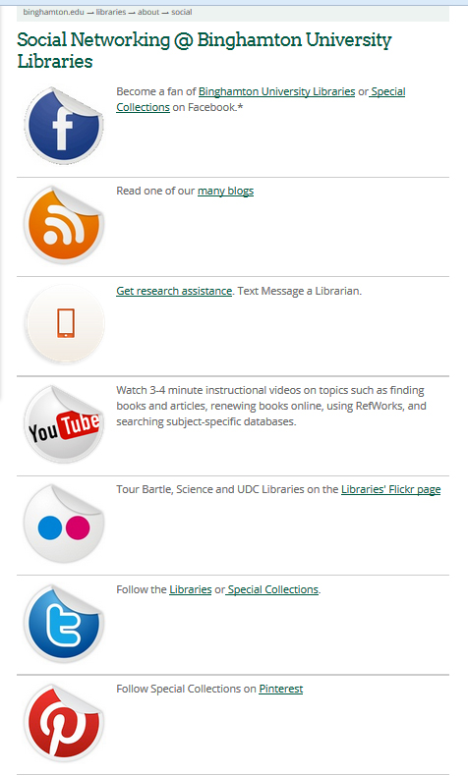
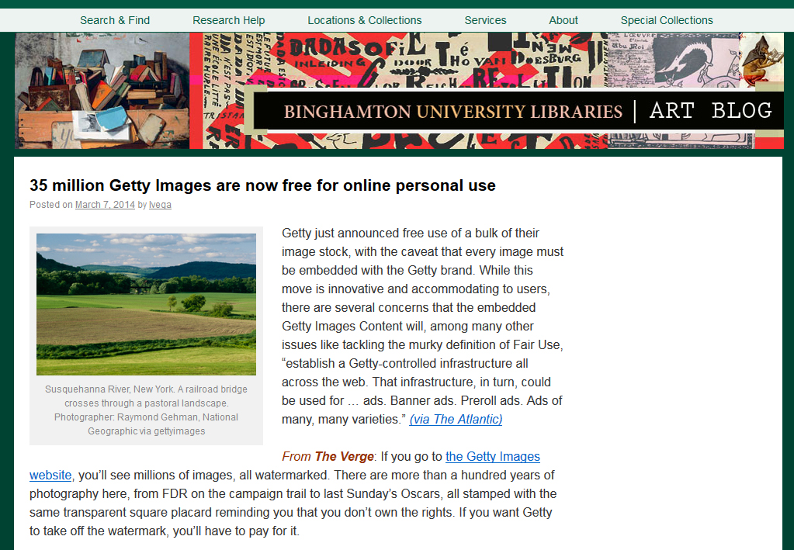
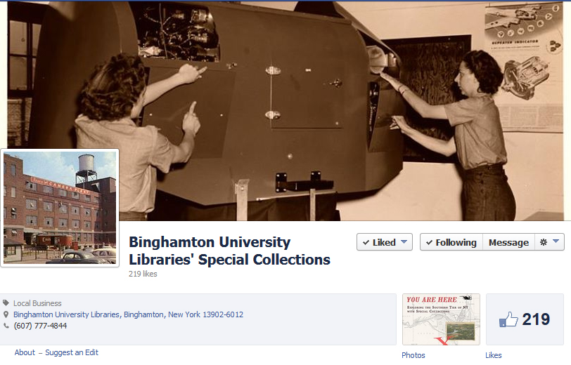
Social
Media
Notes:
SLIDE 10
Promotion through social media is a no-brainer in 2014. Most of us get our news and university updates via Tweets, posts on Facebook, and blog feeds. Special Collections of course has its own blog and Facebook feed, but that may not reach as many people, students and community members alike, as desired. As Subject Librarians, we have our own network of people in our specific departments who we have frequent access to. Some of us have our own blogs that reach out to differing communities. One example is Leslie’s Art blog that reports on campus and community activities, and new resources for art and art history students. Many topics are of interest to those who follow new trends in digital archives.

Slide 11
Notes:
SLIDE 11
One of the things that Leslie has done is to partner with the Head of Special Collections, Jean Green, to build a Pinterest site in order to showcase the collection to a wider audience. This site allows the Library to display collections that we have not yet digitized, or never will. Pinterest is a social networking site that allows members to build their own collection of images by “pinning” them to their own boards. Many University archives have taken advantage of Pinterest as an alternate outlet for promoting collections, exhibits, recent acquisitions, and events. The serendipity of Pinterest works to our advantage—people who wouldn’t normally seek out Binghamton University Libraries or Special Collections stumble upon the collections through other people’s boards or pins.

Slide 12
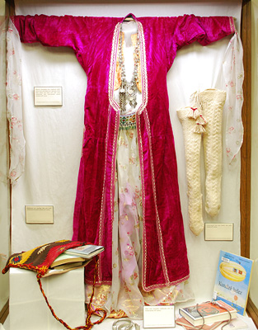
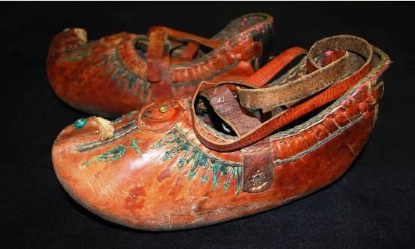
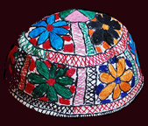
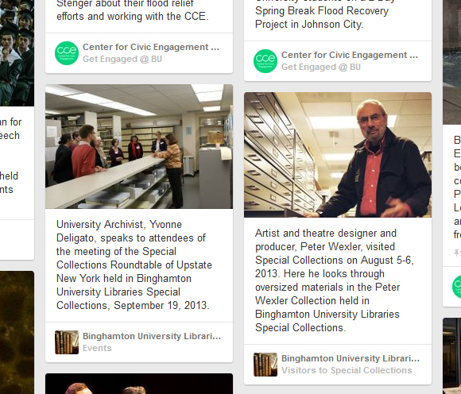
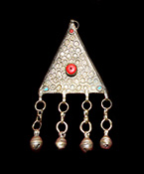
Pinterest Search
Notes:
For instance, people nostalgic for their hometown may look up “Binghamton” and find a pin of the items we have in the Kurdish Collection.

Slide 13
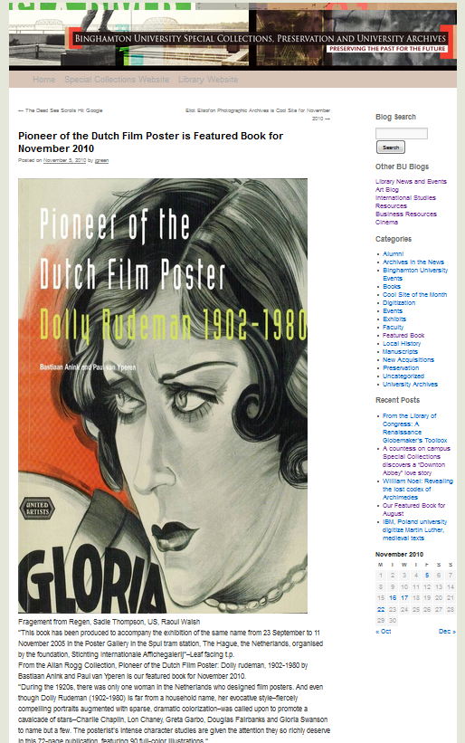
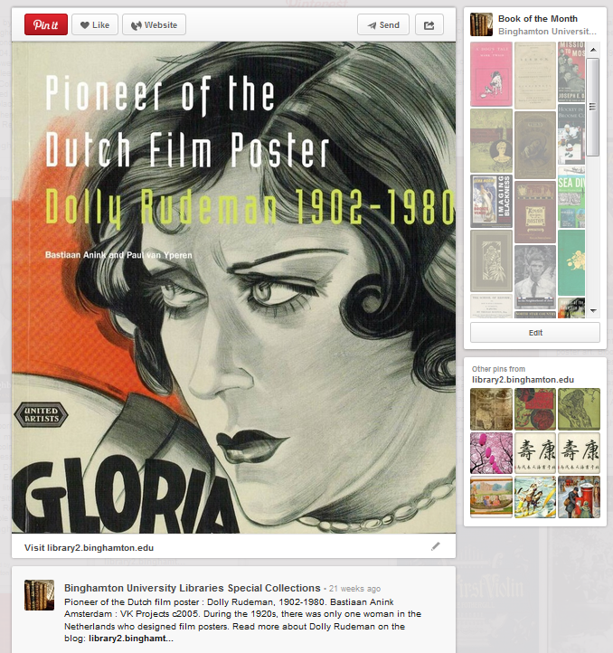
Book of the Month pins send you to the Special Collections Blog to learn more about the book
Notes:
SLIDE 13 Leslie and Jean add items to Pinterest that link back to either blog posts or the Special Collections website for those who are interested in more information about the book, event, exhibit, or photograph posted.

Slide 14
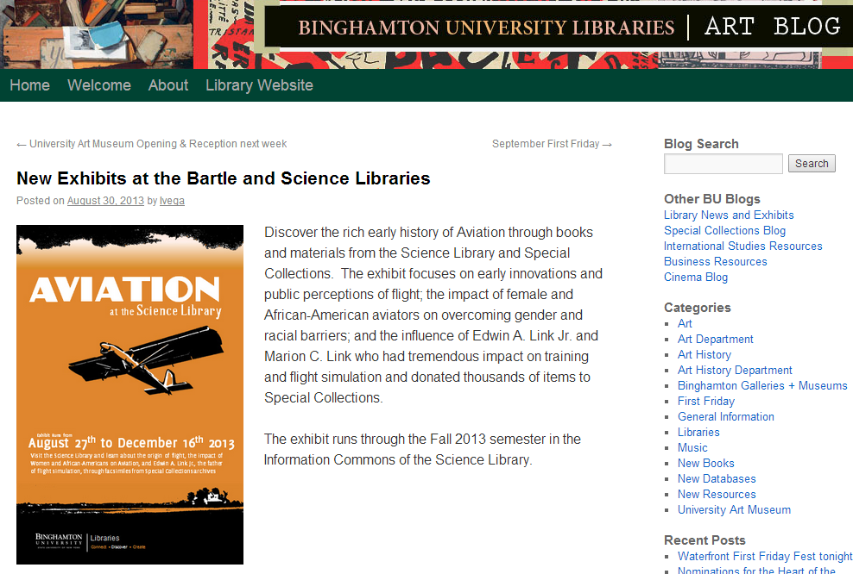
Notes:
SLIDE 14
As chair of the Exhibits Committee, Leslie and the committee take advantage of promoting Special Collections through the Libraries’ rotating Exhibitions. Above, is a screenshot of Leslie’s Art Blog promoting one of the Exhibits that incorporated themes from Special Collections.
The Library has three exhibit spaces: on the second floor of Bartle Library, the main library on campus, in the Science Library, and inside Special Collections itself. The two exhibition areas within the Libraries are more prominently featured—most students will walk past them at some point. Special Collections, however, is more hidden. Students would have to take the initiative to walk into a separate room where they don’t usually frequent, despite the efforts of the Special Collections staff to make the space inviting with signs and posters.

Slide 15
Notes:
SLIDE 14
Some exhibitions are specifically tailored to honor departmental conferences or panels throughout the year. In the Spring of 2013, two exhibits were installed to highlight the Center for Medieval and Renaissance Studies Spring Conference Boccaccio at 700: Medieval Contexts and Global Intertexts. The exhibits, Love and Sex in the Decameron at Bartle Library and Boccaccio’s Plague and the Black Death at the Science Library featured reproductions from Boccaccio works in Special Collections, books from the Library stacks, and images from our Digital Collections.

Slide 16
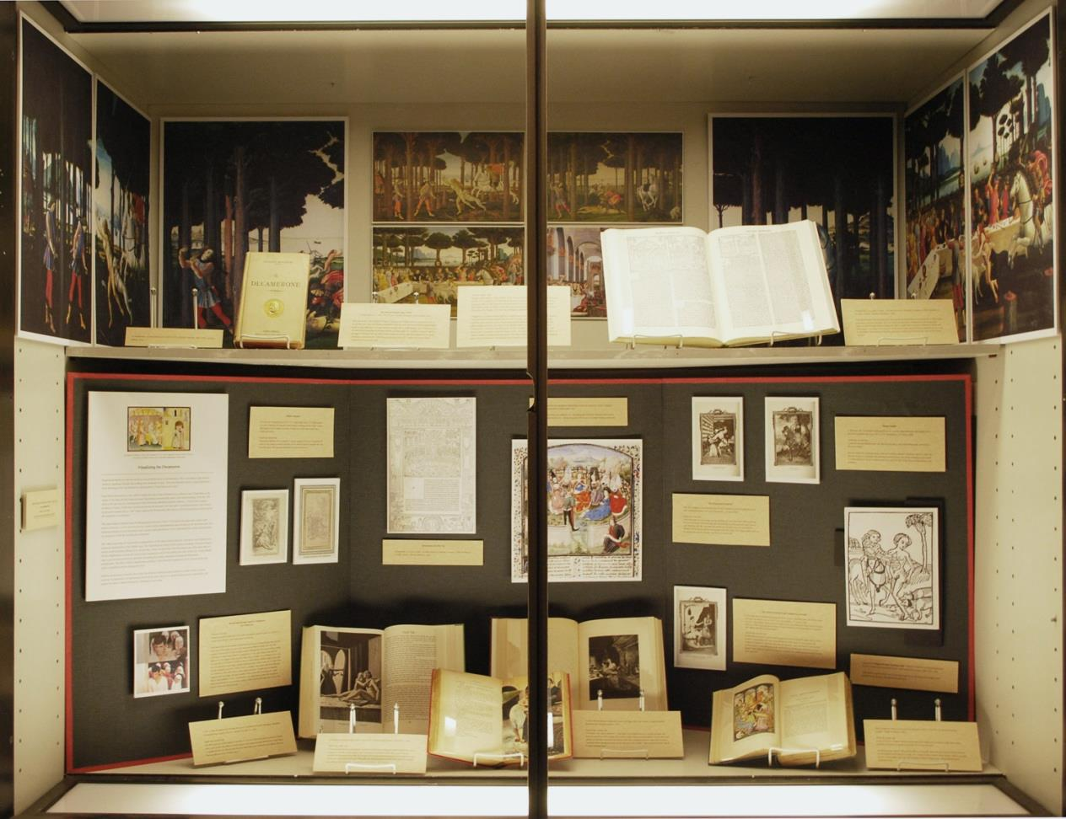
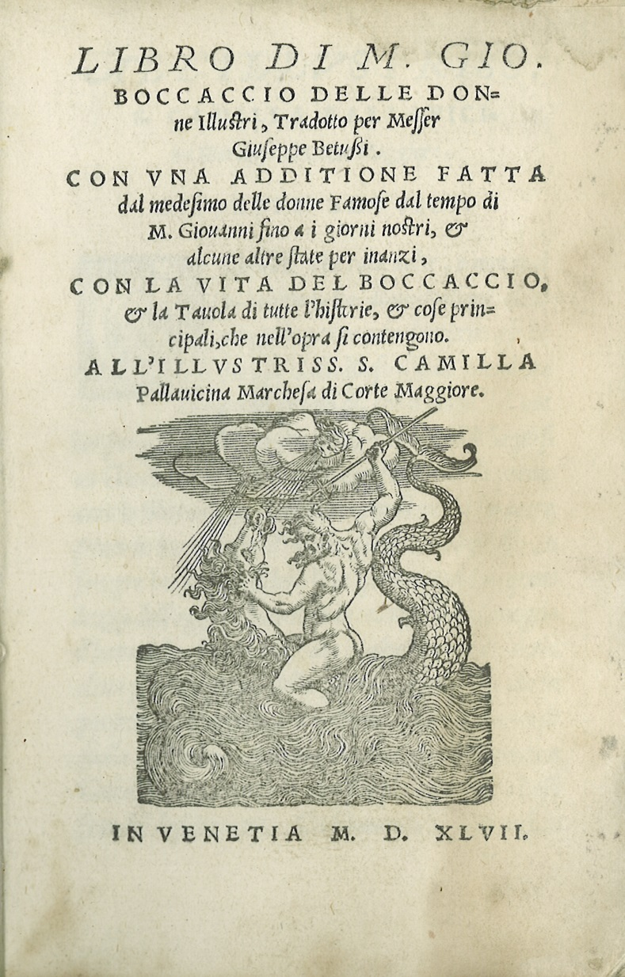
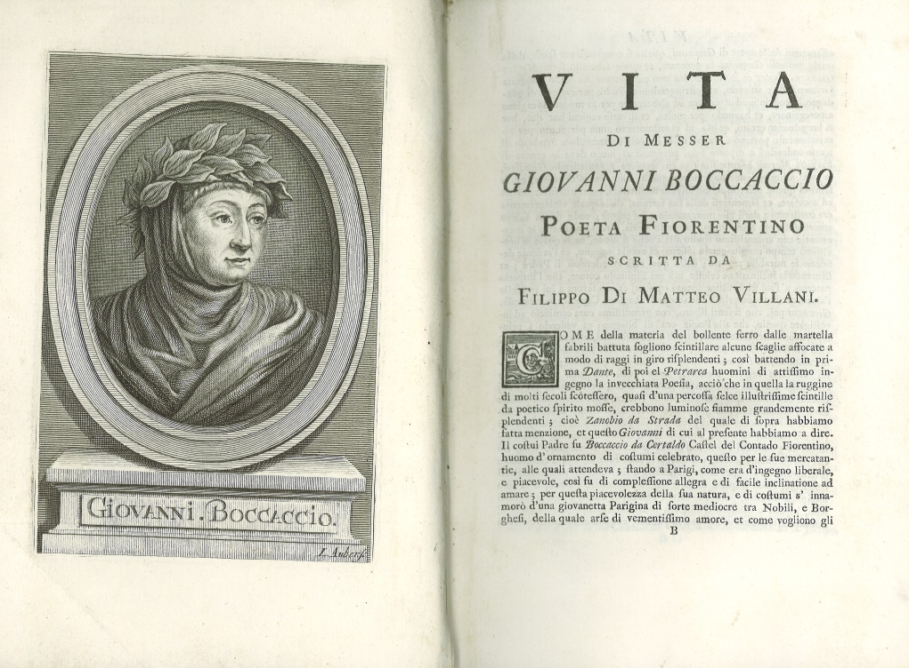
1547 Decameron
1725 Decameron
Notes:
SLIDE 15 Special Collections owns a 16th century and a couple of 18th century Decamerons. The Bartle exhibit featured reproductions of the illustrated frontispieces from these editions as well as details of the spines and an assortment of illustrations within. A complementary exhibit curated by Special Collections entitled Five Centuries of Giovanni Boccaccio’s The Decameron showcased the actual editions of the book as well as other works by Boccaccio and authors that were influenced by Boccaccio’s writing. Leslie was aware of a class on Boccaccio being taught that semester, and invited the class on a tour of the three exhibitions. The professor then tailored an assignment for the class to write a response to what they saw in the exhibit. The class was exposed to Special Collections, some for the first time, and feedback from the students and the professor was overwhelmingly positive.

Slide 17
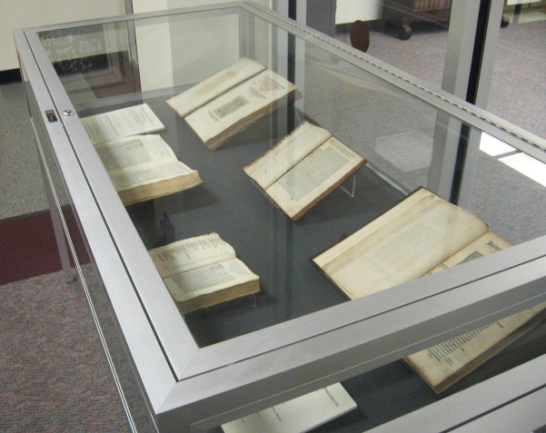
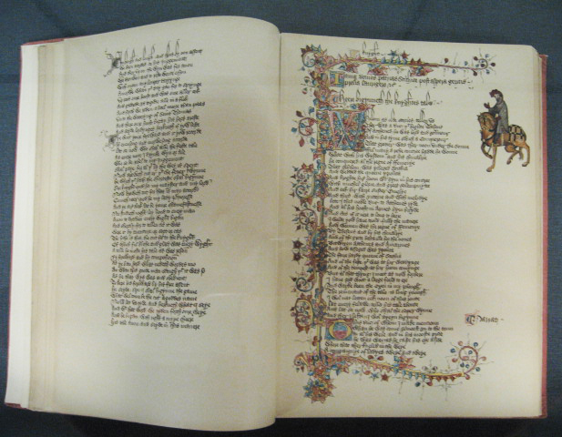
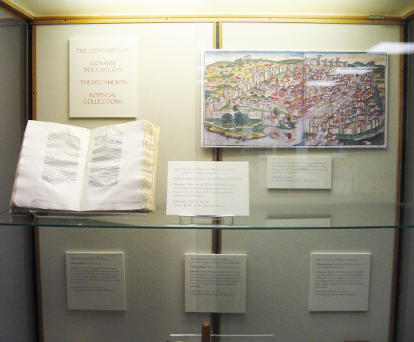
Notes:
SLIDE 17
One of the things the committee likes to do is to digitize items from Special Collections and feature them in the Library cases. Because items from Special Collections can be fragile and valuable, everything in the cases outside Special Collections must be reproductions. Our hope is to spark an interest and lead students and faculty to see the original in the Archive. SLIDE Another benefit of reproduction is that we now have a preservation copy in the form of a .tiff file to possibly use in future online exhibitions.

Slide 18
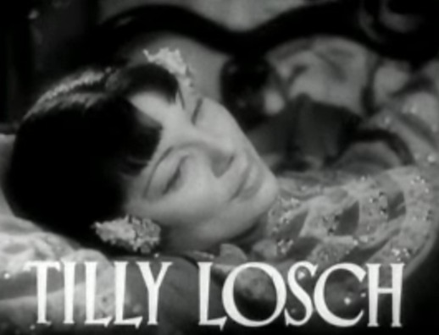
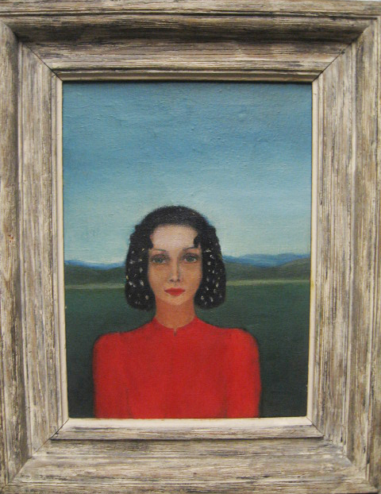
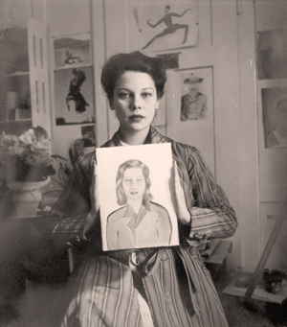
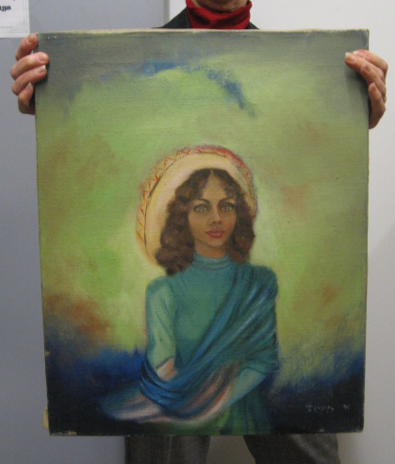
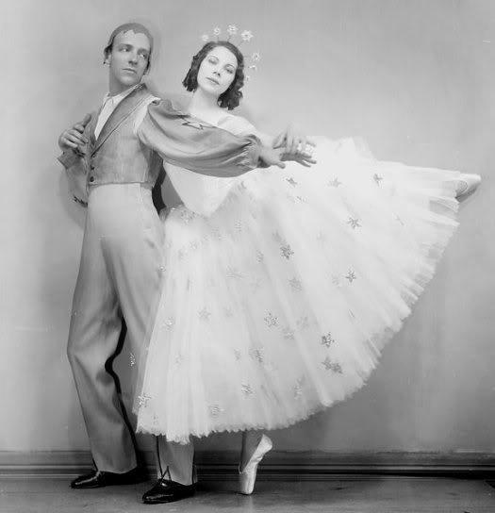
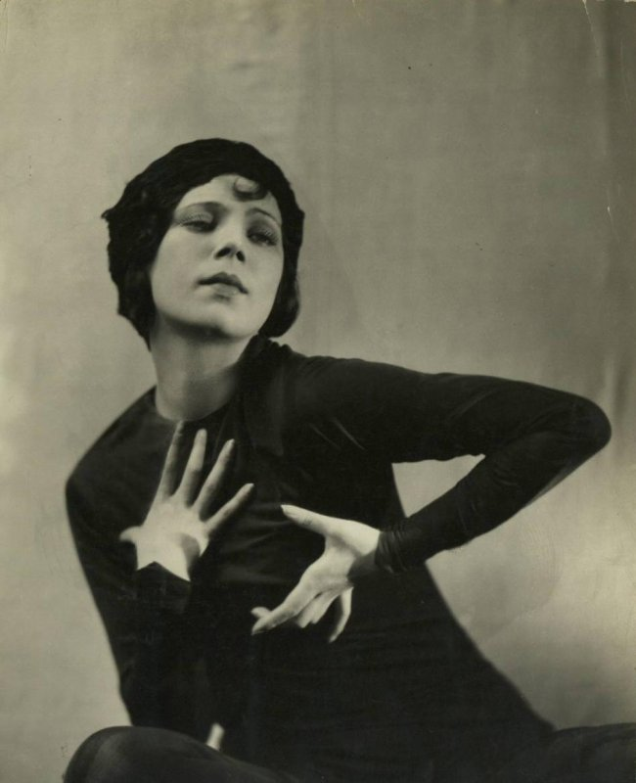
Notes:
SLIDE 17 Leslie also works occasionally within Special Collections to manage and preserve the collections within her subject specialty. For the past two years she has helped to organize the collection of paintings by the dancer and actress Tilly Losch. Tilly Losch bequeathed her archive to Binghamton University in 1975 in order to be incorporated into the Max Reinhardt Archives. Tilly worked with the renowned Austrian theater director early in her career as a ballerina, and wished to associate her legacy with his. She left 40 boxes, including hundreds of letters, photographs, film stills, and newspaper clippings that trace the events of her remarkable life. In addition to these, she also donated unique items not typically left to a Library archive—over 500 paintings and drawings, and dozens of sketchbooks.

Slide 19
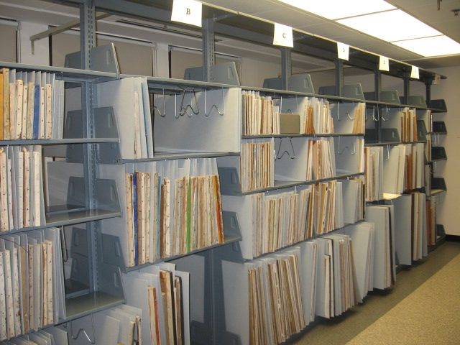
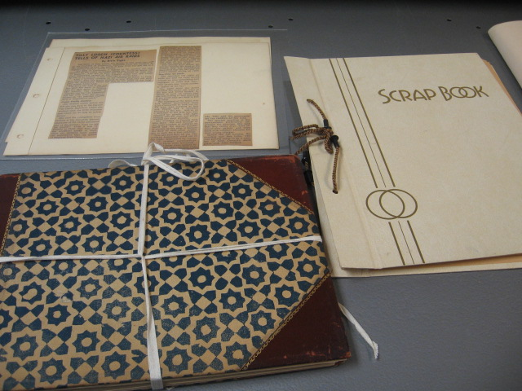
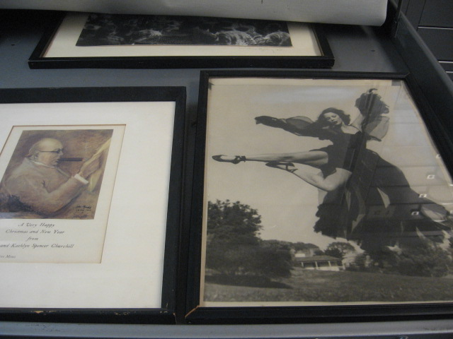
Tilly Losch
Paintings
Inventory
Notes:
SLIDE 17 With the help of Preservation staff Robin Hazen and Mien Wong, Leslie was responsible for a complete inventory and assessment of her paintings, moving them from less than ideal conditions in the off-site library storage annex to the temperature and humidity controlled Special Collections storage vault. As the works were inventoried, Leslie realized there were many more pieces than the 1980’s finding aid outlined, originally cited as having around 300 paintings. The paintings are now in the same space with her sketchbooks, letters, documents, photographs, and other memorabilia for easy access and preservation.

Slide 20
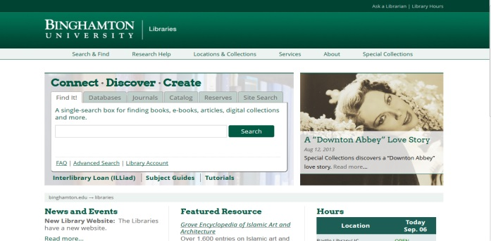
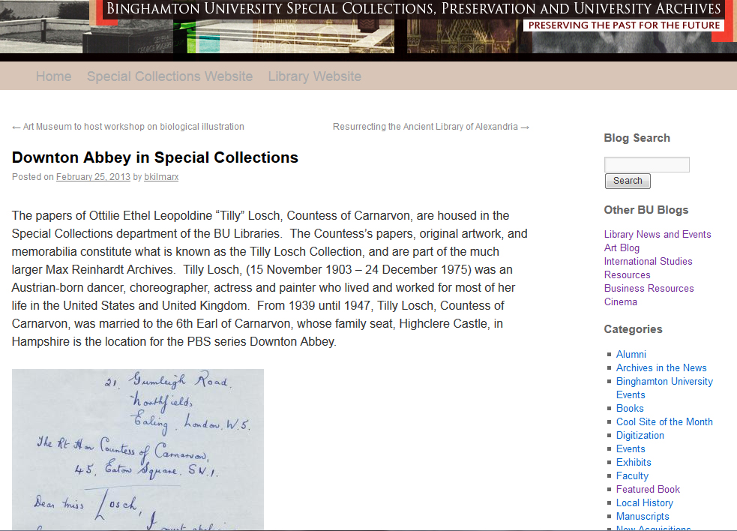
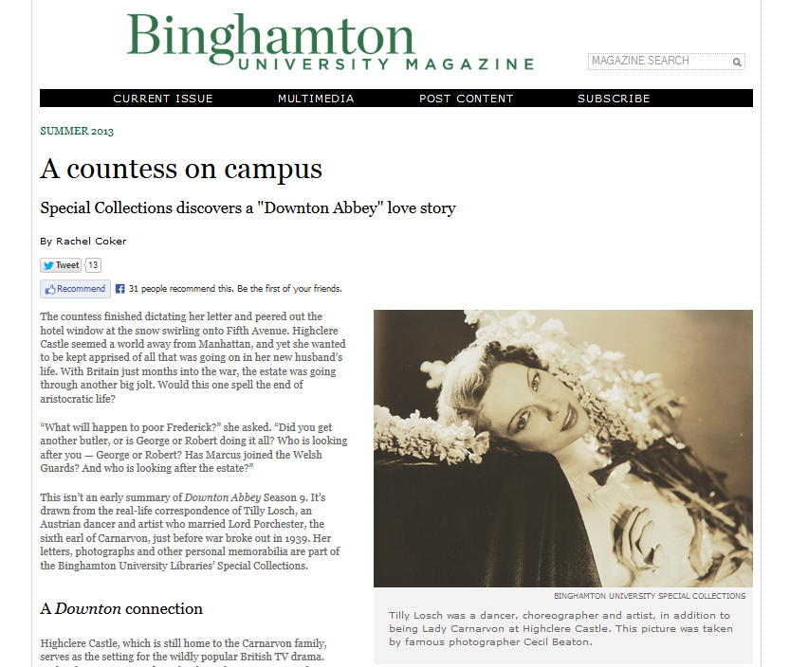
Notes:
SLIDE 20
The renewed attention to the collection sparked a well-timed connection. While going through the Losch papers, Beth Kilmarx, the curator of Rare Books, realized that Tilly’s second husband, the 6th Earl of Carnarvon, lived with Tilly from 1939 to 1947 in Highclere castle. The stately Highclere is the location of the PBS popular show Downton Abbey. Tilly lived at Highclere during WWII and certain events of her life as Lady Carnarvon loosely mirrors the plot lines of the show, including opening the castle to serve as a home for children evacuating London. Following several library blog posts, Binghamton University Magazine wrote a feature called “A Countess on Campus” and subsequently the local paper picked up the story.

Slide 21
SUNY Special Collections Questionnaire
Satisfied with collaborative exchange?
Is a collaborative relationship essential?
Previous working relationship?
Collaborative working relationship for the future?
Notes:
In order to gather more feedback on collaborations that occur between subject librarians and special collections staff, we sent out a brief 6 question SUNY-wide survey. Those who responded gave us some insight as to the level of collaboration that happens within their own institutions, and the importance of continued collaboration for the future.
The survey began by asking the person’s role within Special Collections, and went on to ask:
Are you satisfied with the collaborative exchange that exists between Special Collections Librarians/Staff and Subject Librarians? (yes/no)
Why or Why not?
The librarians who responded mentioned that, with some exceptions, they are not satisfied with the level of collaboration, either because they observe the subject librarians not making an effort to reach out, or that Special Collections staff isn’t aware of what the subject librarians are doing to promote the archives.
One person mentioned that “most [subject librarians] believe [Special Collections] has nothing to do with their work.”
Do you believe that a collaborative relationship between Special Collections and Subject Librarians is an essential component to Special Collections? Why?
The majority of the responses were a resounding yes, this relationship is essential. There needs to be a symbiotic relationship that is fueled upon Subject Librarians acting as a spokesperson for their departments, and the Special Collections staff working on increasing the visibility of the collection.
One Special Collections Librarian stated that “We need the contacts, expertise, and department knowledge that Subject Librarians have not only for acquisitions, but to help identify classes, students, and faculty that may be interested in one of our collecting areas.”
How have you or other Special Collections librarians/staff worked with Subject Librarians in the past?
Many Special Collections Librarians and Archivists collaborate on a variety of projects and services within and outside of the library, including purchase acquisitions, instructional courses, class projects, presentations, and papers. Majors with a heavy research component such as history have benefited from instructional sessions on how to conduct research within the college archives.
How would you or other staff in Special Collections like to work with or collaborate with Subject Librarians in the future?
There is a sense of desire for more collaboration, and some librarians shared their ideas.
One University Archivist mentioned that “Working together improves outreach efforts and also offers a “total view” of what our libraries offer in a subject area. I believe Special Collections staff should teach how to use library materials WITH Subject Librarians. Currently these sessions are kept separate. It would be beneficial to everyone if we showed students all of our resources together….we need to be integrated into daily library business. ”
Another wish for the future is collaborating on exhibitions with Special Collections, where the input of a subject specialist would offer enhanced scholarship, or reflect the classes taught each semester. Subject Specialists could also assist with the creation of metadata when Special Collections begins to digitizing a collection.

Slide 22
Thank You!
Anne Larrivee
Bibliographer for Anthropology, Social Work, Human Development, Africana Studies
Leslie Vega
Visual Arts Librarian, bibliographer for Art, Art History, Music
Notes:
In conclusion, Special Collections is a treasure that deserves to be highlighted. Since Subject Librarians are more likely to have direct contact with the University Community, it should definitely be one of the priorities of the subject librarians to help spread the word to their departments.
Thank you, any questions?

