Slide 1
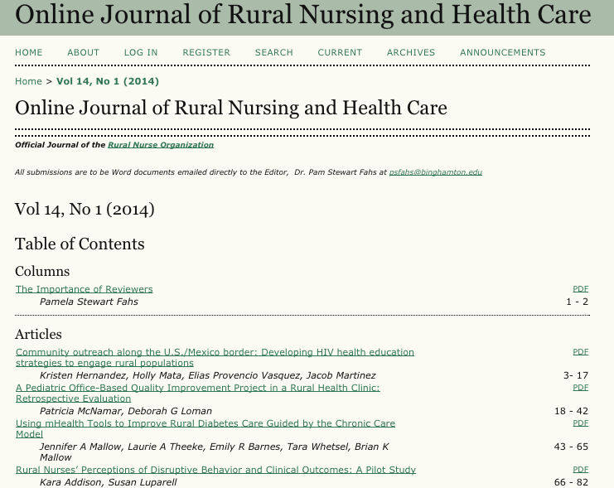
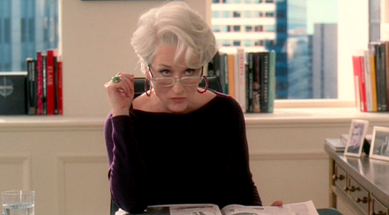
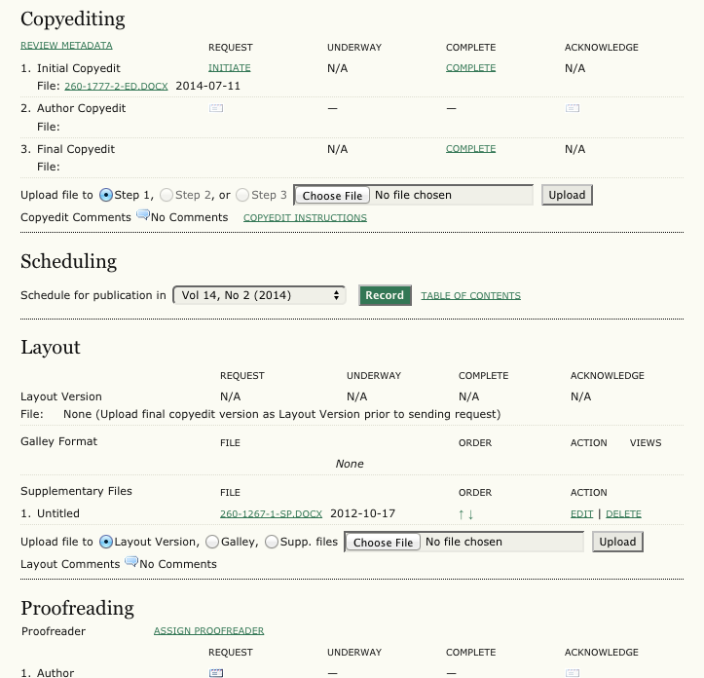
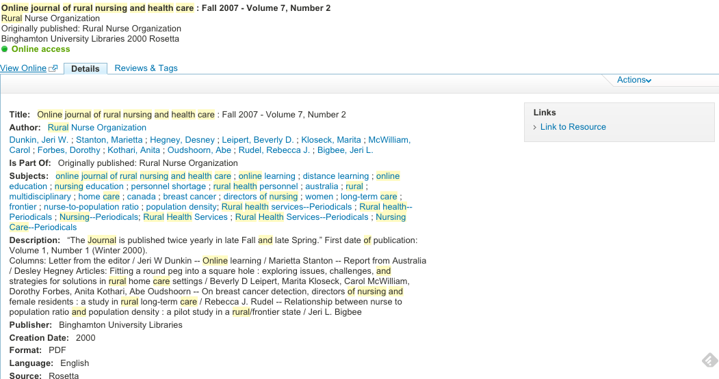
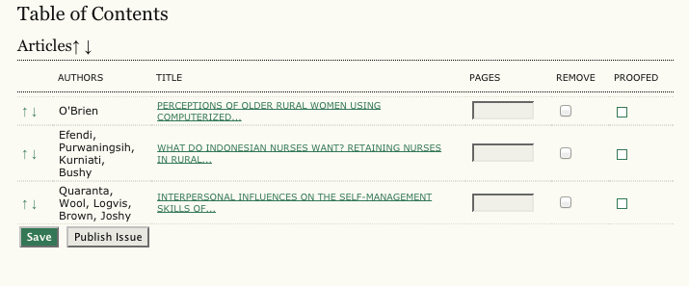
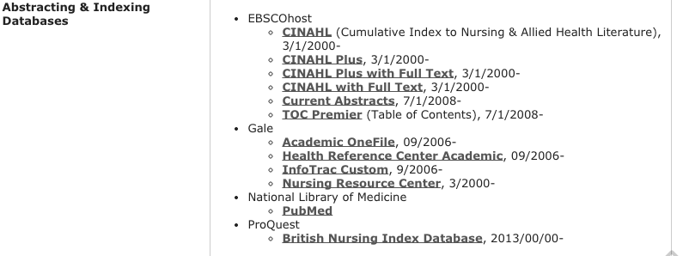
Librarian as a Managing Editor for the Online Journal of Rural Nursing and Health Care
Indexing
LIBRARIAN SKILLS AND KNOWLEDGE
WHAT I DON’T DO
I’m not a nurse or nurse researcher so I’m not involved in the peer review process. I’m also not an editor so I don’t decide what is published.
HOW I BECAME A MANAGING EDITOR
Journal was originally housed by the University of Alabama. Dr. Steven MacCall from the SLIS was the Managing Editor
Migrated to Binghamton University in 2011
Dr. Pam Stewart Fahs, the Editor, asked if I, the Nursing Bibliographer, would be willing to serve as Managing editor
WHAT I DO Become involved after articles have been accepted for publication
Copyediting:
Add and format the title, abstract, author information, keywords, page numbers
Ensure tables, figures are labeled and formated correctly
Ensure article conforms to APA, especially the bibliography
Double check the references
Add links to PubMed in the references
Add dois to the references
Convert articles to PDF
Send proofs to authors for review
ESTABLISHED A DOI
OHRNHC joined CrossRef in early 2014
Set up the process for creating dois
Add dois to references in the bibliography
Upload the journal issue to CrossRef after its been published
Troubleshoot problems
PRESERVE IN THE LIBRARIES’ DIGITAL PRESERVATION SYSTEM
WHY I SAID YES (TO BEING A MANAGING EDITOR)
An opportunity to innovate and explore new models of services traditionally not offered by libraries
An opportunity to support an open access journal
Build upon existing relationship with Nursing Department
Leverage existing skills and knowledge
Opportunity to learn new skills and expand my job responsibilities
Sounded fun!
INDEXING OF JOURNAL
HOW WE OPERATE
Hosted on Online Journal Systems
Three person “operation”: Editor, Managing Editor and IT staff person
Typically two issues are published a year and each issue includes five or six articles
Budget = $0
CHALLENGES
Increased workload: Spend about 15 -20 hours per issue (so 40-50 hours a year)
ROI (professionally)
Not an expert in publishing, OJS
No background in rural nursing
FUTURE PLANS
Have journal indexed in PubMed
Analytic studies
Become more familiar with OJS
Search engine optimization and promotion
Erin Rushton, Binghamton University Libraries

