Slide 1
3rd Party Integrations, Import and Publishing Profiles in Alma (playing with external systems)
ENUG
October 2019
David Schuster
Interim Associate University Librarian for Library Technical Services, Technology, and Special Collections
Binghamton University

Slide 2
Communicating with External Systems
Integration Profiles: allow Alma to connect with 3rd party external systems such as campus student (SIS), campus bursar, vendors, and self-check machines to exchange data. May require an s/ftp connection.
Import Profiles: define how BIB records come into Alma from external systems.
Publishing Profiles: define how BIB records are pushed out of Alma to external systems

Slide 3
Some of what we’ve configured
Integration Profiles (Configuration/General/External Systems)
SIS/ITS/Banner: patron (Banner) data into Alma, fine/fee data out of Alma to Bursar
Meescan self-check software: patron and fulfillment data(3m replacement)
Springer, Elsevier, Ovid: vendor managed access to our e-resources
OASIS/GOBI New Order API (Real Time Ordering from ProQuest/Yankee)
Import Profiles (Acquisitions/Import/Manage Import Profiles)
PDA/E-collection records
Marcive to import Govt doc records (originally, now part of GNET PDA)
Other repositories - ORB(BePress), Rosetta, Libguides
Publishing Profiles (Resources/Publishing/Publishing Profiles)
IDS journals available via ILL (uses ALIAS)
OCLC to update holdings
Google Scholar

Slide 4
Financial Info to Bursar (Bannerout)
Work with campus ITS to identify fields to match on (we use BNUMBER, which is unique) and directory on ITS sftp server.
Create an Integration Profile of type Bursar, using campus sftp server.
Schedule job to run nightly to gather and export desired fines/fees for specific user groups to ITS sftp server (fines subdirectory) in xml file.
ITS - processes the file into Banner - once a day

Slide 5
Integration Profile for Fines/Fees to Bursar
Notes:
Ensure match identifier is correct! Need to have all User Groups you want exported to Banner system included. We don’t have Community borrowers exporting for example.
What types of fines/fees do you want sent over?
Which Libraries

Slide 6
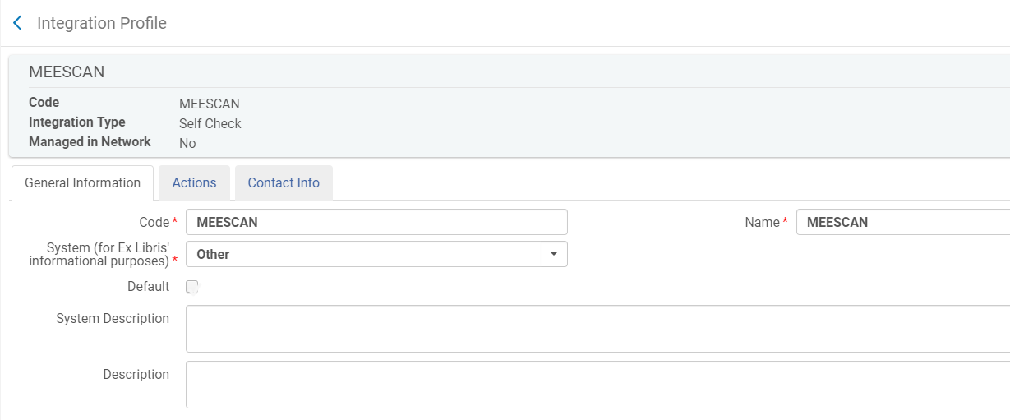
Meescan setup (We formerly had 3M)
Information exchange between ITS and Bintec vendor for authentication(SAML).
The certificate was important for both ends with Authentication - and location ID’s via google so the mobile would know which library.

Slide 7
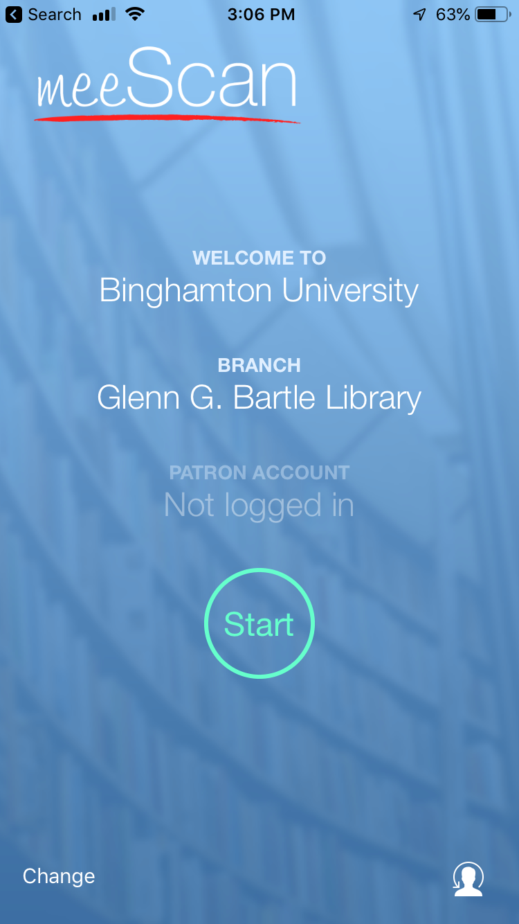
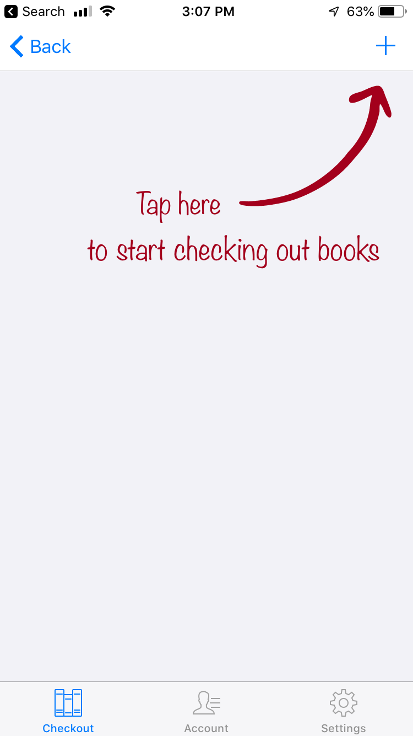
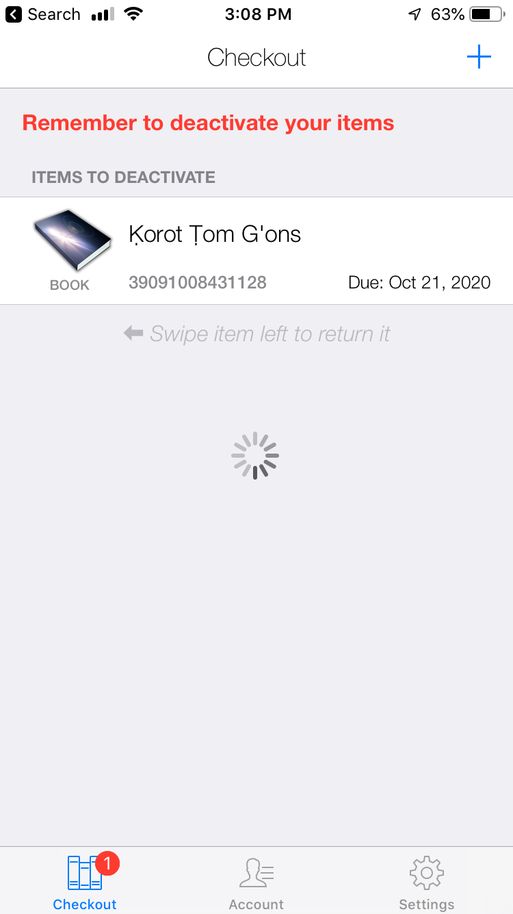
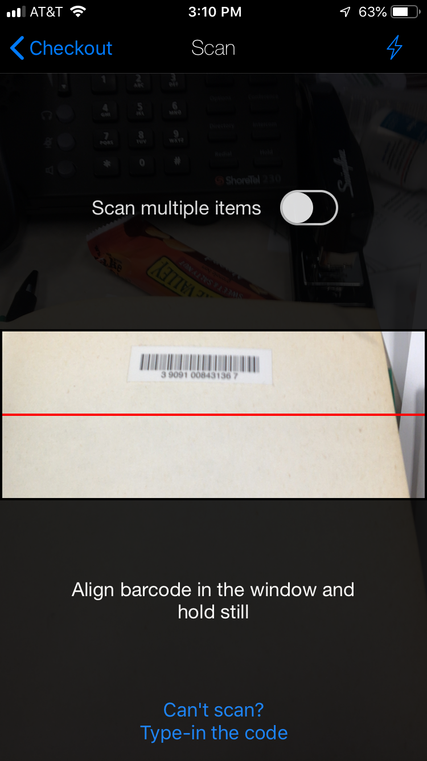
Meescan mobile screens

Slide 8
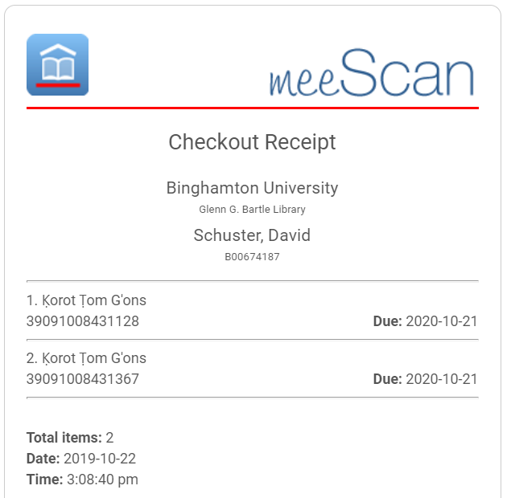

Slide 9
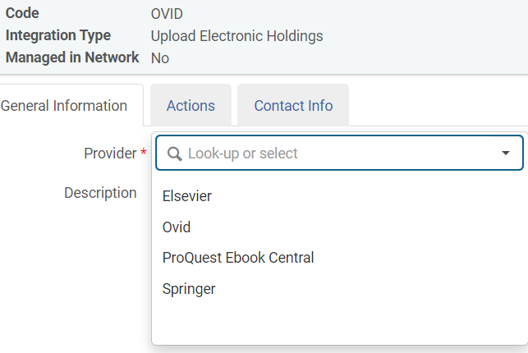
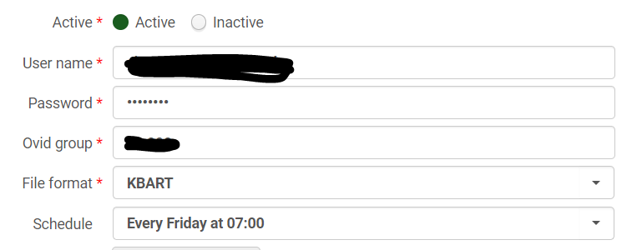
Journal holdings updates
You have to have the
coordinating CZ collection
activated:
SpringerLink Journals - AutoHoldings
Journals@Ovid Complete
Elsevier ScienceDirect Journals Complete

Slide 10
Google Scholar Publishing Job: set profile to publish electronic holdings (title, ISSN/ISBN, full coverage)

Slide 11
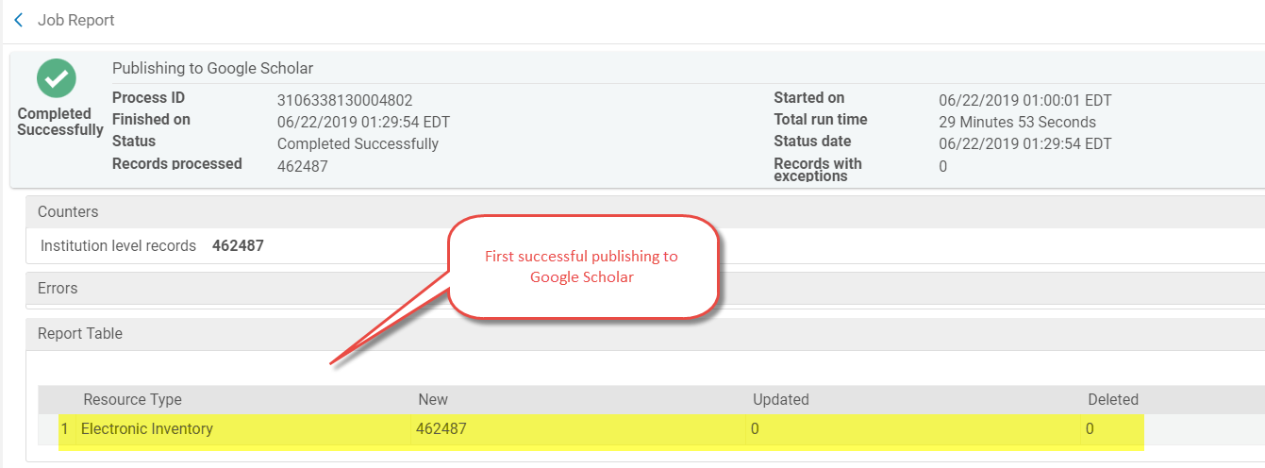
Report of Google Scholar Publishing Job

Slide 12
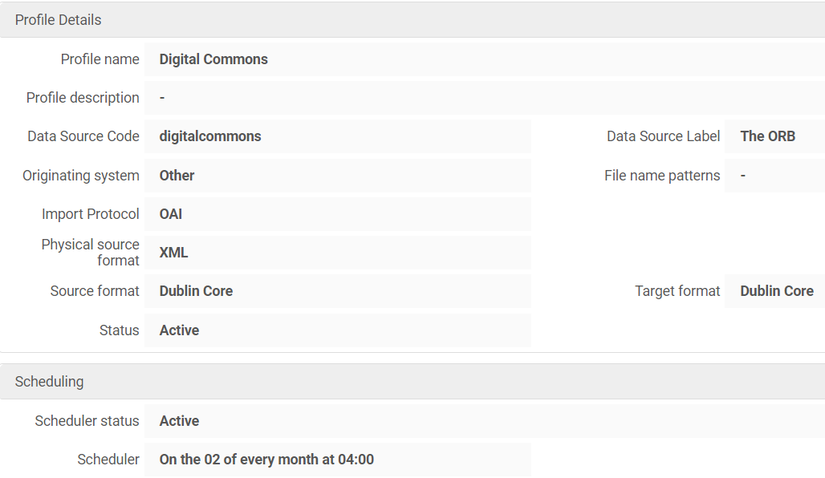
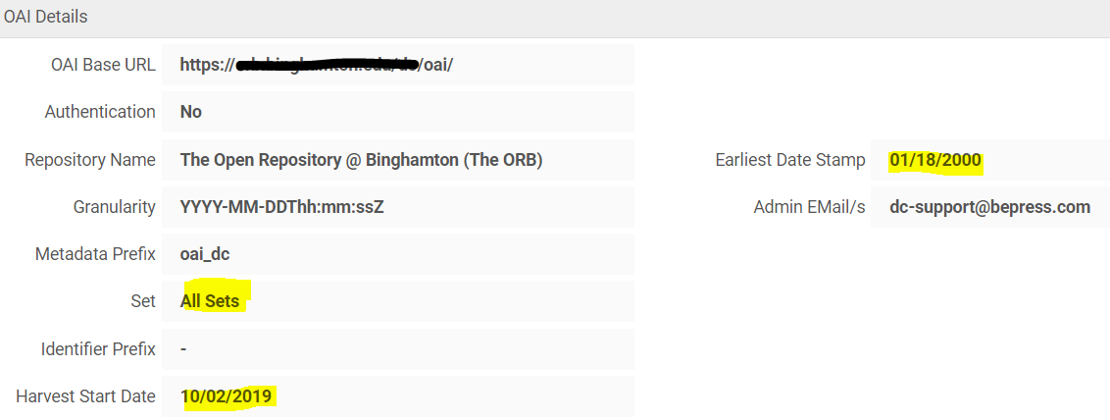
Repository into Primo VE

Slide 13
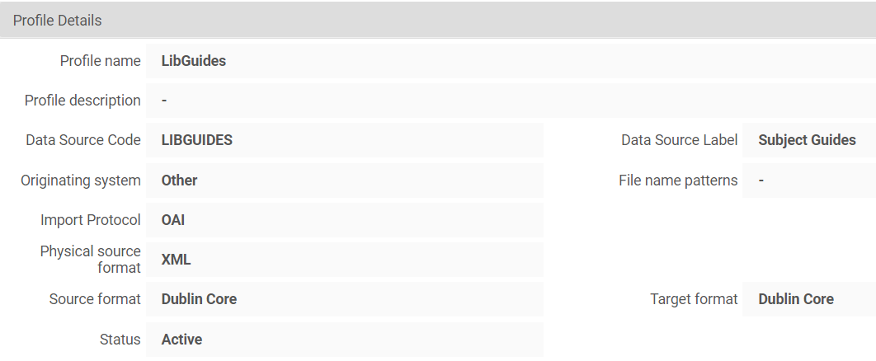
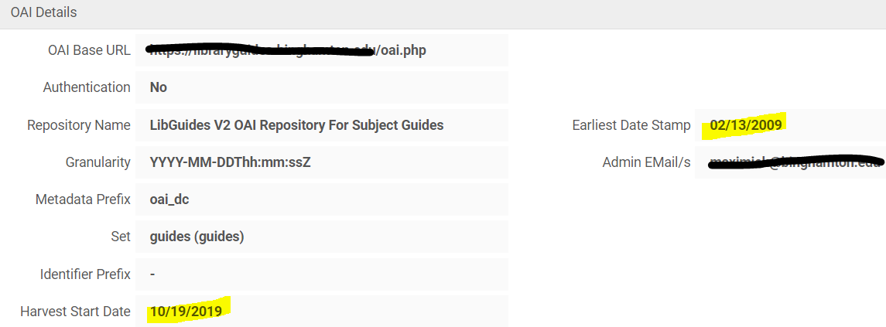
Libguides (dublin core)
Unfortunately these don’t “auto delete” so you need to run a job to delete and reload regularly.

Slide 14
Resources
Integration Profiles:
https://knowledge.exlibrisgroup.com/Alma/Product_Documentation/010Alma_Online_Help_(English)/090Integrations_with_External_Systems
https://knowledge.exlibrisgroup.com/Alma/Product_Documentation/010Alma_Online_Help_(English)/090Integrations_with_External_Systems/030Resource_Management/Upload_Electronic_Holdings_from_Springer (Springer)
https://knowledge.exlibrisgroup.com/Alma/Content_Corner/Knowledge_Articles/Upload_Electronic_Holdings_from_Elsevier (Elsevier)
Import Profiles:
https://knowledge.exlibrisgroup.com/Alma/Product_Documentation/010Alma_Online_Help_(English)/040Resource_Management/060Record_Import/020Managing_Import_Profiles
http://slcny.libanswers.com/faq/236195
Publishing Profiles:
https://knowledge.exlibrisgroup.com/Alma/Product_Documentation/010Alma_Online_Help_(English)/040Resource_Management/075Publishing_Profiles
https://public.3.basecamp.com/p/xmaGzrJCuPcG4uYun8dtEj2L (OCLC)
https://knowledge.exlibrisgroup.com/Alma/Product_Documentation/010Alma_Online_Help_(English)/090Integrations_with_External_Systems/030Resource_Management/150Publishing_Electronic_Holdings_to_Google_Scholar (Google Scholar)

