Slide 1
A Wizard with Many Hats: The Eclectic Role of Digital Scholarship Librarians
Amy Gay
Digital Scholarship Librarian
Binghamton University Libraries
@iamabooknerd
Notes:
Introduce who I am

Slide 2
Overview
Defining Digital Scholarship
Digital Scholarship at Binghamton
Roles of Digital Scholarship Librarians
Needs for DS Success and Sustainability
Upcoming Regional Events
Notes:
Today, I will share one way to define digital scholarship, how digital scholarship has been implemented at Binghamton, the roles played by DS librarians play and what is needed for sustainability, also some upcoming events in other parts of the CNY region that may be of interest to this group

Slide 3
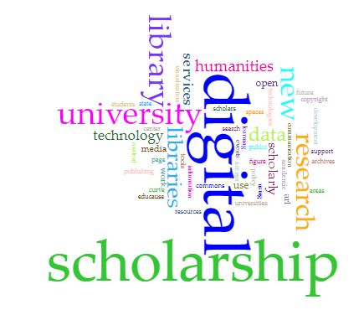
Defining Digital Scholarship
Making use of digital tools and methods to view research, scholarship, and pedagogy in new and different ways
Includes text analysis, digital publishing, visualizations, mapping, data cleaning and analysis, programming languages, and many other topics and tools
Created using Voyant Tools
Notes:
Defining Digital Scholarship:
Umbrella term that incorporates a variety of services, ideas, and technology
Defined differently everywhere - wordcloud of commonalities
Keywords: digital; scholarship; research; technology; services; [digital] humanities; support; open; future; data; spaces or a center
At Binghamton, we keep our definition broad, as we are serving a wide variety of backgrounds and expertise while also still in the learning stages of what the needs are on campus [definition on slide above]

Slide 4
Binghamton University
Part of the SUNY system
Student enrollment: approximately 17,500
About 14,000 undergraduate and about 3,500 graduate students
Made up of 6 schools
Harpur College of Arts & Sciences
College of Community and Public Affairs
Decker School of Nursing
School of Pharmacy and Pharmaceutical Sciences
Watson School of Engineering and Applied Sciences
School of Management
4 campus locations
Notes:
Binghamton is part of the SUNY system, about 17,500 students, mix of undergrad, grad, and PhD candidates
Made up of 6 schools and 4 campus locations, so although our central library is on main campus, not all of our patrons come to main campus, so we are working to find ways to offer DS services across campus locations

Slide 5
Digital Scholarship at Binghamton: how we got started
Workshops and speakers - growing interest
Digital Scholarship Steering Committee (Libraries)
Hiring a Digital Scholarship Librarian (me!) (January 2018)
Literature Review and Site Visits
Needs Assessment and Environmental Scan
Campus Outreach
Notes:
Over the last few years, the Libraries along with members of the teaching faculty, began talks about the growing need for digital scholarship and digital humanities services at Binghamton. This group brought in speakers and offered workshops to get the wheels in motion. One thing this led to was the creation of a new position, a Digital Scholarship Librarian, which brought me back to Binghamton in January 2018. Being the first in my role, I decided we needed to take a step back and spend Spring 2018 putting together a literature review of what others are doing, visit some of these other institutions, and conduct a needs assessment on campus. I started the NA by meeting with subject librarians to learn more about their interactions with their departments, how they see DS playing a role for their faculty and students, and any names of faculty they would recommend to meet with. I then put together a list of these faculty and met with them one-on-one, either in their office or over coffee, and talked about their research, what they know about DS, and where they see gaps in services we may be able to fill. I also attended as many campus events as I could to introduce myself and make others aware that these new services exist in the libraries.

Slide 6
Digital Scholarship at Binghamton: What we’ve done from then to now
Binghamton Digital Humanities Research Institute
Workshops
The ORB and the Open Access Policy
Collaborations with SUNY, CUNY, CNY region
Digital Scholarship Center
Consultations
Notes:
From summer 2018 to now, we have put together a few different things to kick off the growth of our services and the campus DS/DH community

Slide 7
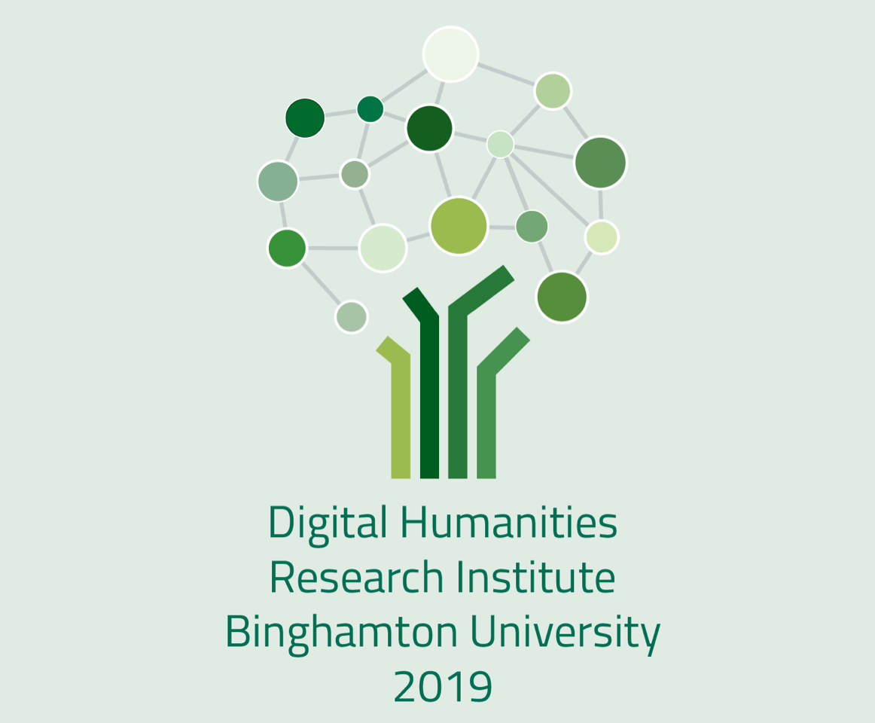
Binghamton Digital Humanities Research Institute (BingDHRI)
4-day intensive workshop
Included seminar-type sessions, hands-on workshops, and invited speakers
Co-organized with Art History faculty member, Nancy Um
2 graduate assistants
4 invited lecturers / instructors
Multiple campus sponsors
To learn more: https://bit.ly/bingdhri19
Notes:
The Binghamton DHRI was a 4-day workshop this past May where we had 17 participants, a mix of faculty and graduate students interested in digital humanities. Our colleagues from Albany also joined us for part of the DHRI
The institute included seminar-type sessions and hands-on workshops on topics such as data visualization, digital mapping, Python, and digital pubishing platforms. We also invited instructors from Cornell Libraries who taught sessions on the command line and text analysis and lecturers from CUNY Graduate Center and Columbia University
It was co-organized by myself and Nancy Um and developed based on a ten-day train-the-trainer type workshop at The CUNY Graduate Center and funded by the National Endowment for the Humanities

Slide 8
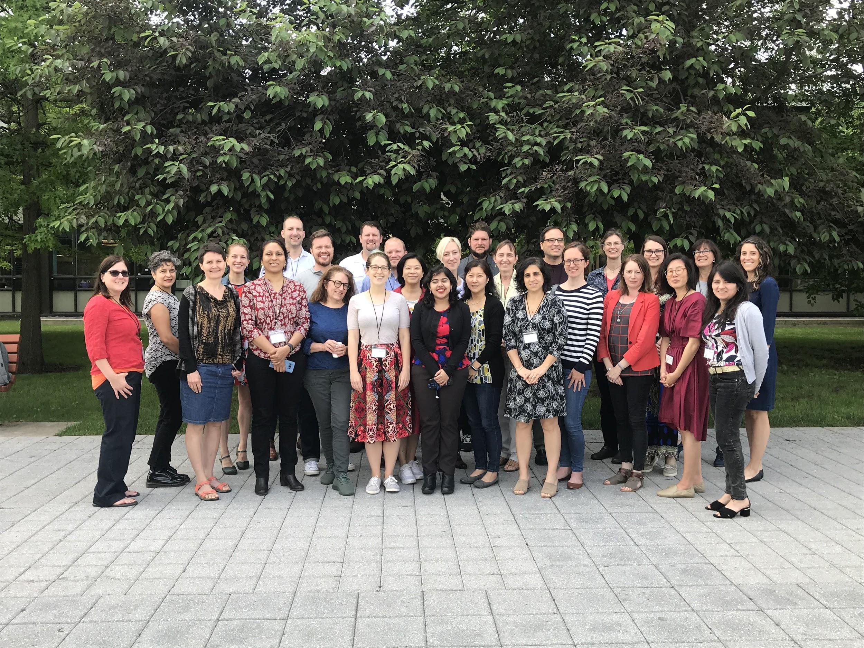
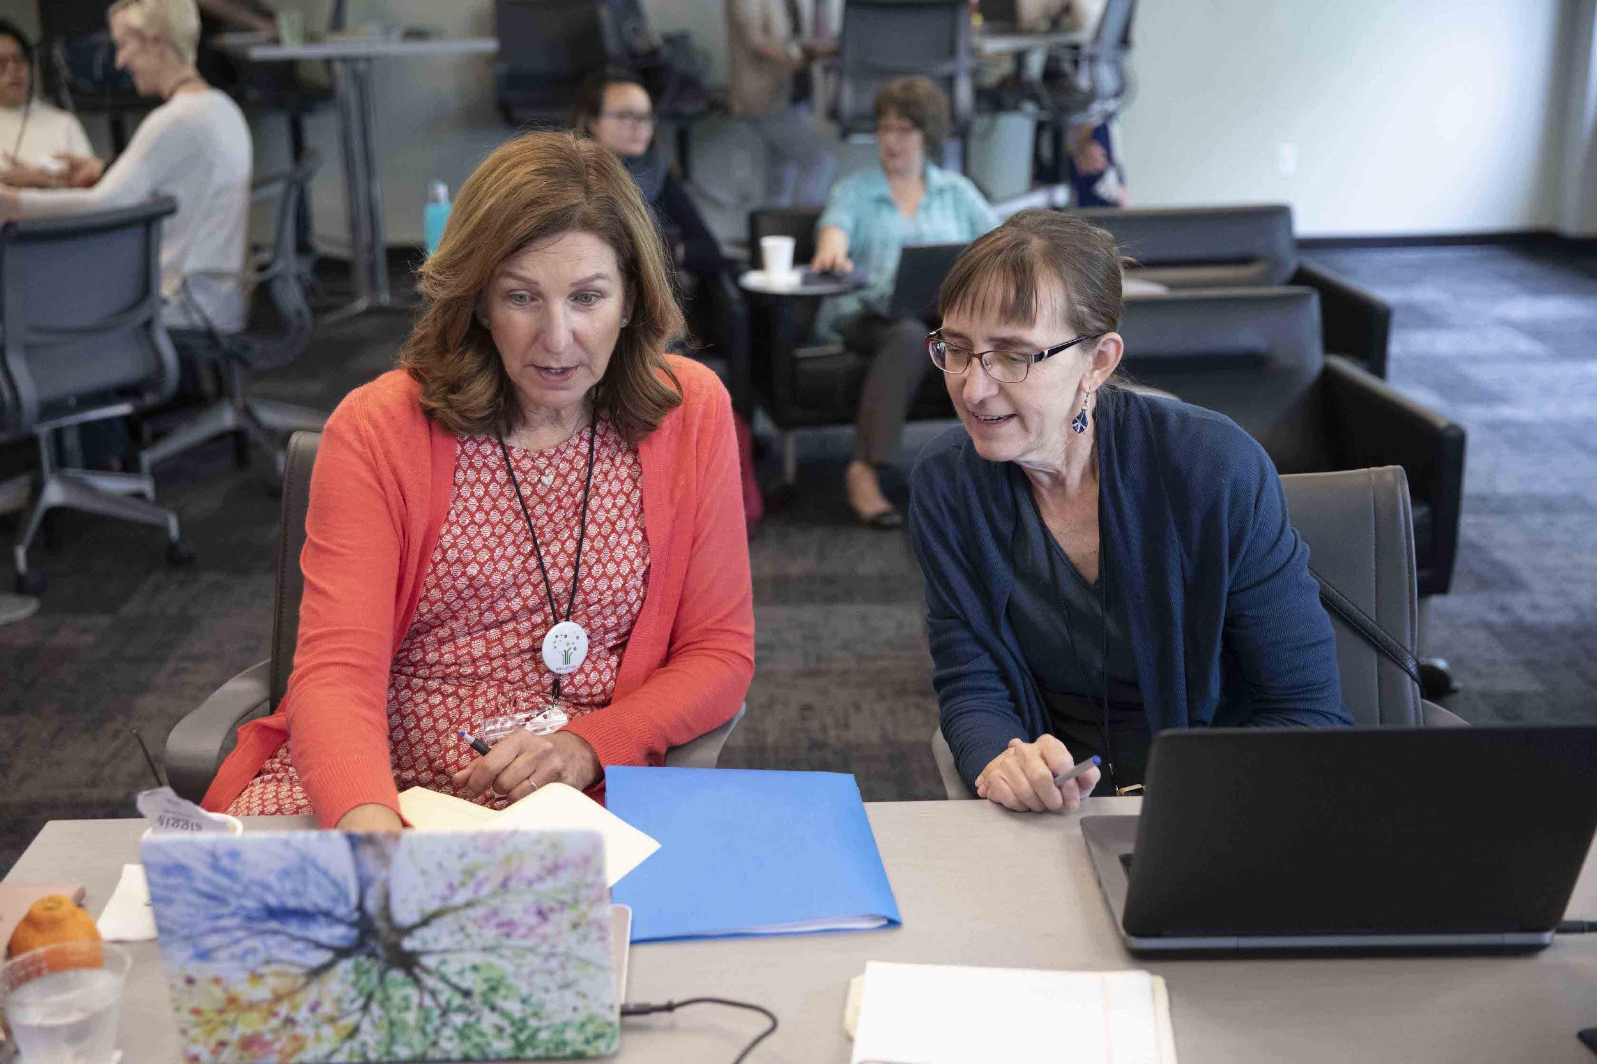
Binghamton Digital Humanities Research Institute (BingDHRI)
Notes:
Just a couple of pictures from the Binghamton DHRI: our group on the last day (left) with our Albany colleagues, and 2 members from our co-sponsors who attended (right) along with participants

Slide 9
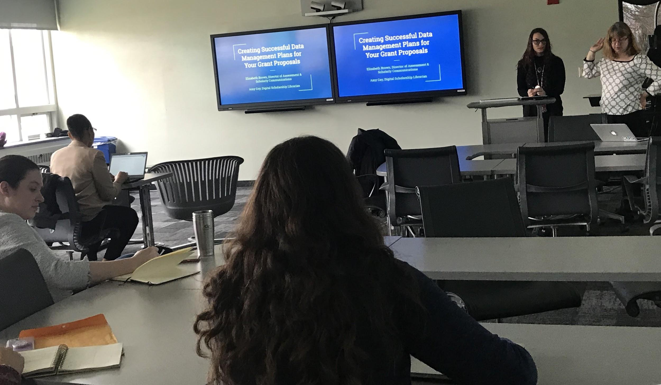
Workshops
Data management planning workshop using DMPTool (now recurring each semester)
Workshops that came from DHRI:
OpenRefine
Tableau
Reclaim Hosting / WordPress
Scalar (upcoming)
Notes:
DMP workshop came from needs assessment (DMPTool) – started based off of the needs assessment after meeting with faculty members -- fills up and now offered every semester
Post-DHRI has kept Nancy and me busy! We’ve been invited to groups on campus to offer workshops on data cleaning and analysis tools, offered our first open office hours to DHRI participants on reclaim hosting sites, and have an upcoming workshop for graduate students on Scalar

Slide 10
The ORB and the Open Access Policy
The Open Repository @ Binghamton (the ORB) is our institutional repository (https://orb.binghamton.edu/)
Published research, theses and dissertations, image collections, data sets, audio projects
Open Access Policy passed by Faculty Senate in December 2018
To learn more, visit here: http://bit.ly/BingOAPolicy
Notes:
The ORB is an open platform for our faculty and students to promote, share and archive scholarly and creative works. The ORB has given faculty and students a chance to share both their published scholarly research and creative endeavors, including photo exhibitions; audio archive of a student radio show; showcase digital collections; and create and manage student journals
All SUNY campuses required to create and implement an OA policy by March 31, 2020
The Faculty Senate at Binghamton passed our Open Access Policy in December 2018, requiring all future research to be shared via the ORB. Therefore, the Scholarly Communications Librarian and I have ben going to departments on roadshow to inform faculty of policy and let them know we have the ORB and are here to help

Slide 11
Collaborations
Groups on campus:
Digital Scholarship Steering Committee (Libraries)
Digital Humanities Faculty
Digital Humanities Research Institute (BingDHRI)
Virtual Reality (VR) Taskforce (Libraries)
Data Science Transdisciplinary Area of Excellence (TAE)
Collaborations in the classroom - assistance with instruction on digital tools, open access, and Creative Commons
Notes:
There are multiple groups on campus, both in and outside of the libraries, that have been supportive and collaborative when it comes to digital scholarship. I hope, moving forward, to have more cross-collaborations occur across these groups to put together events, lectures, workshops and other opportunities valuable to our campus community. Since the DHRI, the Libraries and DSTAE are supporting our efforts to create a dataviz interest group on campus. This has been a good start
I have also taught digital tools in classrooms for faculty wishing to have a digital component to student projects, and this semester I will be floating in a classroom for a professor who wants to try teaching TimelineJS to her students
Nancy and I also hope to have more collaboration opportunities with other SUNY institutions like our colleagues at Albany, Cornell, and CUNY Graduate Center. It would be great to see working groups across SUNY down the road as well.

Slide 12
Digital Scholarship Center
An open space for collaboration, consultation, and use of software that is not easily accessible elsewhere on campus
Pilot space planned for 2020
Actual space planned for 2023
Notes:
Our Digital Scholarship center is a project in the planning stages. Currently, we have a digital scholarship center working group made up of 5 librarians, with the plan to add faculty and students to the group in the future. This group has gone on site visits to other institutions who are at different stages of this process to learn more about what has been valuable in their space. In our pilot space, we plan to have VR equipment available for use, flexible furniture, glass white boards, and open hours for consultations. The goal is to use this time to gain a better understanding of what we can offer in our future permanent space that would be essential to our campus community.

Slide 13
Consultations
Offered to faculty and students
Consultations have included:
Digital tools
Digital platforms
Data Management Plans
Integration into research and class projects
The ORB
Notes:
Consultation services have seen an increase since the DHRI took place as well. Faculty have reached out for recommendations on digital tools to use in their research and to teach students in their classrooms, including OmekaS, TimelineJS, Voyant, PermaCC, and the ORB

Slide 14
Roles of Digital Scholarship Librarians
Consultant
Notes:
So, now that I have told you about a few of the hats I wear in my digital scholarship role. This is the cluster of roles I see involved in DSL life: To sum it up, a DSL is a consultant: there to offer guidance on digital platforms and tools.

Slide 15
Roles of Digital Scholarship Librarians
Consultant
Researcher
Notes:
A DSL is a researcher, learning about what others are doing in the field regularly, as this is a growing and ever-changing area

Slide 16
Roles of Digital Scholarship Librarians
Consultant
Collaborator
Researcher
Notes:
We are collaborators - on research, in the classroom, presenting, and for continuing education development

Slide 17
Roles of Digital Scholarship Librarians
Instructor
Consultant
Collaborator
Researcher
Notes:
We are instructors, teaching others how to use digital platforms and tools for use in their research and how to integrate it into their teaching practices

Slide 18
Roles of Digital Scholarship Librarians
Mentor
Instructor
Consultant
Collaborator
Researcher
Notes:
We are mentors - to the other librarians who are working to implement DS services at their institution

Slide 19
Roles of Digital Scholarship Librarians
Mentor
Instructor
Consultant
Student
Collaborator
Researcher
Notes:
And we are forever students, with new tools constantly being developed and needs of our faculty and students changing as time goes on

Slide 20
Needs for DS Success and Sustainability
Defining success for your institution
Support from administrators and colleagues
People (librarians, faculty, students, staff)
Collaboration between groups
Notes:
How success is defined and what sustainability looks like will depend on the needs of your institution. The Needs assessment helped us know where to start our services, having support from admin & colleagues is also a major factor; and advocacy by those who we have already brought into our DS and DH communities
At Binghamton, in order to continue this growth and sustainability, I see the need for more people to assist with these services, as I am currently a one woman service for DS.

Slide 21
Upcoming around the Area
Library Carpentry -- Intro to Data & OpenRefine
October 25, 2019, 9a – 5p
SUNY Oneonta, Oneonta NY
Sign up: https://nydclc.github.io/workshops/
THATCamp CNY 2019
One Day unconference for those interested in digital humanities
October 25, 2019 - all day
Bird Library, Syracuse University
Learn more and sign up: http://cny2019.thatcamp.org/

Slide 22
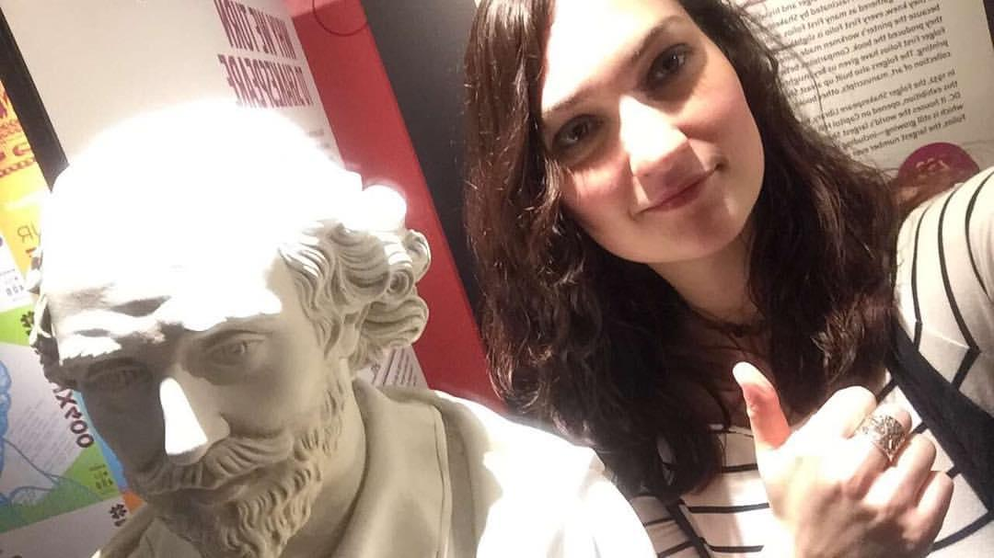
Thank you!
Amy Gay
Digital Scholarship Librarian
Binghamton University Libraries
aegay@binghamton.edu
@iamabooknerd
Selfie with William Shakespeare statue @ Folger Shakespeare Library, Washington D.C.

