Slide 1
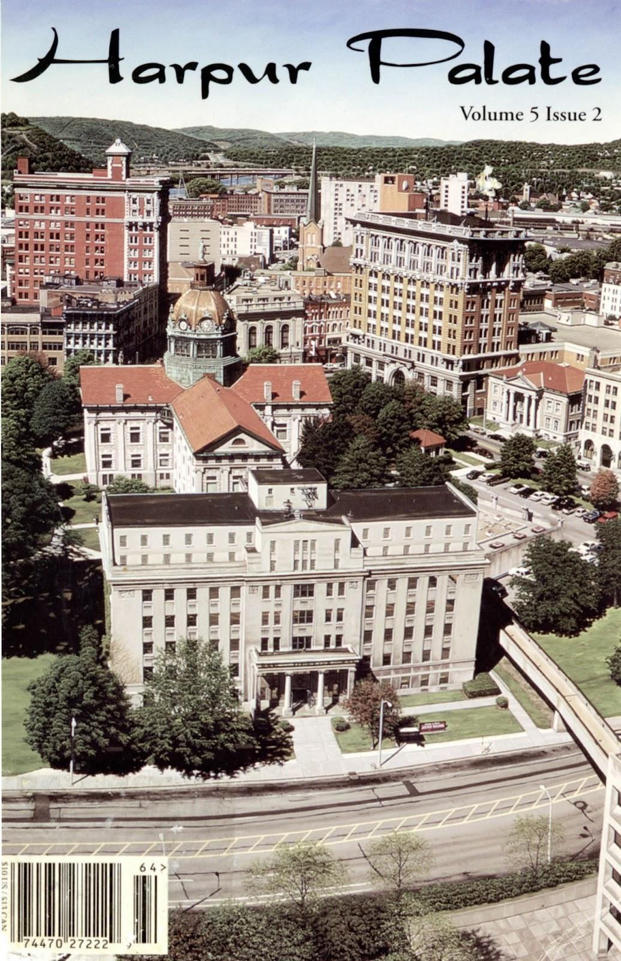
Collaborative IR Projects with the Campus Community
Caitlin Holton and Erin Rushton
2022 Digital Commons North American Conference
November 9, 2022

Slide 2
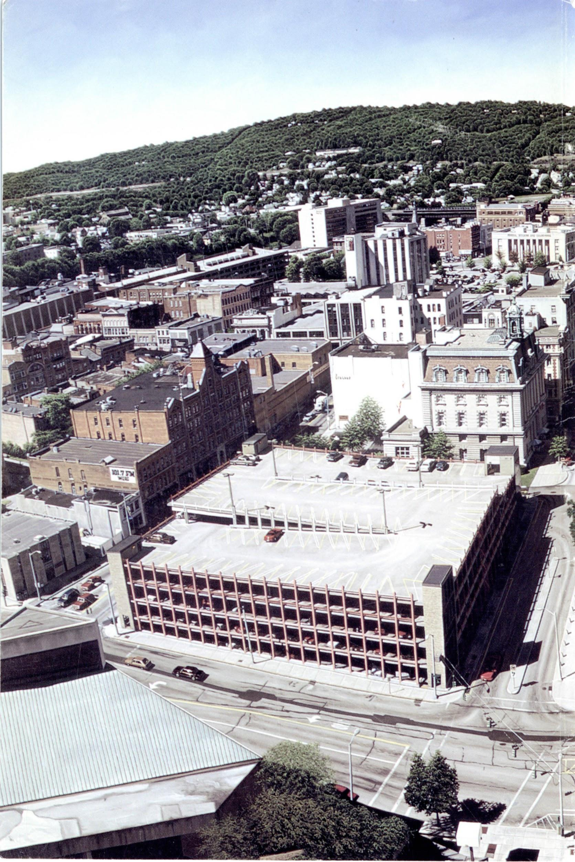
Introductions
Erin Rushton, Head of Digital Initiatives and Resource Discovery
Caitlin Holton, Digital Initiatives Assistant
Amy Gay, Assistant Head of Digital Initiatives for Digital Scholarship

Slide 3
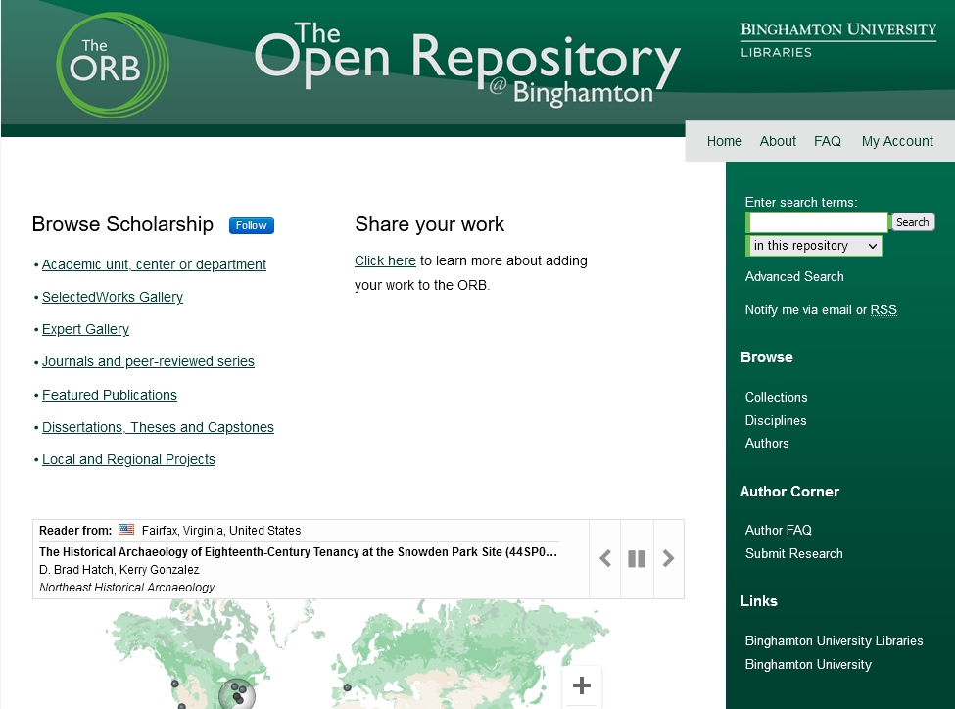
The ORB
Launched November 2016
Home to over 3000 works that encompass a large range of materials created by Binghamton University faculty, staff and students. These works include:
Research articles
Journals
Datasets
Working papers
Creative works
Podcasts
Oral Histories
Videos
Posters
Presentations
Image galleries
Theses and dissertations
Departmental resources
More!

Slide 4
Snapshot of the ORB

Slide 5
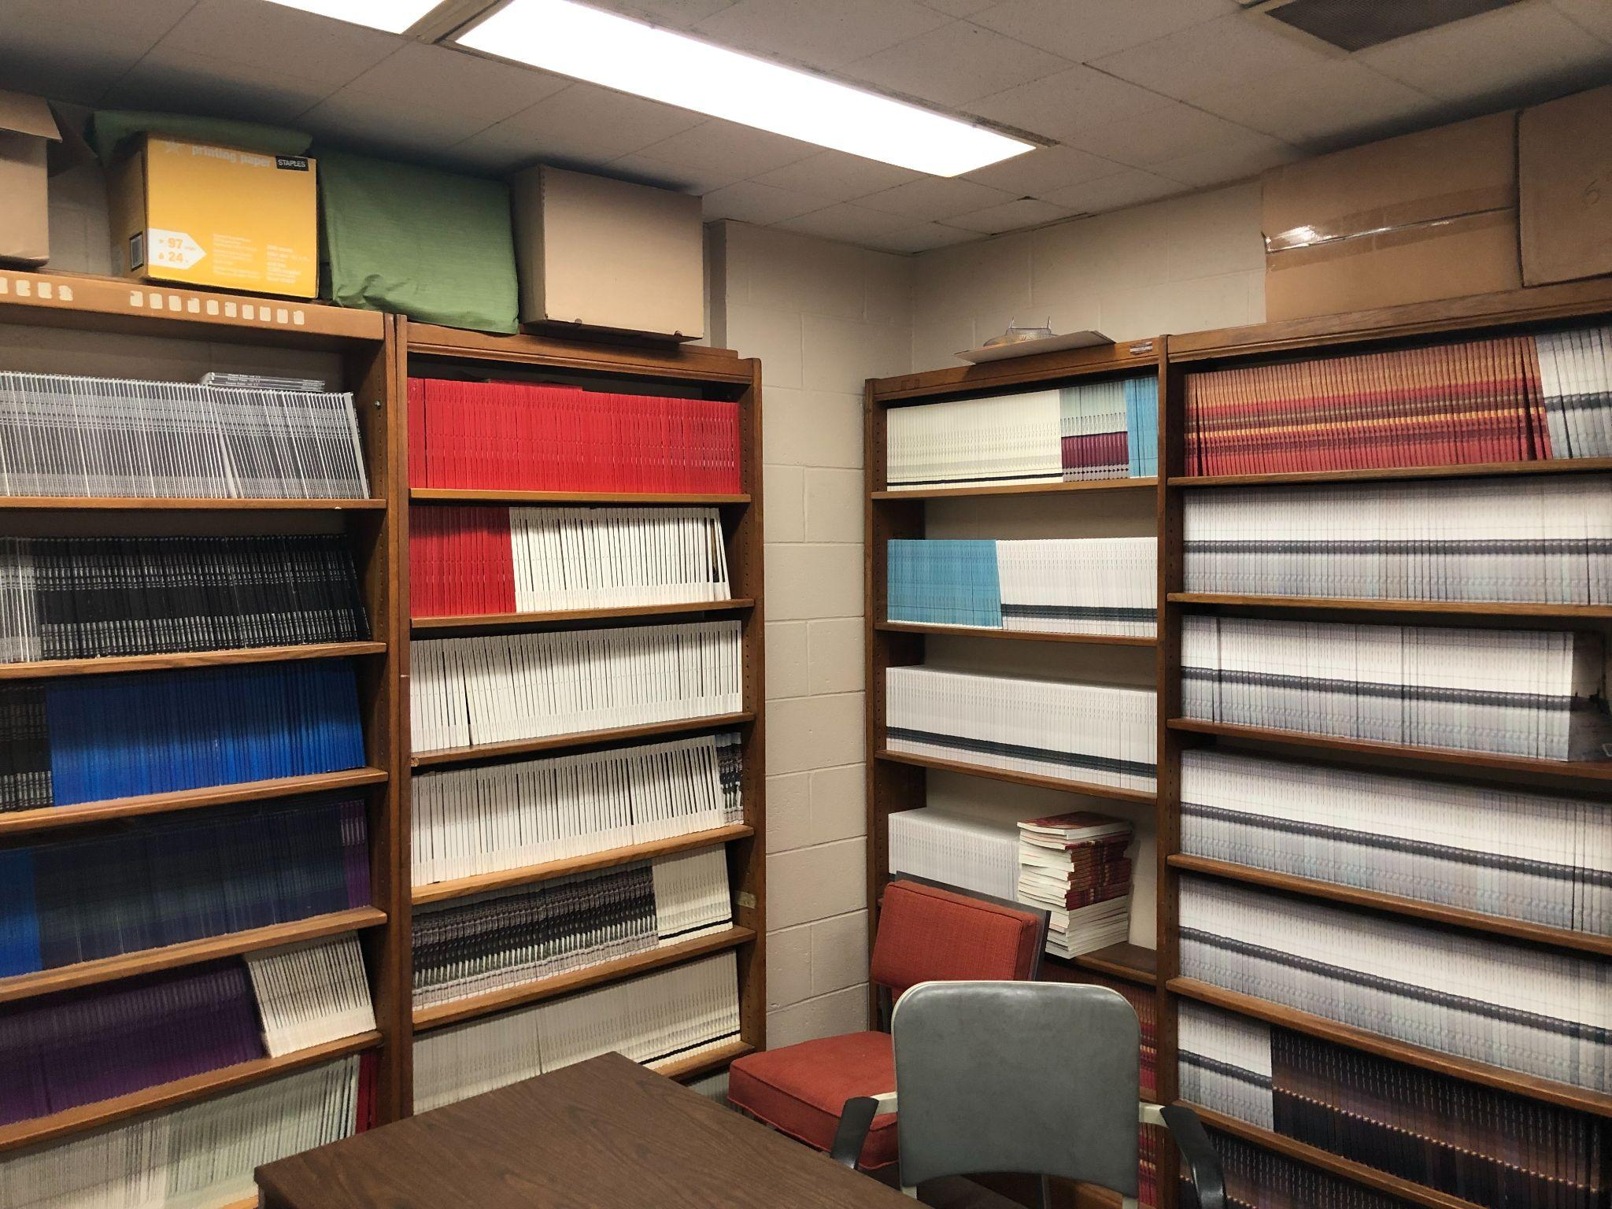
Harpur Palate
A campus literary magazine started by creative writing graduate students in 2000
Originally was a print magazine with paid subscribers, but in 2020, the magazine editors made the decision to transfer to a fully online magazine.
Approached the Libraries because they wanted to digitized 20 years of back issues and create an online, searchable open-access archive
Image credit: Harpur Palate

Slide 6
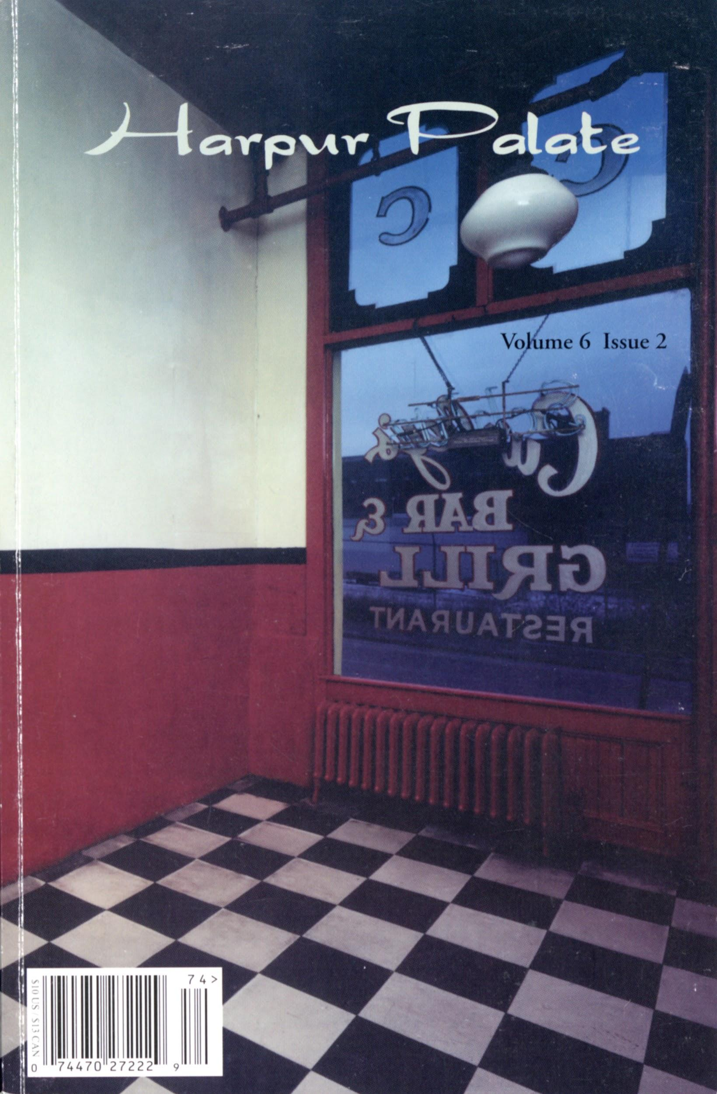
The Challenge
How to digitize over 20 years of back issues AND create online issues in the Libraries’ IR ?

Slide 7
Collaboration with Harpur Palate and the Libraries
Regarded this as a mutually beneficial project for the Libraries and the journal.
The journal would be able to digitize their back issues and make them publicly accessible.
For the Libraries, the project:
aligned with our digitization priorities (campus publications)
would help us expand our digital collections
provided an opportunity to collaborate with a university department
could be used to help promote the ORB to the campus community
did not require a lot of labour on our behalf because Harpur Plate would be doing the digitization and creating the metadata.

Slide 8
Digitization
Harpur Palate agreed to digitize the back issues using their own staff and student workers
We provided access to our digitization lab.
In addition we:
Created instructions on how to use the scanners
Trained Harpur Palate students and staff on digitization best practices
Coordinate schedules with other student workers
Conduct quality control and OCR

Slide 9
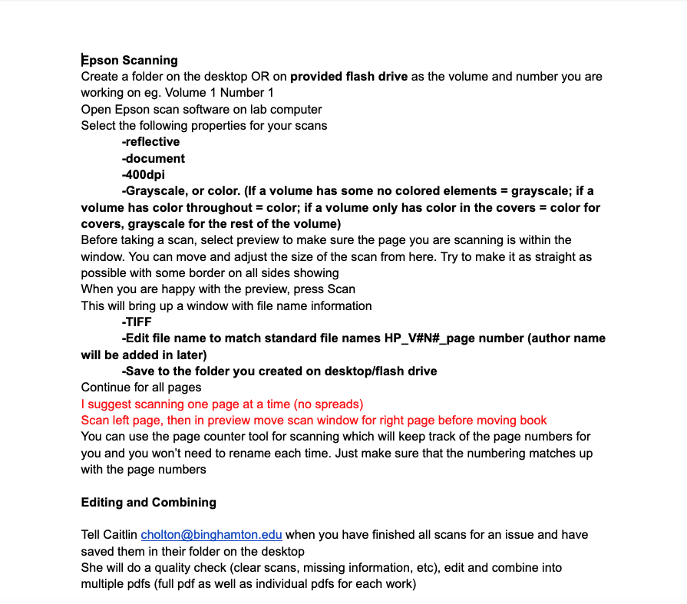
Digitization
Original scanning documentation for students
Originally trained 5 students on scanning with our equipment
2 undergraduate students scanned until the end of the semester (spr)
Currently, only the Editor-in-chief uses the lab once a week
Scan as TIFF and combined later as PDF
Issues have their spines cut so that each page can be scanned

Slide 10
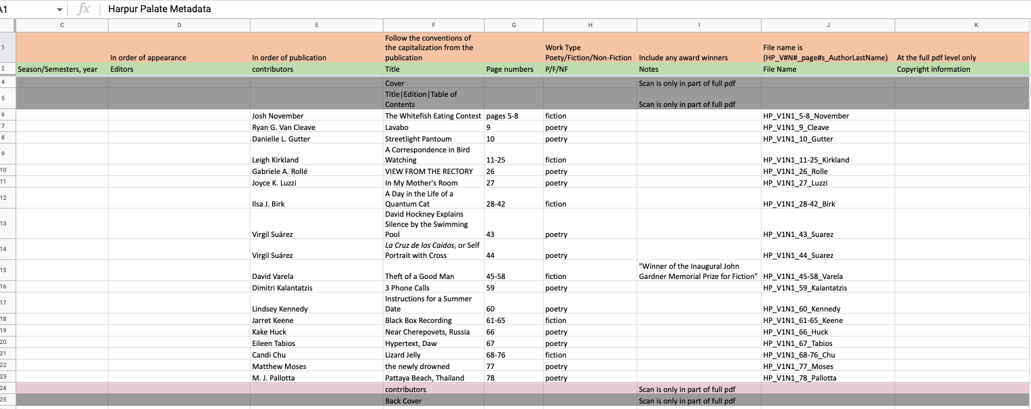
Metadata

Slide 11
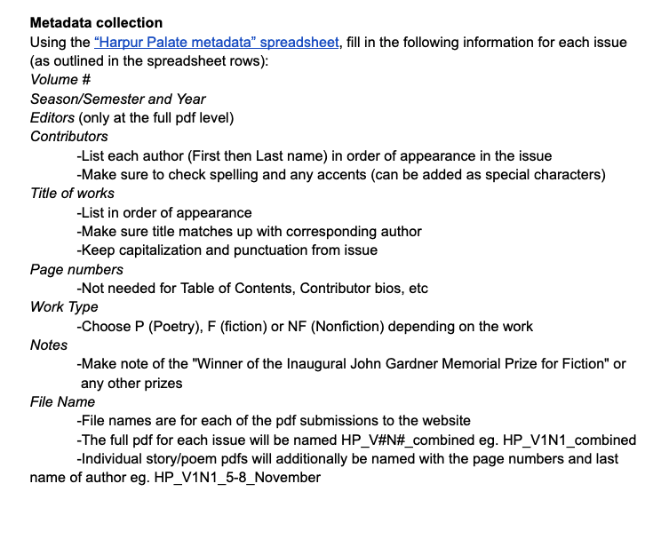
Metadata
Created a template and instructions for students to use
Editor-in-chief or myself would double check metadata before submitting
Large emphasis on displaying titles and names as they originally appeared
Still working to properly incorporate full editor information per issue

Slide 12
General Workflow
Harpur Palate: Digitize issue and create metadata
Libraries: Quality check (clear scans, missing information, etc), edit and combine into multiple pdfs (full pdf as well as individual pdfs for each work)
Libraries: OCR PDFS
Harpur Palate: Submission of issues and individual works
Libraries: Review and approve submissions

Slide 13
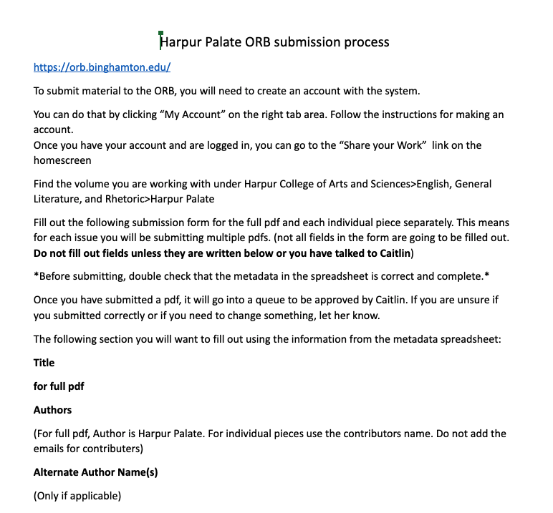
Submitting material to the ORB
Original submission workflow for students
Original workflow had students submitting stories one at a time into separate series for volumes
Quickly learned that a journal structure was much better suited
Allowed limited administrative access to HP Editor-in-chief
Able to batch upload full issues at a time with small metadata tweaks
Custom document type metadata

Slide 14
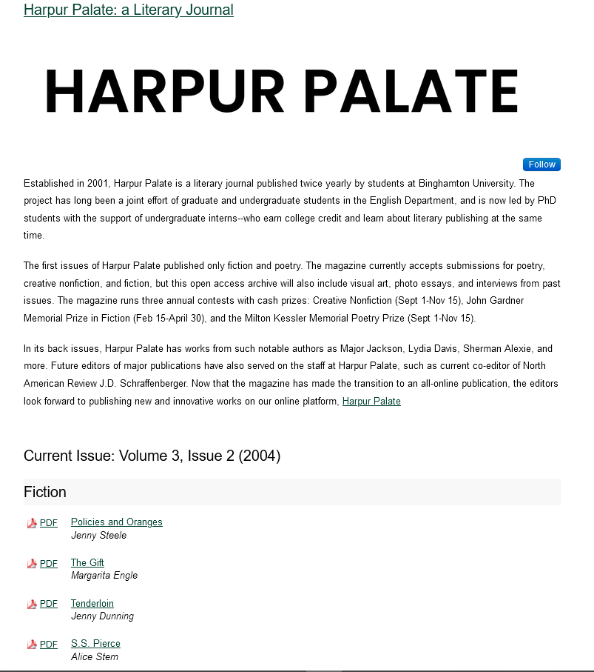
Current Status on the ORB
Individual landing page with bio written by Editor-in-chief
6 volumes live on the ORB
Another 6 soon to be ready for submission
Outreach via recent ORB Showcase during Open Access Week

Slide 15
Lessons learned
We forgot to talk about copyright in our initial meetings with Harpur Palate
Need to modify our expectations of what students can accomplish
Need to have a fluid “project timeline” when collaborating with others

Slide 16
Next steps
We believe this project can serve as a “template” for additional collaborations with campus
Working on creating a document that outlines roles and responsibilities for future collaborations

