Slide 1
Call numbers,
oh call numbers on ebooks, why have you forsaken us!
Notes:
March 10th - 30 min with 5 qa **1:00 pm - 2:00 pm EST**

Slide 2
Who we are
David Schuster
Sr. Dr. for Library Technology and Digital Strategies
dschuste@binghamton.edu
Sasha Frizzell
Catalog / Metadata Management Librarian
sfrizzell@binghamton.edu
Notes:
Self introductions
https://www.suny.edu/attend/visit-us/campus-map/
Binghamton is one of the 64 campus’ in the SUNY system and 1 of the 4 larger University Centers and has a Carnegie R1 status.

Slide 3
How we got here
Notes:
David
NYSCILIB’22
Spoon, Henrik; Chandler, Adam; and Daniels, Laura, "E-books need call numbers to be discoverable" (2022). Upstate New York Science Librarians Conference. 114.
https://surface.syr.edu/nyscilib/114
What led us here -
We both attended a session presented by Henrick Spoon from Cornell University on their concern for lack of call numbers in Ebooks. Stating ebooks didn’t show up in their catalog browse because they didn’t have call numbers. As they explored records they were finding many with few access points being either Call number or subject.
Henrick was open for participants to investigate, especially those from other ILS vendors.

Slide 4
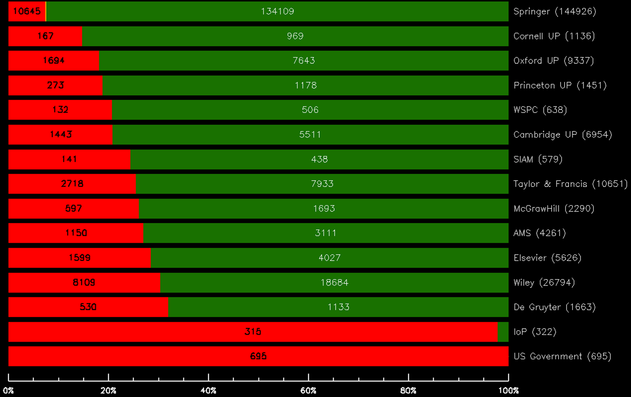
Cornell by publisher - lacking classification
Notes:
Sasha
- what is the problem -
Explain the graph
What is completeness and why does it matter? QA example from Henrik (mathematics or computer science) - pulling ebooks by classification / subject impossible without classification / 6XX. Browsability in “books like this”
Cover results - 10 - 100% missing classification

Slide 5
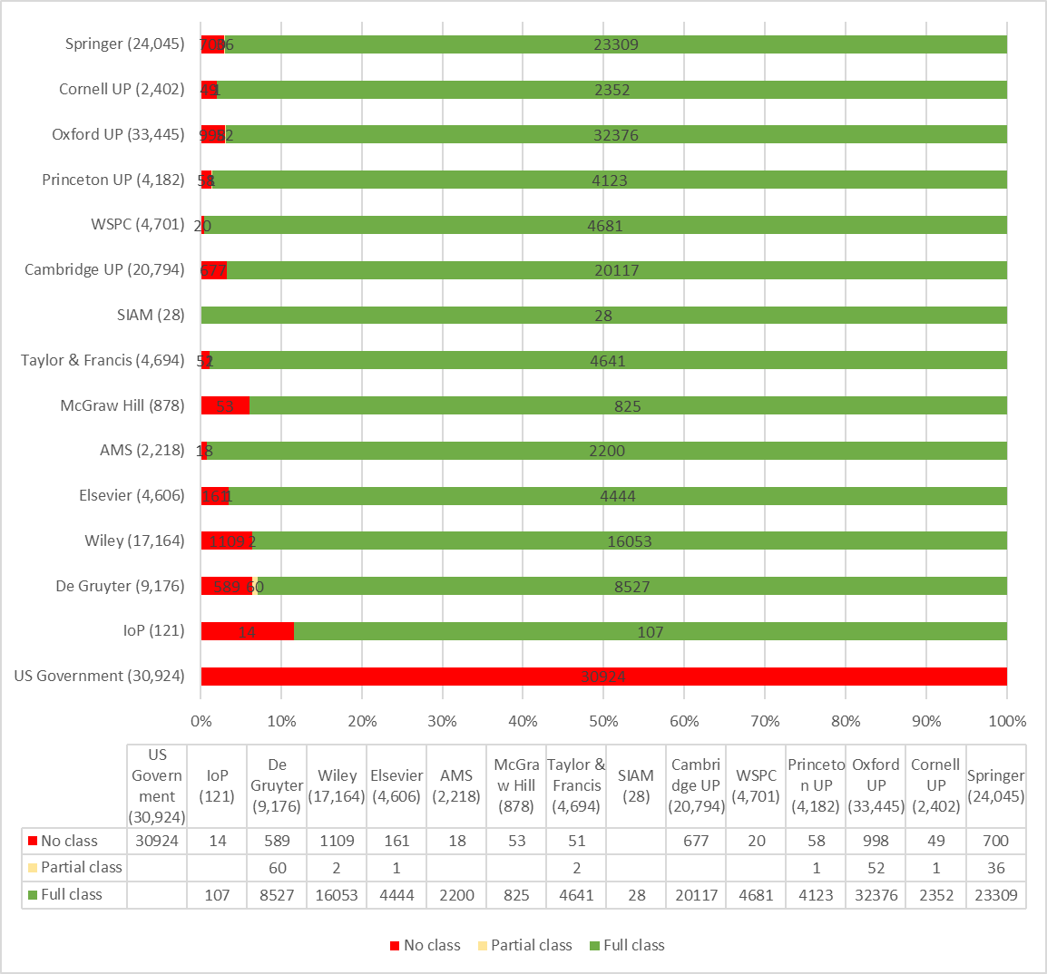
Binghamton
Lacking classification
77.8% have LC classification
35,421 have no LC classification
Notes:
Sasha
In comparison, the numbers from our Institutional catalog were less shocking but still offered cause for concern. Across most of our publishers, we had just over 22% of records missing an LC classification number. The anomaly would be our Government Documents, which all lacked LC numbers but did include SuDocs (Superintendant of Documents.). The SuDoc number does allow for the government documents to be browsable in the “find a related resource” in, our Primo library catalog, but they do not interfile with LC classified resources, so they are considered incomplete.
For more clarity, there is a breakdown at the bottom of the graph.with the numbers in each publisher and all three classification possibilities.
Even though the numbers for out catalog are lower, they still add up to a problem. Across these publishers, we have over 35K records with no LC classification. These publishers represent a small snapshot of our catalog as a whole, so it’s worth exploring where this metadata is coming from and why it isn’t consistent across ILSes.

Slide 6
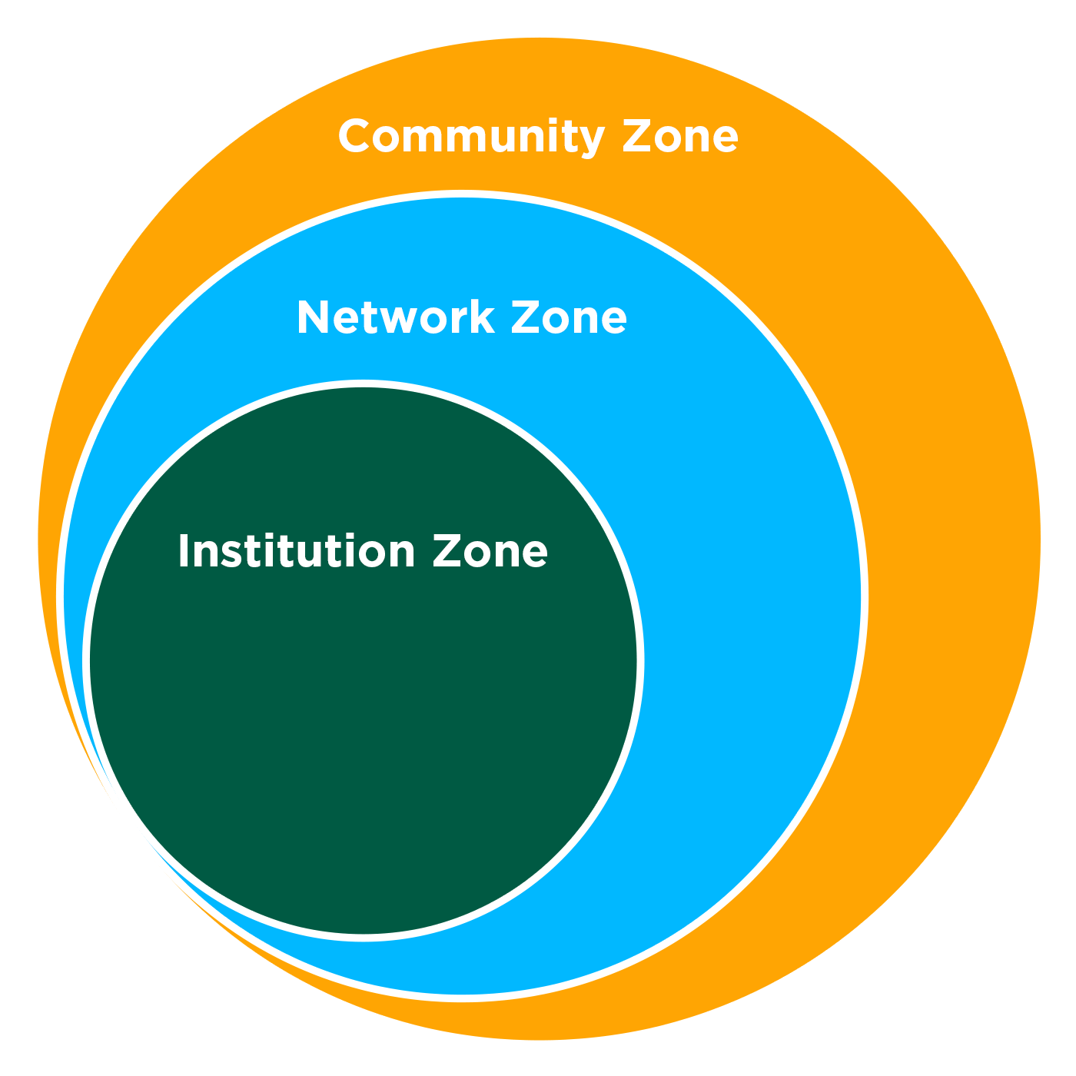
How Vendors Manage Knowledge Bases varies
Notes:
David
- Alma CKB vs EBSCO CKB
- Explain a little bit about ven diagram of Zones
- Ebsco’s - publisher provided records
- Ethics of shared databases and vendor provided records
EBSCO - Cornell - uses Blacklight with EBSCO Discovery Service - for their Catalog

Slide 7
IZ/CZ/Cornell Lacking Classification
 | IZ | CZ | Cornell (Catalog)
Elsevier | 3.495% | 6.72% | 28.42%
Cornell (Publishing) | 2.12% | 8% | 14.7%
De Gruyter | 6.4% | 39.9% | 31.87%
Notes:
Sasha:
Percentages between IZ/CZ/Cornell call numbers
IZ vs CZ vs Cornell, items w/o call numbers. Outline of why these numbers are so different.
A lot of the same problems you’d see in any shared catalog:
Stub records,
duplicates,
alternative classification
+
overlaying records

Slide 8
Binghamton Exploration
Query by: publisher & resource type
Save and Filter Query
Run job to export bibliographic records
Notes:
David - clarification so we didn’t use the CKB collections themselves for “packages”
IZ / NZ / CZ querying by electronic resource & publisher. Make sure to query for any possible publisher variant name (i.e. SIAM listed on our charts is also Society for Industrial and Applied Mathematics). Chose to break them out with publisher level data to receive manageable numbers of bib records to export. Save Query. Saving the data at this point is important because electronic collections are very prone to fluctuations. Run job, export bibs, run through MARCEdit.

Slide 9
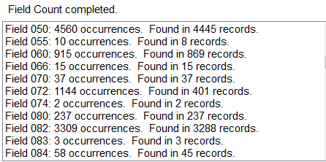
Explore the Data
Using:
MARCEdit Field Count Report
MARCEdit Export tab delimited records
Excel field level analysis
Notes:
Sasha
Field Count report for general analysis, high level overview of metadata. Tab delimited records for more granular analysis in excel.
The actual analysis of the data could be done in many different ways. Similar projects have used Java, R, or Python in order to assess metadata quality for records. For this analysis, i went extremely low-tech and used MARCEdit paired with Excel to learn more about the bib records.
First, I pulled MARCEdit Field Count Reports for each publisher, using the method David described. This gave me a general idea of how many records had certain fields and how many of those fields were present across the set. Here we can see that in my record set, 050 field for LC classification occurs 4560 times in 4445 records, which means that some records have multiple occurrences of the field.
This was helpful when looking at high level statistics but in order to assess the actual quality of the classification, I would need to take a closer look at the fields. To do this, I exported the tab delimited records from MARCEdit into an Excel spreadsheet.
Inside Excel, I could separate specific fields to get more granular information about the metadata. For example, I isolated the 050 column in order to see which records had full, partial, incomplete, or incorrect classification information. The separate field column allowed me to analyze how many 6XX fields each record averaged and which vocabularies the headings came from to get a broader understanding of subject access across the record.
Instead of walking you through each of the analysis points, I’ve added some technical slides at the end that get more in depth with the actual process of analysis.
Now that we had this point of comparison with the EBSCO knowledge base, we could easily see that our records both had problems – but in different ways. So where is the information coming from and, more importantly, how do we fix it?

Slide 10
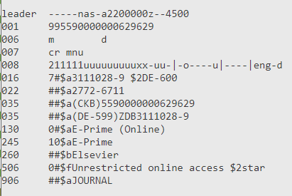
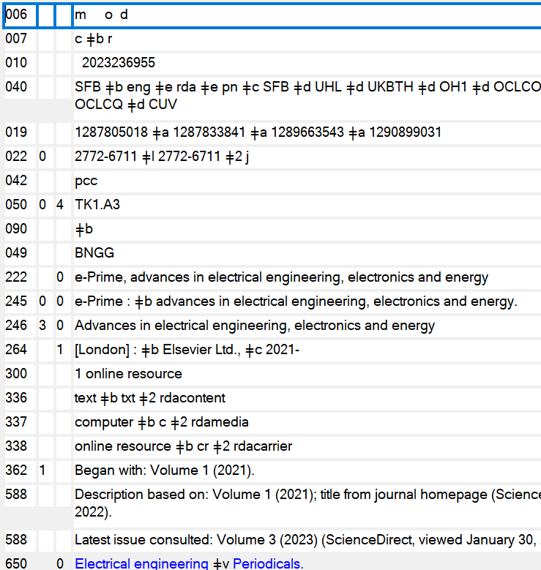
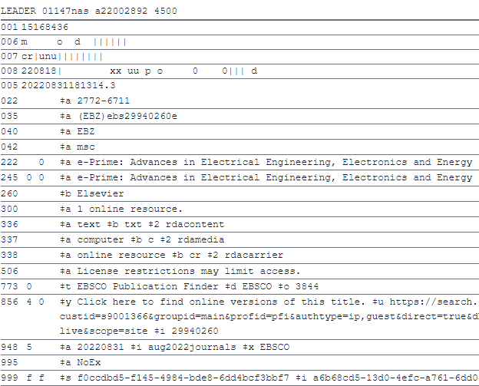
Where did this come FROM!
Notes:
Sasha
- as we looked at the data there is no provenance to how it got into the KB of CZ
Cornell is reaching vendors and talking Ebsco improving their KB - where we can actually impact the Alma Community Zone KB directly.
This is one example of an incomplete record from our knowledge base.
Top Left - Binghamton Record.
Bottom Left - Cornell Record
Right - OCLC
Outline metadata quality issues – ALMA no sub b, no publisher stuff, no class, no subject – known item searching
Cornell at least has a subfield b for keyword access
OCLC wins.
Where are the variations coming from? Why do we have such disparity in data? 040 field.
Versioning in Alma
Cornell is going to advocate for better data quality at the vendor – we’re going to update and improve the records

Slide 11
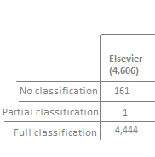
Evaluate and Update
Elsevier
Updated 50 records in the CZ
Added 050 and 6XX fields
Chiefly peer-reviewed, open access health sciences journals
Notes:
Sasha
Looking at a small batch - slide with BU only information & how that was adjusted -Sasha -Elsevier only information
- modify call number/add subject - Sasha subject / call analysis -
Options for improvement – Adjust in the IZ, no one else benefits. Adjust in the CZ, others benefit. Asked the listserv first. Not that different from OCLC.
Elsevier outline – ScienceDirect
Understanding we’ll test analytics for improved and unimproved (111) records to see if its making an actual difference.

Slide 12
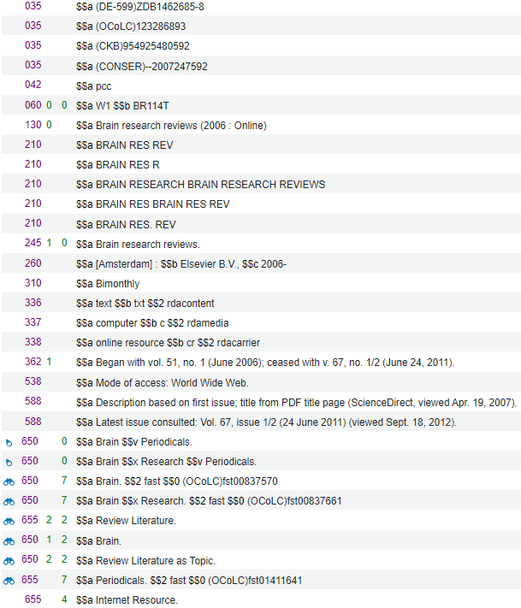
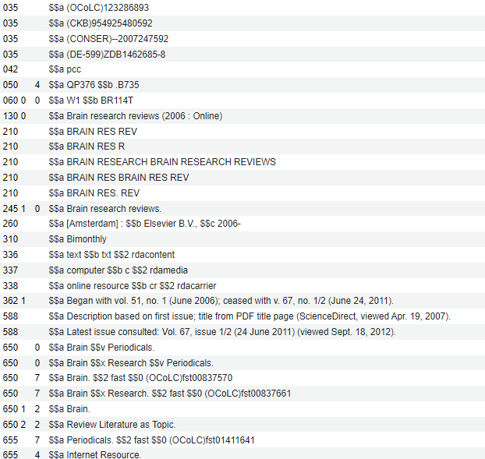
What we have seen so far
Current CZ record Updated Record - Overwritten
Notes:
David
Overwritten record not following CZ standards for management
Current CZ record – 050 has been wiped out and a 655 genre term for Review Literature has been added. Our updates with overwritten by Casalini Libri upload. Likely they had an outdated form of the record and published the change to the 655

Slide 13
Next Steps
Waiting to see what the numbers look like in May.
After call numbers usage is up almost 7%
Not sure if that is organic or driven by this change.
Evaluating other collections for potential changes how do we select them?
Assigning call numbers and subjects can be time consuming is it worth the effort?
Ethics of using Vendor provided content and adding it to the CZ when OCLC did the enhancements even though the vendor paid for it
Provides a better understanding of the collection by call number
Analysis provides data on potential vendors in the CZ with poor quality records for future purchase consideration
Notes:
David -
Statistics - we have taken 50 records from one publisher and enhanced the records - we are tracking those records in the Knowledge base, and in our analytics reporting tool to track clicks for usage to see if this adjustment has an impact in 5 months of usage.
We will look at the whole collection for that publisher as well as for the records we did not enhance to see if there is a usage trend. (May will be our first evaluation)
Next steps - after this evaluation of usage - should we enhance other collections and how do we select them? Assigning call numbers and subject headings can be time consuming - need to evaluate the cost benefit.
BUT Doing this does provide us a more accurate picture of our collections for a digital collection analysis and about what is being used.
Other benefits
Analysis of vendors we expect bad metadata from - for future purchases
Using the method to improve stats on low circ collections or legacy records - need to evaluate the collection content - is it a keyword collection or people will know exactly what they are looking for by title?

Slide 14
Thanks!
Technical slide to follow

Slide 15
Excel features used
For call numbers:
Sort by length - formula LEN(A1)
Sort smallest to largest
Search column for hyphenated numbers
Search column for subfield b ($b)
Search column for errors / anomalies
For 6XX / repeatable fields
Data - text to columns - separate by delimiter
for subfield level or line level separation
A-Z for controlled vocabulary type analysis

