Slide 1
Digital Scholarship at Binghamton

Slide 2
DS Community: Who
Groups:
Spatial humanities, Digital history interest group, Data visualization, Engaged digital humanities
Programs:
Digital storytelling, Digital and data studies minor, Digital humanities research institute
Other:
TAEs (Data science, Material and visual worlds, sustainability), IASH

Slide 3
DS Community: What
Digital humanities
Classroom and pedagogical focus
Research and campus projects
Community engaged
Dissertation components
OERs

Slide 4
DS Community: How
Barriers? We’ve got ‘em
funding
space (virtual)
labor and compensation
legitimacy
expertise
people

Slide 5
Fitting in SUNY Create

Slide 6
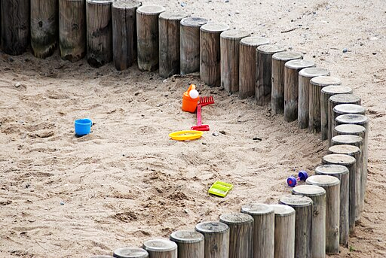
A space to learn in: the value of a ‘sandbox’
“SUNY Create is a helpful platform for me. With access to it, I feel supported as I know whence to turn to when I need a new tool.”
me, CC BY 3.0 <https://creativecommons.org/licenses/by/3.0>, via Wikimedia Commons

Slide 7
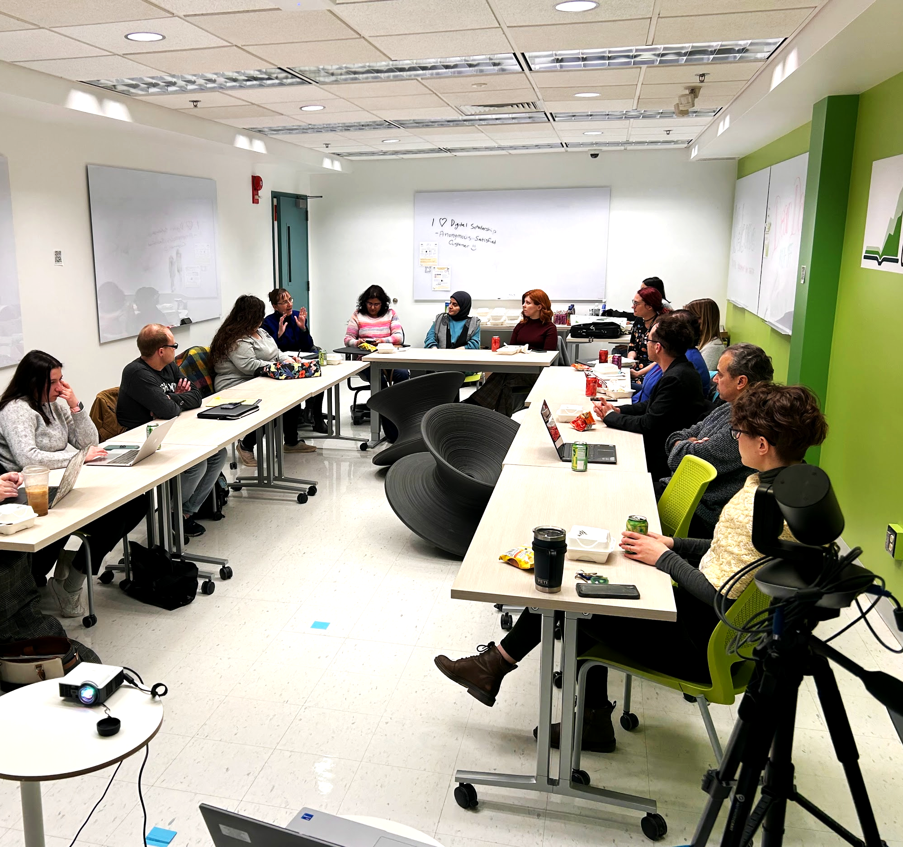
In the classroom: Digital Storytelling made eas(ier)
Everything is one place and there is campus support for class visits and troubleshooting

Slide 8
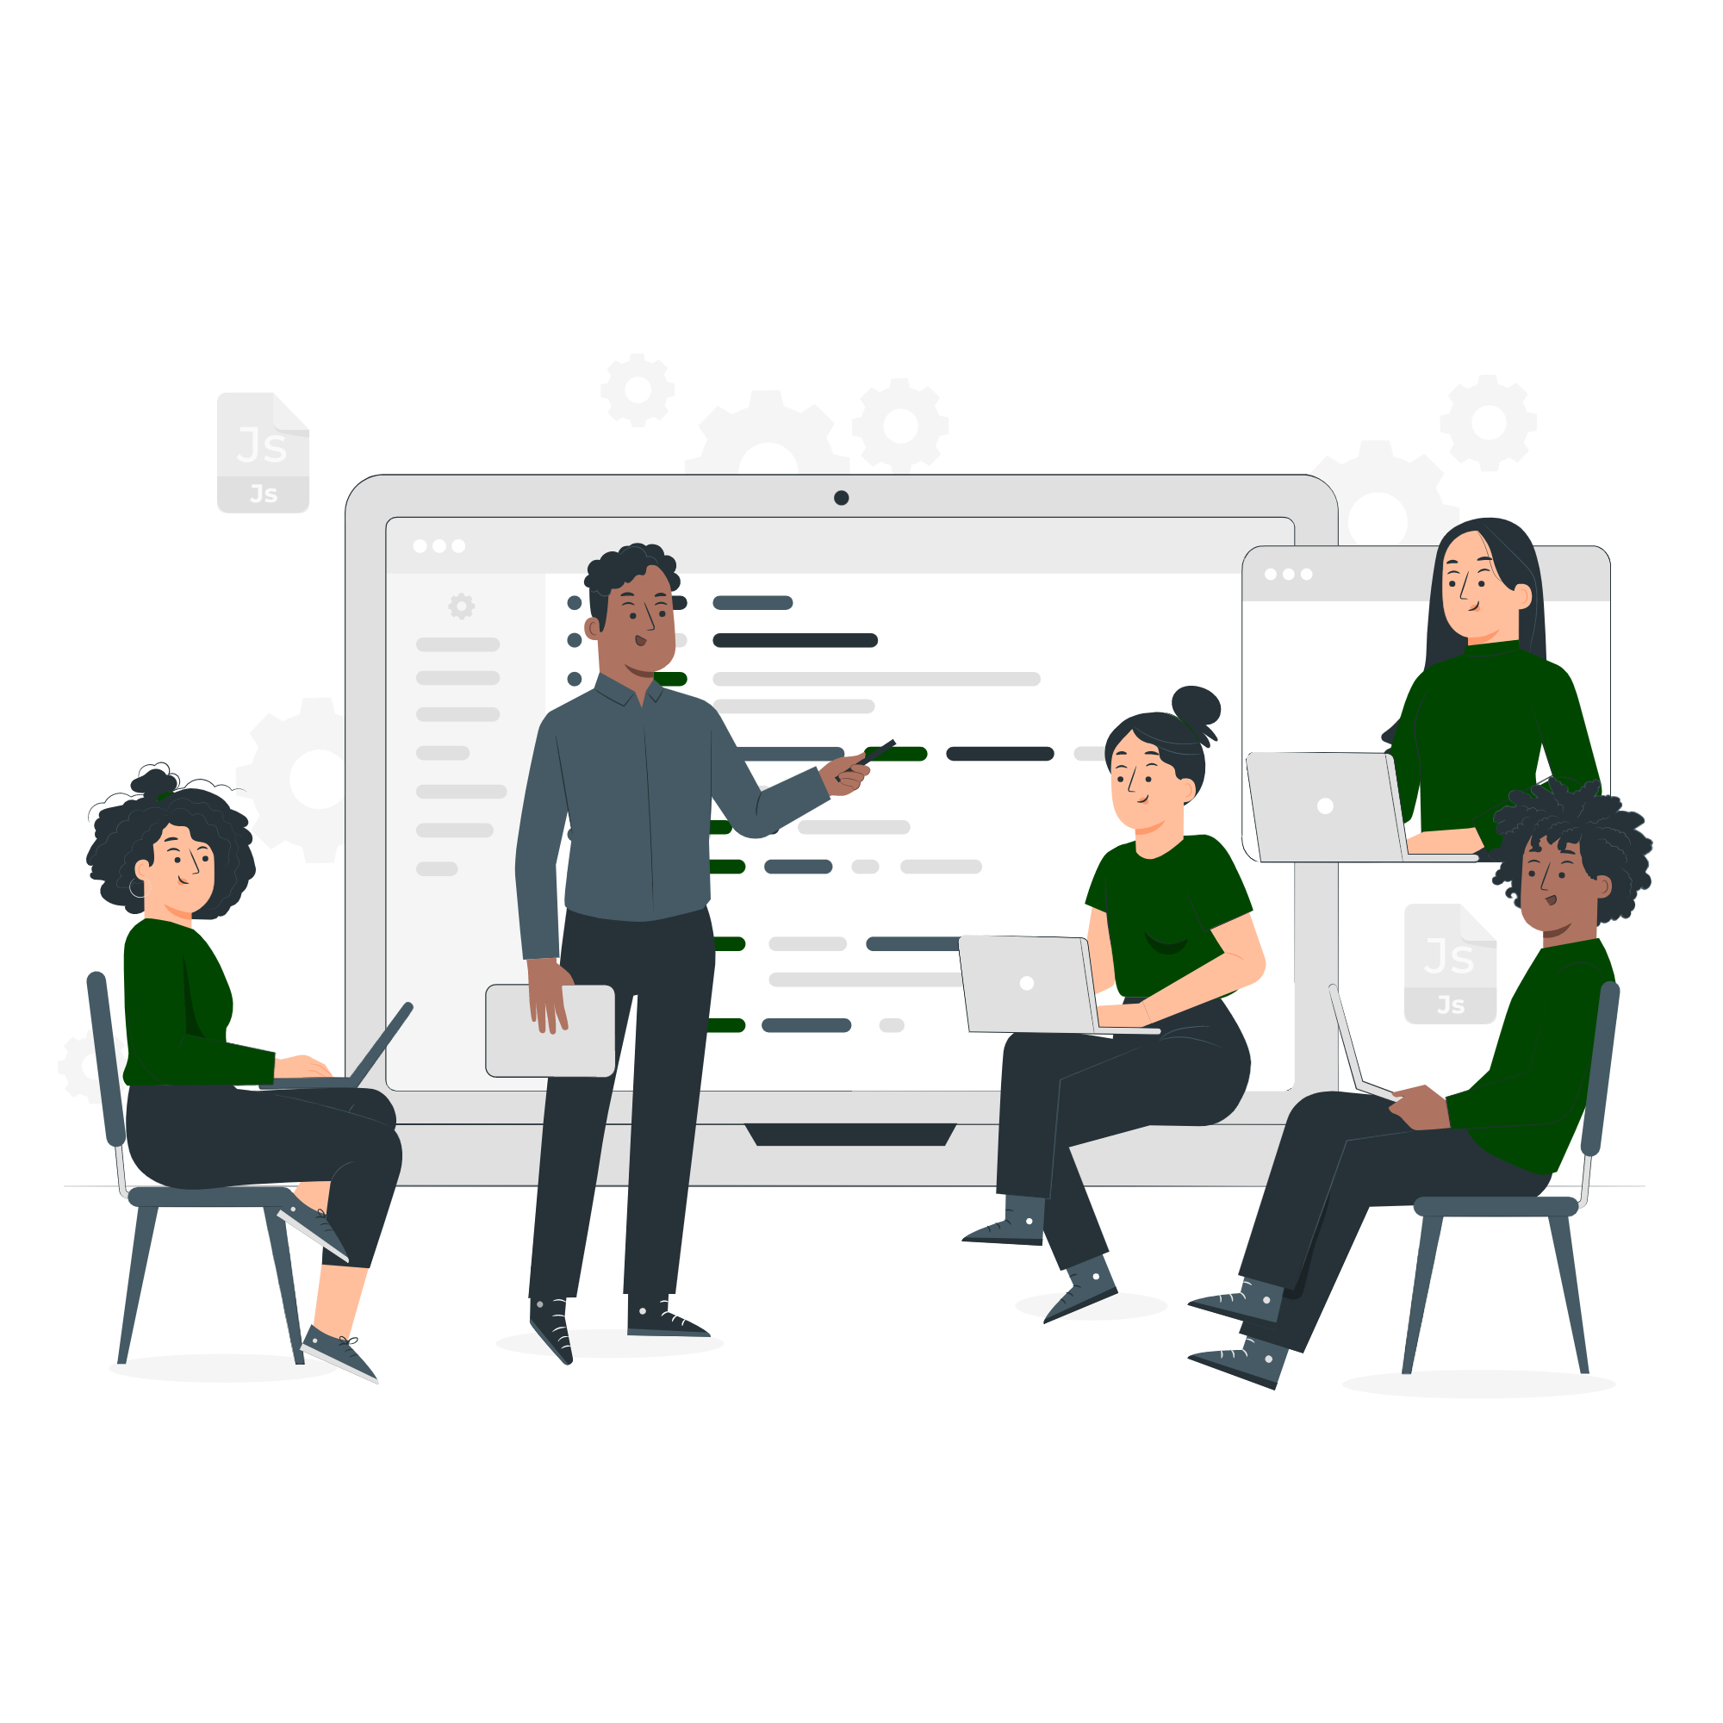
Outreach: Workshops
Fall 2022:
Joint workshop with Binghamton CLT
Workshop “Introduction to SUNY Create” through the digital scholarship center
Digital Storytelling session on SUNY Create
Spring 2023:
Introduction to Wordpress with SUNY Create
Introduction to Omeka S/Classic with SUNY Create

Slide 9
Outreach: Class and consultations
What do people want to know?
Who owns my content?
How do I keep my site once I leave?
What’s the difference between using wordpress.org and SUNY Create wordpress?
How do I add students to my site?
How do I stay organized?
Which tool is the best for my project?
Do you know why XXX isn’t working?

Slide 10
Outreach: Class and consultations
What do we cover?
Signing up for an account
Tour and overview of the SUNY Create cpanel
Common definitions: front end, back end, server, domain
Installing apps using the installer
Overview of how to collaborate on projects and class sites
Accessibility
Digital project management and best practices

Slide 11
SUNY Create: Outreach Materials

Slide 12
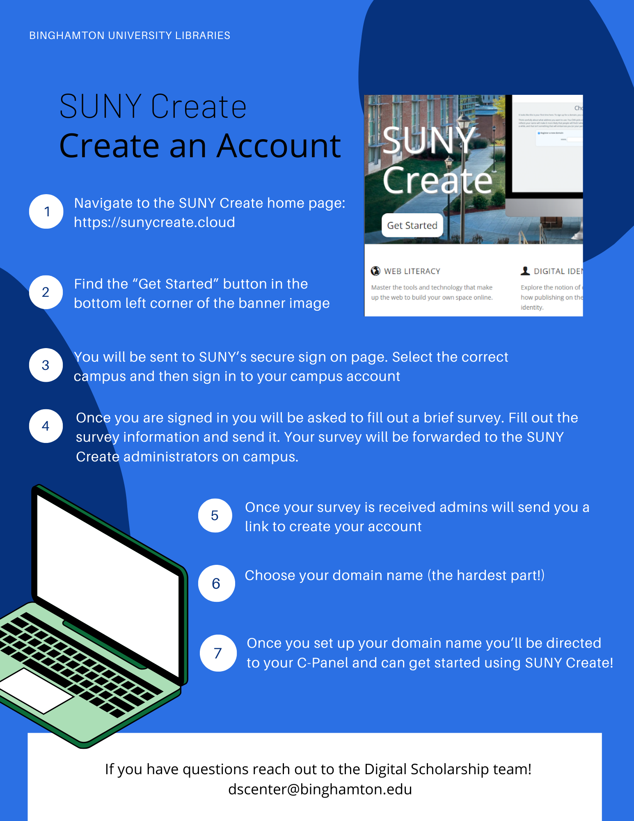
Sign-up one pager
What the Create an Account one-pager covers:
The workflow for creating a SUNY Create account including -
Getting to the SUNY Create homepage and authentication
Information necessary to start your account (brief survey; MOU; accessibility checklist review)
Selecting your domain name and getting started!

Slide 13
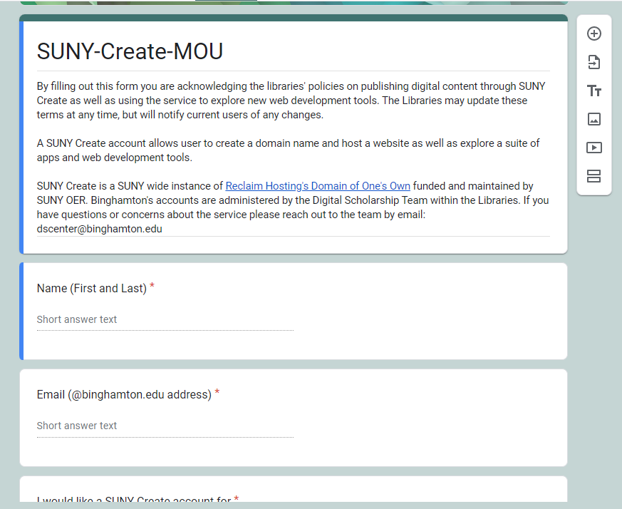
MOU
What the MOU covers:
Who the content creator is and what SUNY Create is being used for
Responsibilities of content owners versus platform administrators
Understanding policies regarding takedown and accessibility
Importance of domain name selection

Slide 14
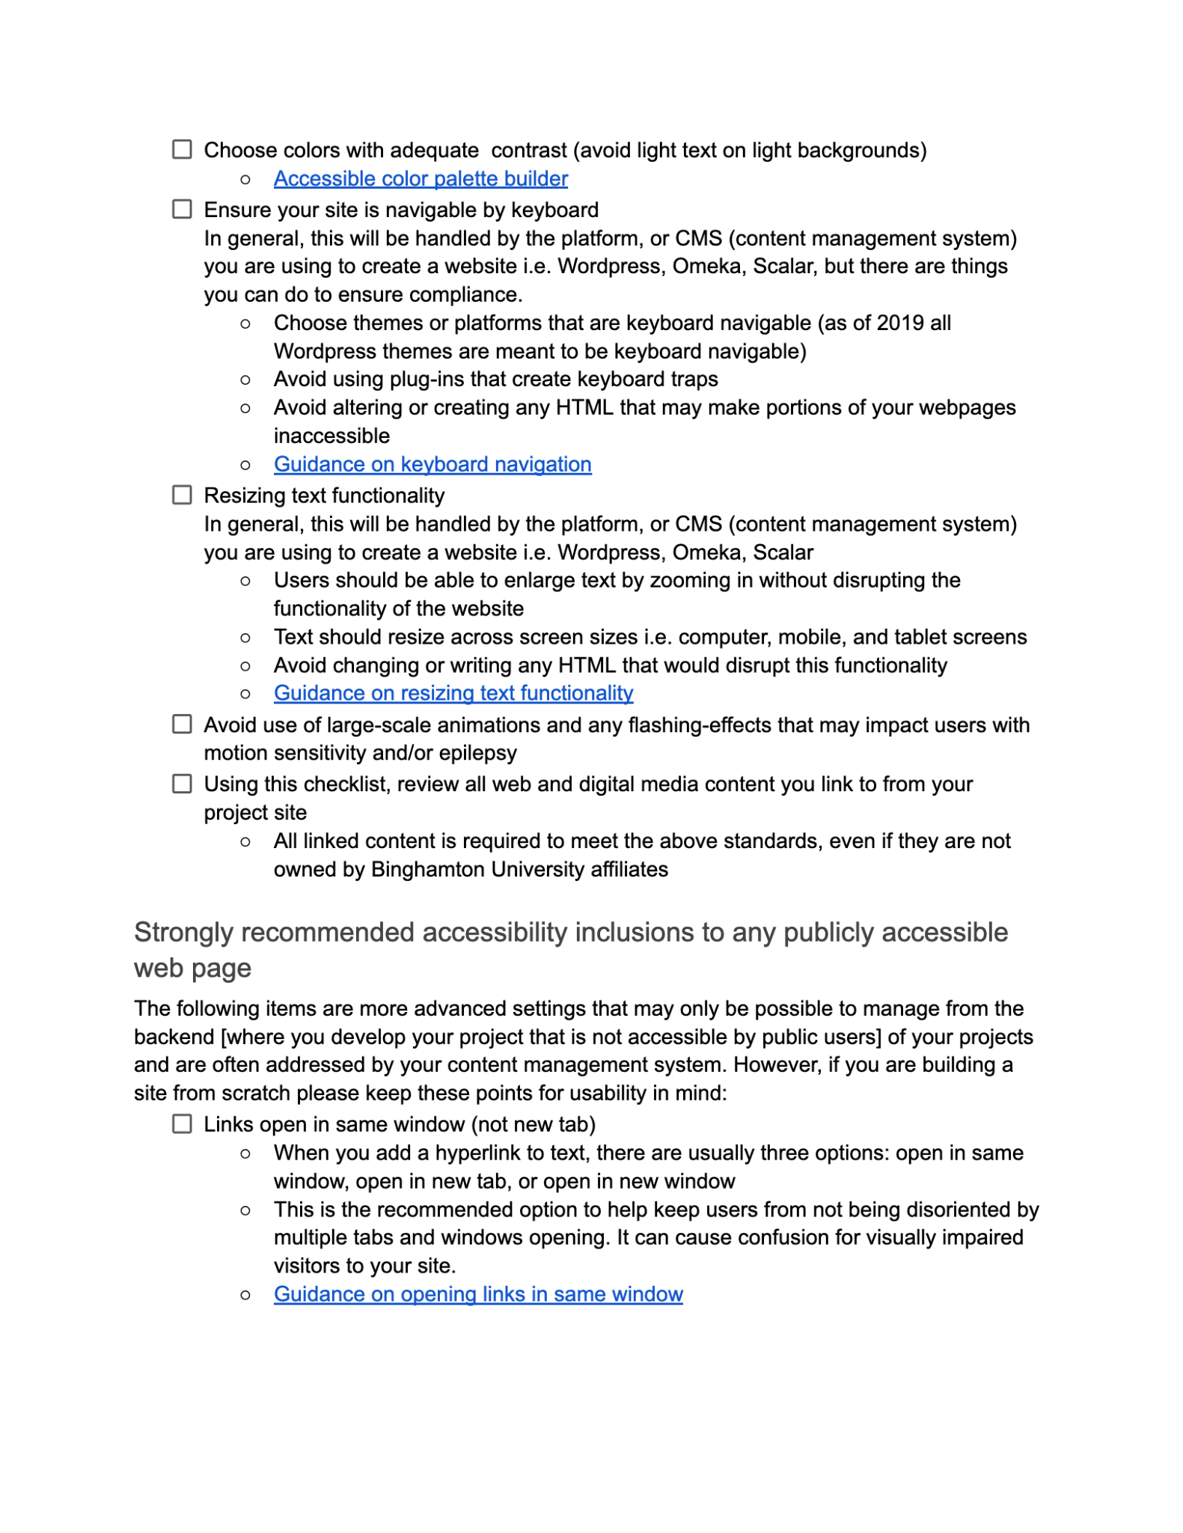
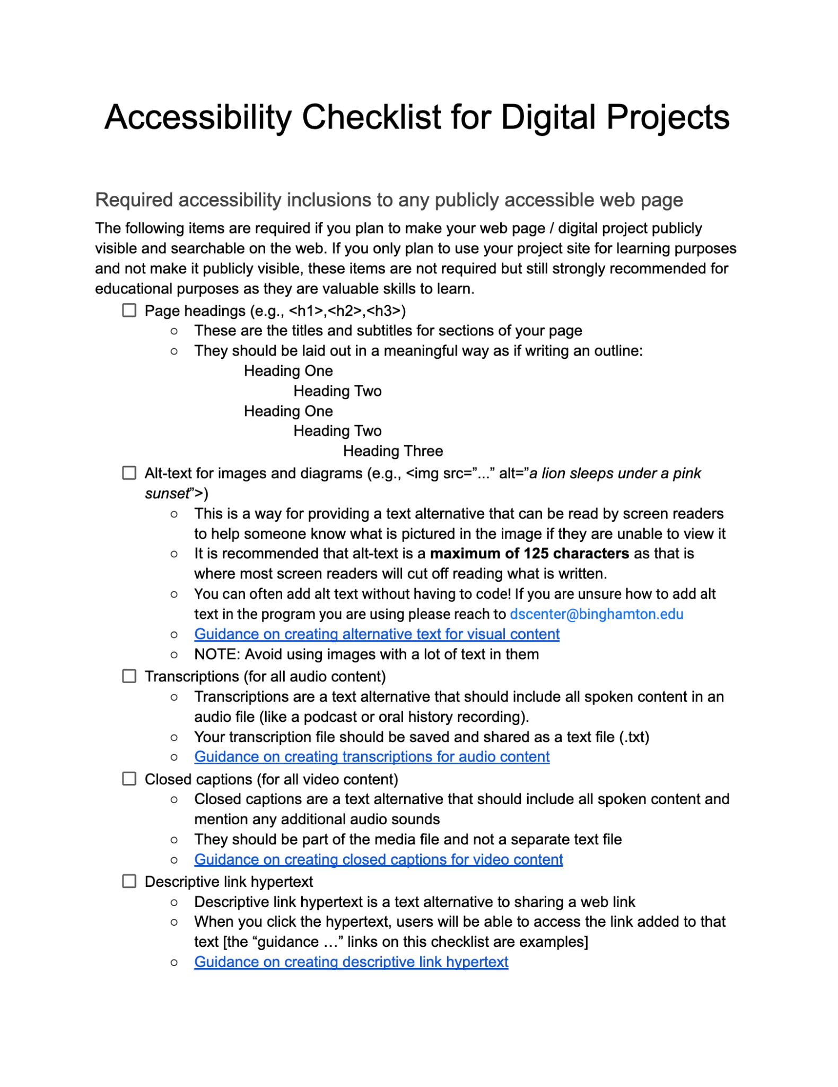
Accessibility
What the Accessibility checklist for digital projects covers:
Guidelines of what is required (at minimum) to meet digital accessibility guidelines at Binghamton
Guided checklist of what to review, including descriptions and linked resources
Additional recommendations (but not required to meet the above criteria)

Slide 15
SUNY Create: Next steps for Binghamton

Slide 16
Account Numbers
43
11
2
Authors
Contributors
Editors
Made up of graduate students, faculty, professional staff, undergraduates, and librarians
Those who may have been interested, but did not follow through on signing up
Two digital scholarship librarians managing the service for the campus

Slide 17
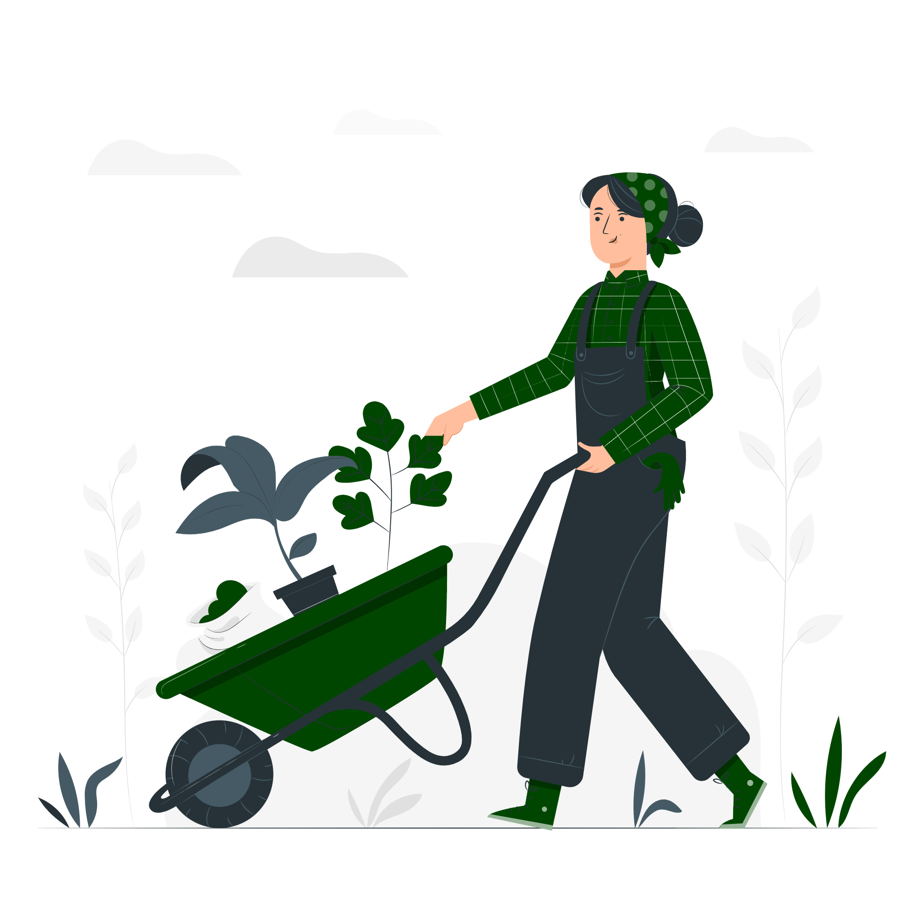
A sustained DS community
More resources for engaging in digital projects and research
More visibility for existing tools and platforms
A virtual learning space
Video and written tutorials
Rethinking our workshop structure
Continue to expand our outreach and advocacy

Slide 18
Questions?
Ruth Carpenter (they / them) rcarpen@binghamton.edu
Amy Gay (she / her) aegay@binghamton.edu

