Slide 1
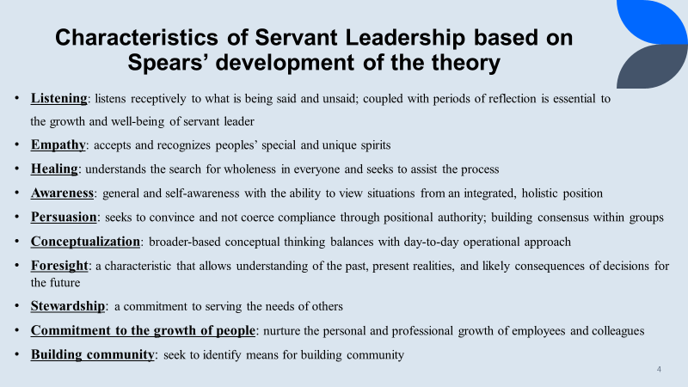
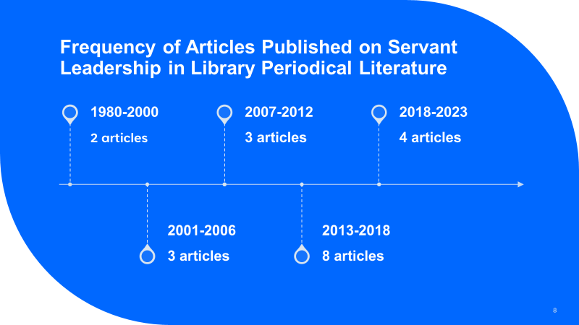
Servant Leadership in the Periodical Literature of Librarianship Presented by: Darlene Ann Parrish, Ph.D., Florida Atlantic University Libraries &
Simone Clunie, M.S.I., Binghamton University Libraries

