Slide 1
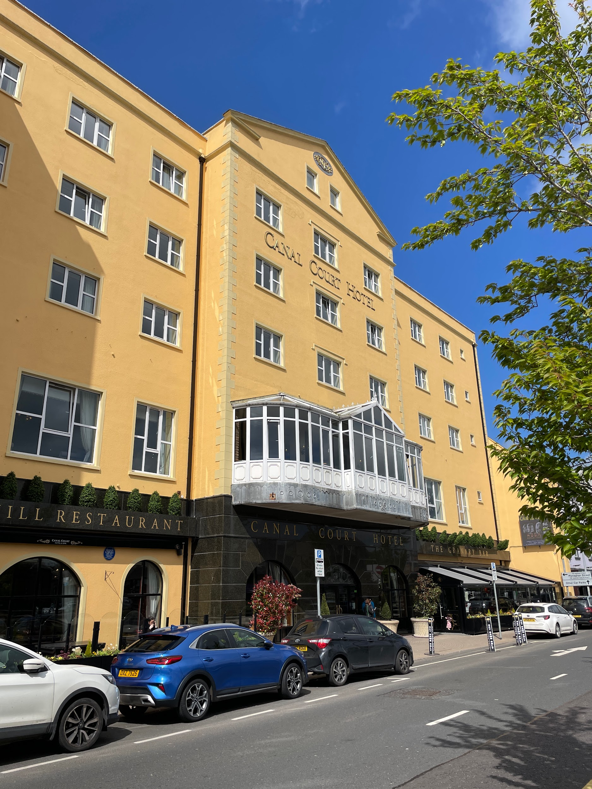
Connecting the Global Library
Our Experience at an
International Library Conference
Halie Kerns, Meghan Lenahan, Simone Clunie. 2024

Slide 2
OUR JOURNEY
Binghamton
Our starting point, University Libraries
Newry
2024 CILIP Ireland/LAI joint conference

Slide 3
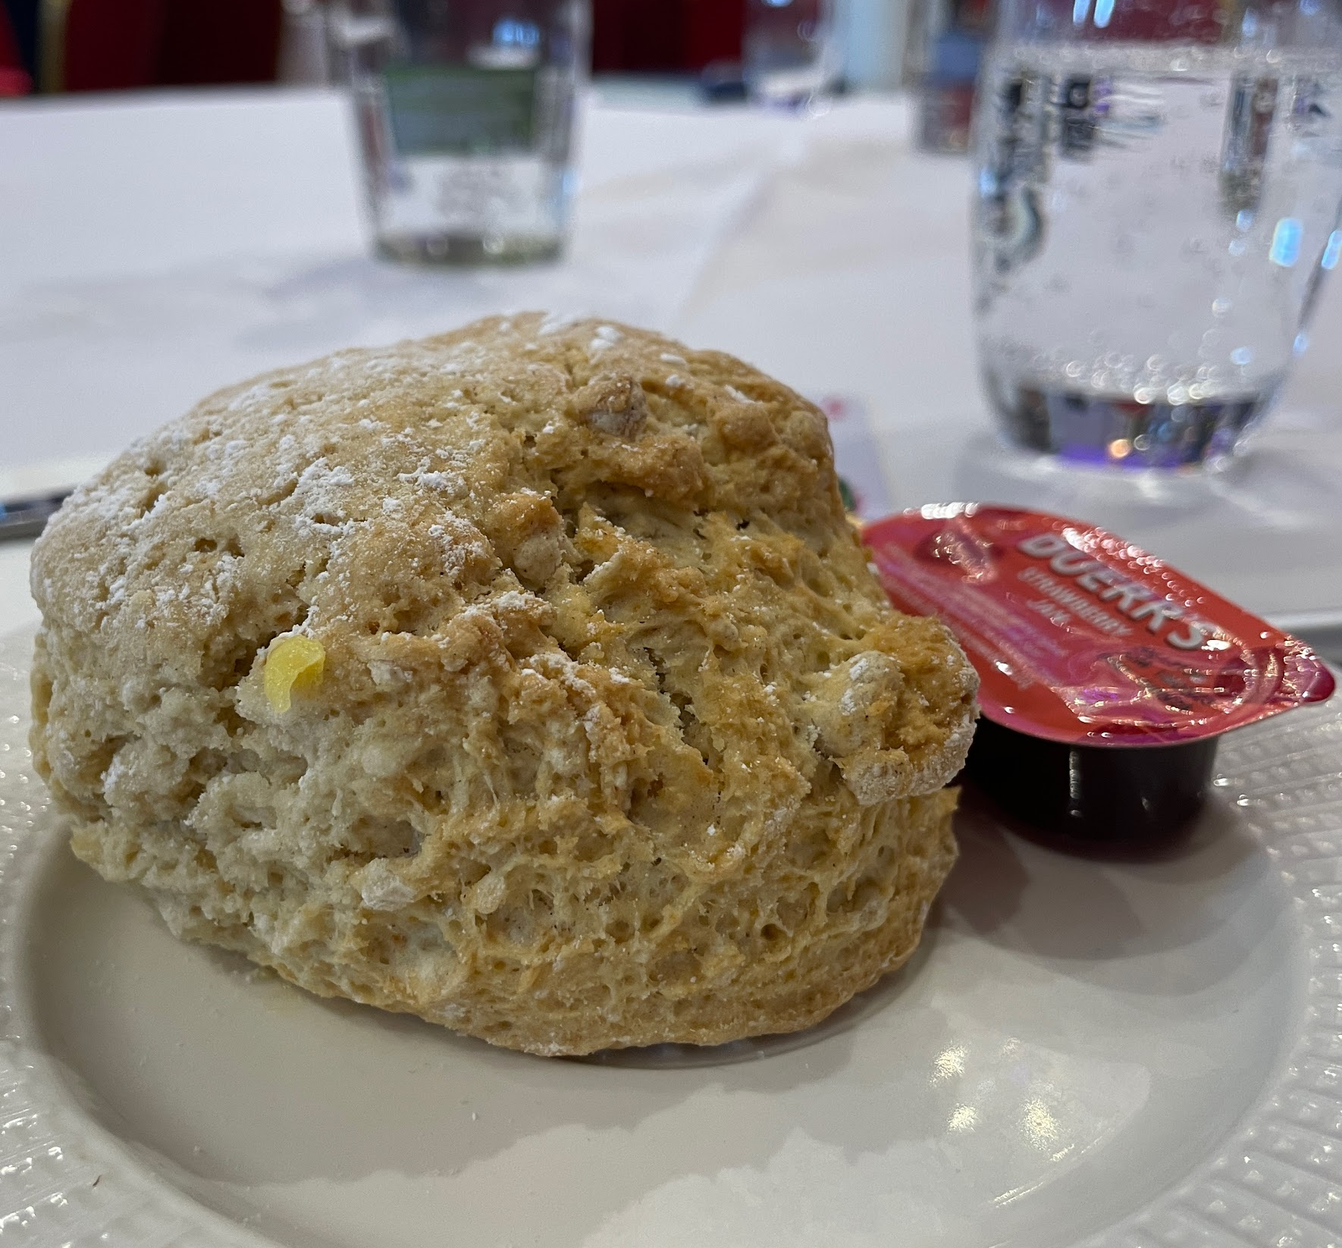
PLACE
01
Contextualizing Libraries

Slide 4
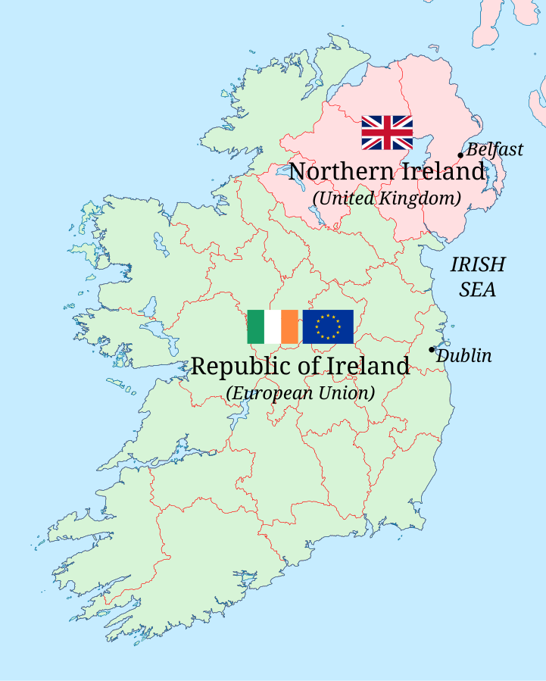
Joint Conference
The ALA of Ireland
CILIP - Main library organization in UK
LAI - Main library organization in Ireland
Every year they switch out between Ireland and NI

Slide 5
Joint Conference
Different countries within different country systems
Ireland - within EU
Northern Ireland - within UK (no longer EU since Brexit)
Same island
No border patrol
Trains connect all of Ireland/NI but you have to buy tickets from different services

Slide 6
Difference of Place
01
02
TRANSPORTATION
REGIONALITY
Much easier to get around than US conferences
Location off the beaten path
03
04
FOOD
HOUSING
Potato, potato, potato
Downtown versus outskirts

Slide 7
Sociopolitical Context

Slide 8
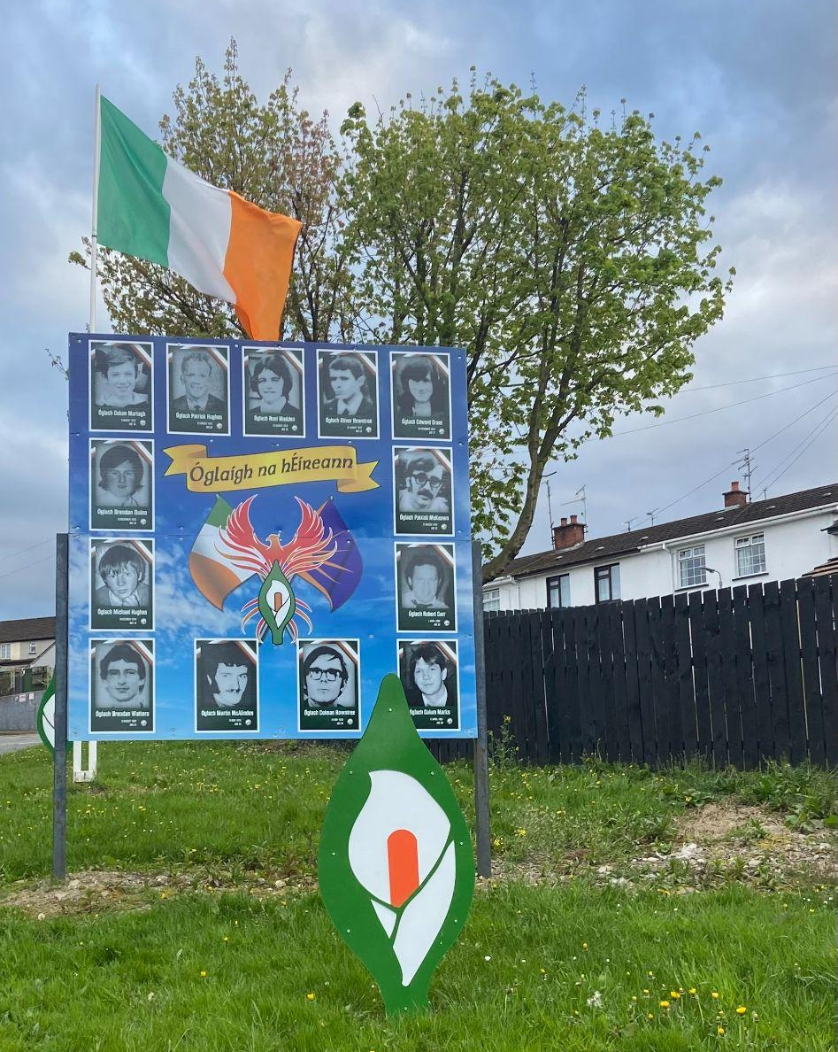
Sociopolitical Context

Slide 9
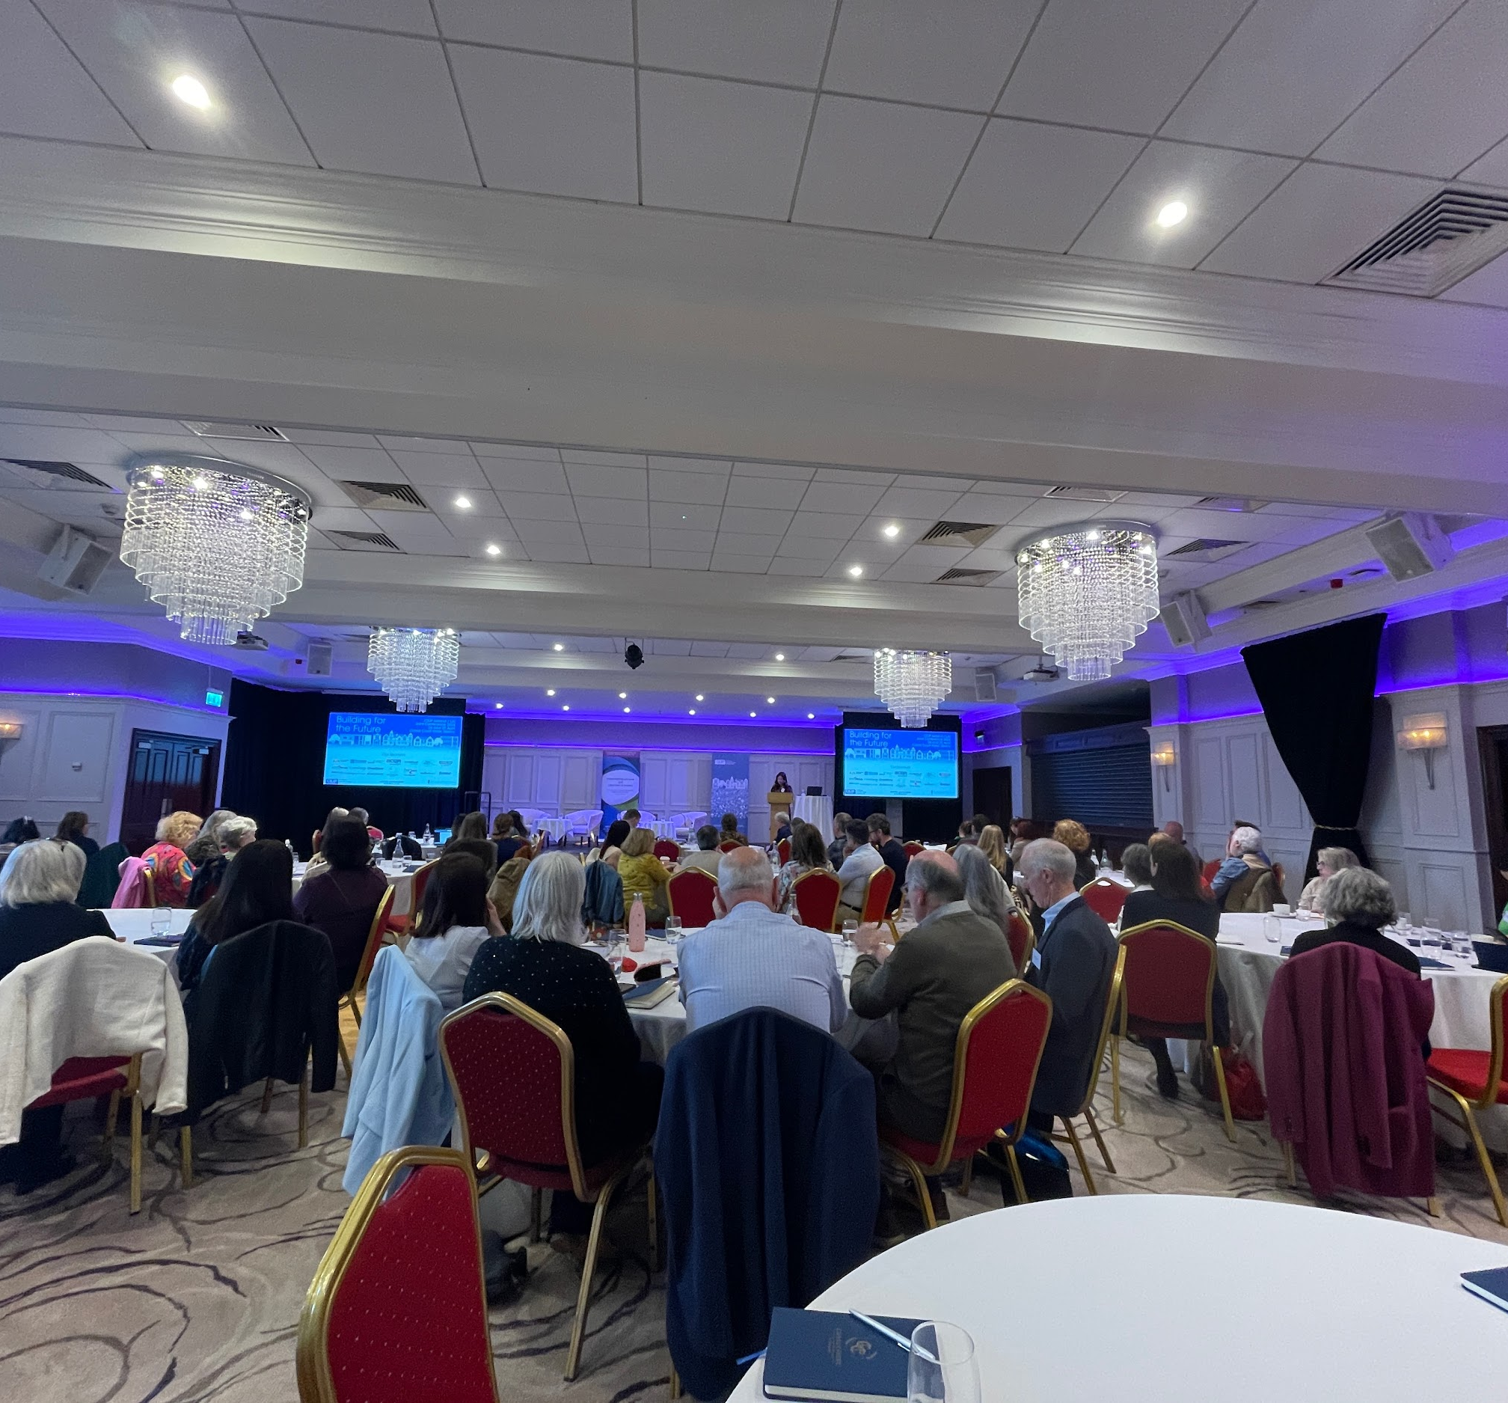
PEOPLE
02
Making connections

Slide 10
NEWRY QUICK FACTS
Population
Irish language
City of 27,913 (2021 census)
20% of population know some Irish
Demographics
86% Catholic 61% identify as Irish
Source: “Newry”. Wikipedia https://en.wikipedia.org/wiki/Newry.

Slide 11
A SMALL, BUT VERY WELCOMING GROUP
Organizers - very helpful and accommodating from the start
Small regional conference - bet. 150-200 attendees
Attendees from England, Hong Kong, and someone else from the U.S.!
Interest and questions about our presentations
Excited to connect with us
Invited to reception dinner
Conversations about library similarities and differences
Met people who knew Binghamton and librarians here!

Slide 12
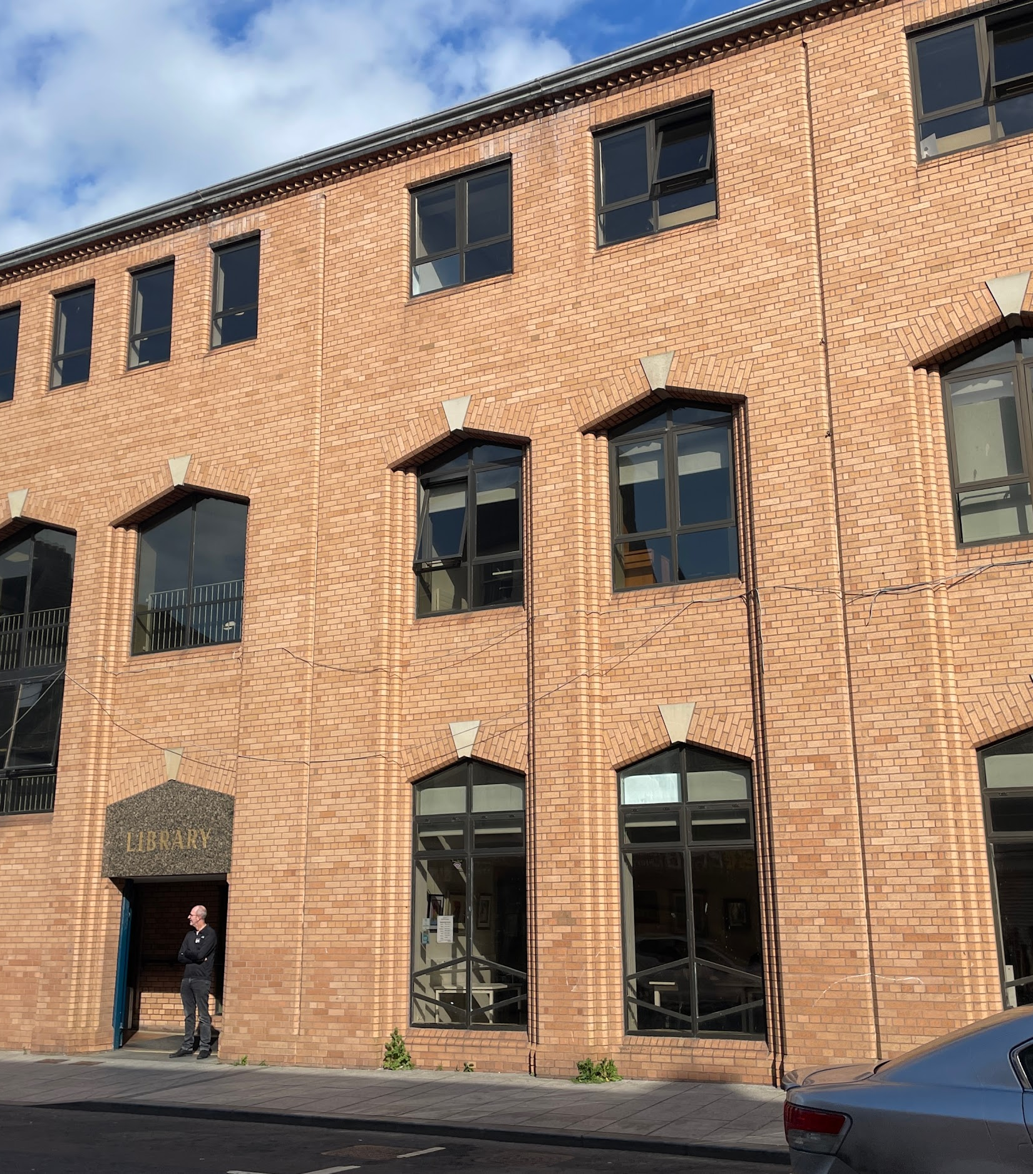
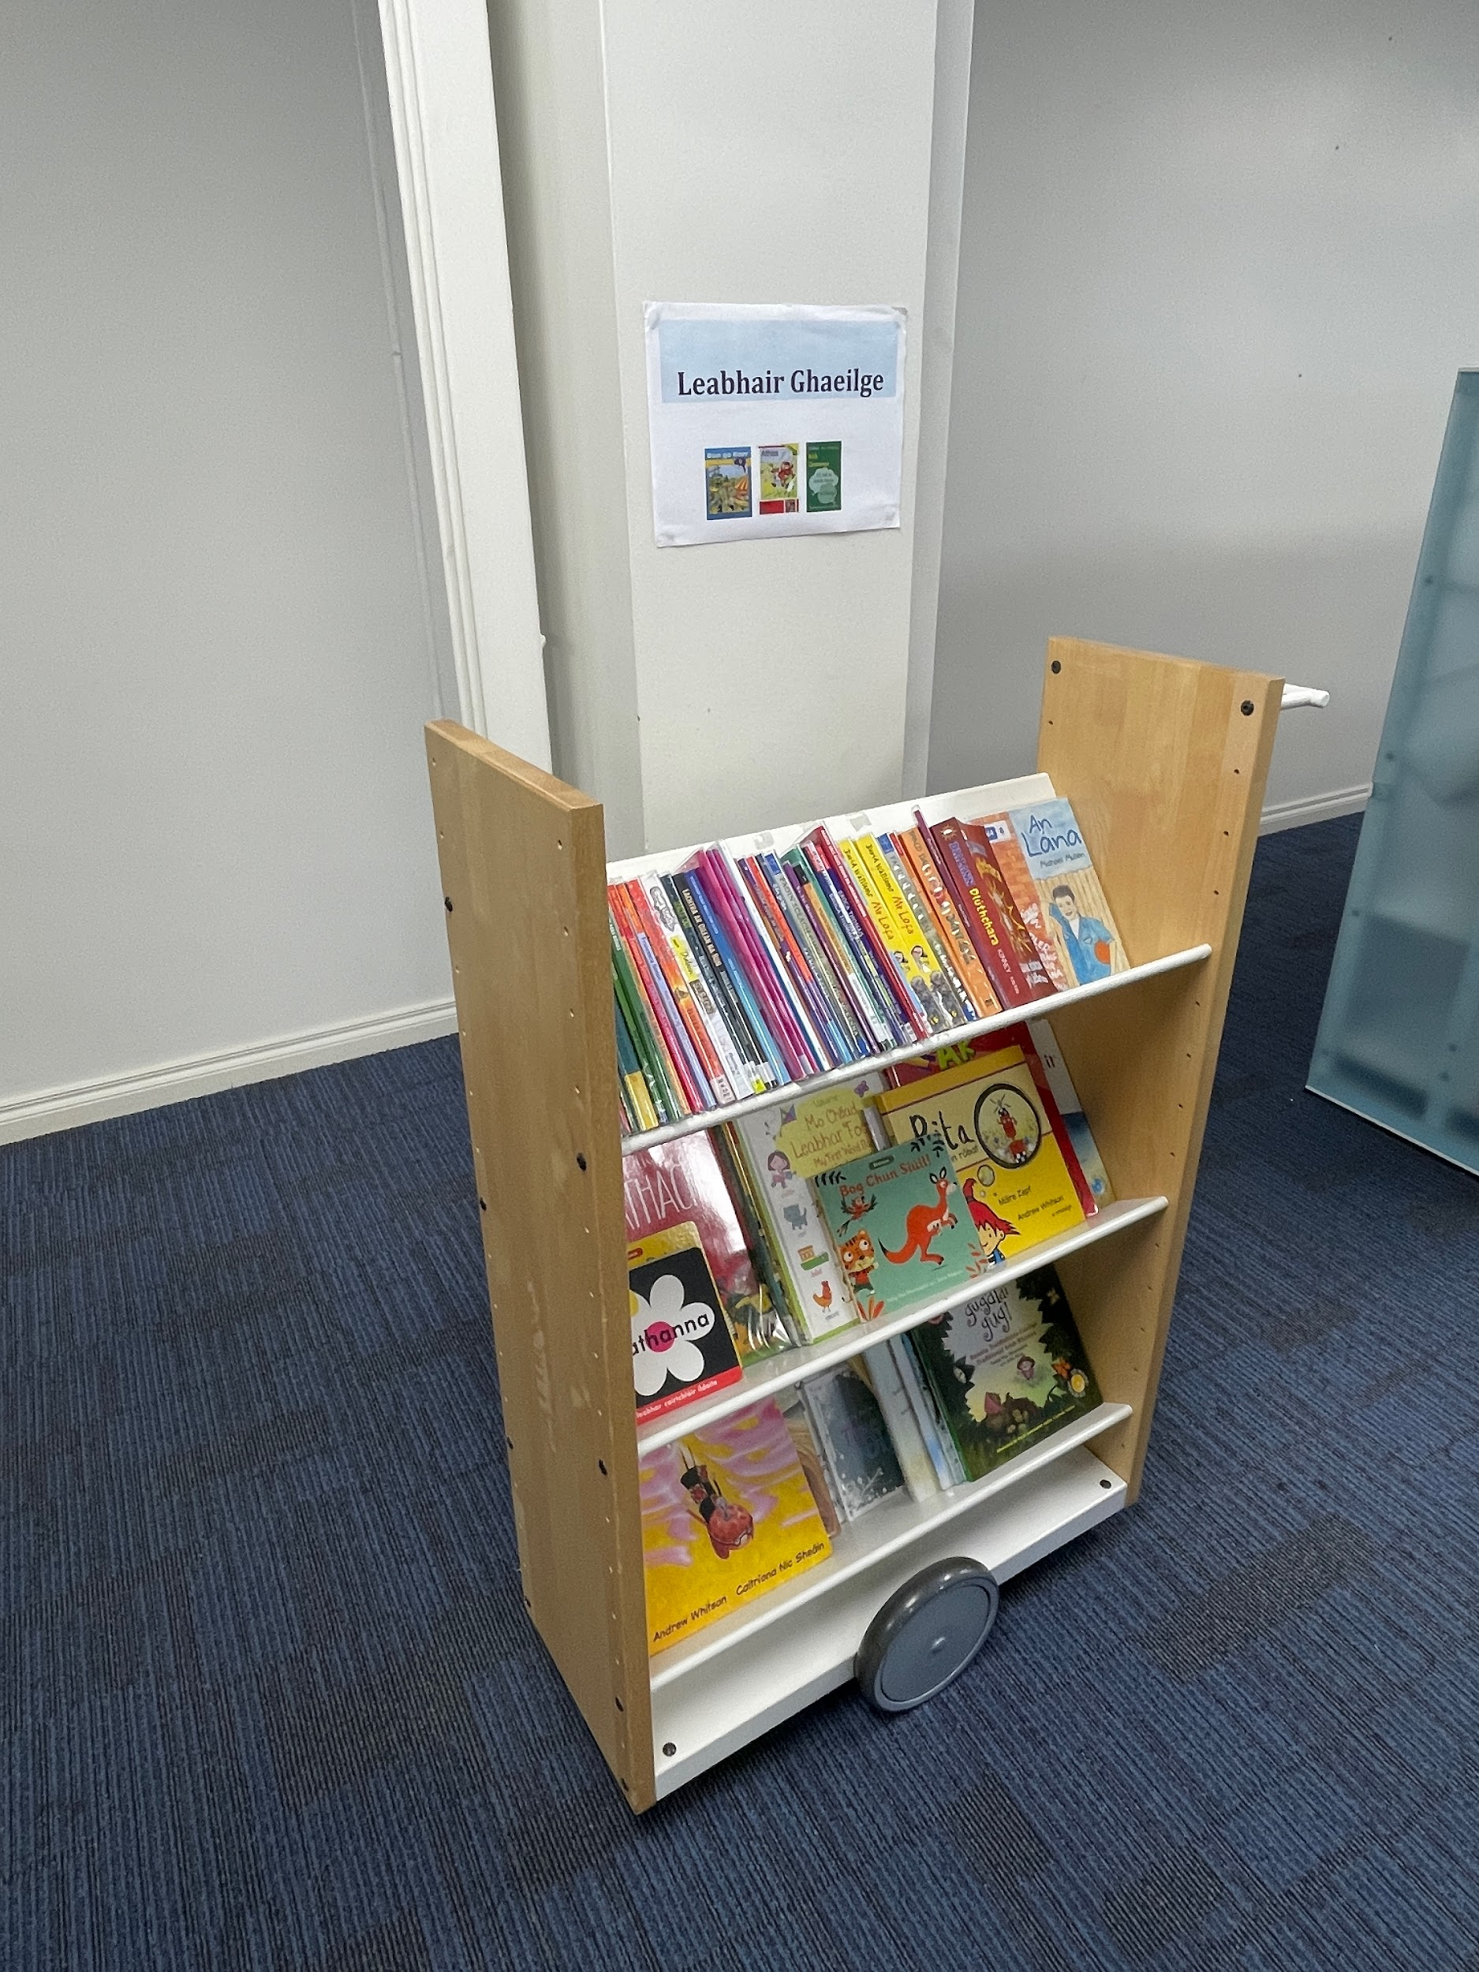
LIBRARIES NI
One underfunded public library system serving underrepresented communities such as refugees, Irish speakers, and traveler communities
Newry City Library

Slide 13
THINGS
03
Keynote
↕
Plenary
↕
Learning Session
↕
Lightening Session
↕
Poster

Slide 14
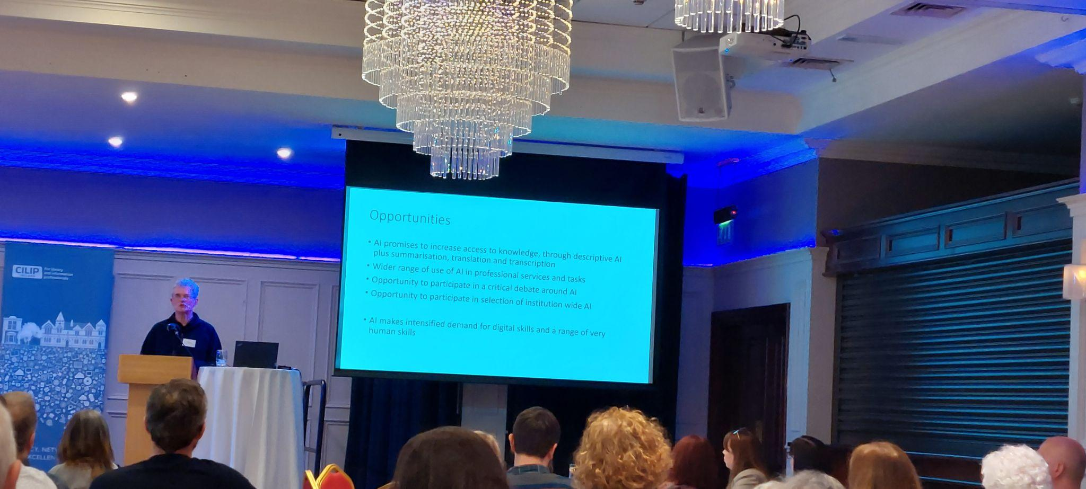
Keynote I
Building Our Future: What is the Role of AI?
Dr. Andrew Cox
Senior Lecturer, University of Sheffield

Slide 15
Day 1
Future of Public Libraries Sue Williamson, CILIP President 2024
Innovation in Reader Development: A Libraries NI Approach Sean Beattie, Head of Service-North & East. Libraries NI
Building for the Future: Humanity & Emotion Dr. Liam Campbell, Mellon Centre for Migration Studies
Students' Perceptions and Uses of ChatGPT: Implications for Educators Claire McGuinness & Stefanie Havelka, School of Information and Communication Studies, UCD

Slide 16
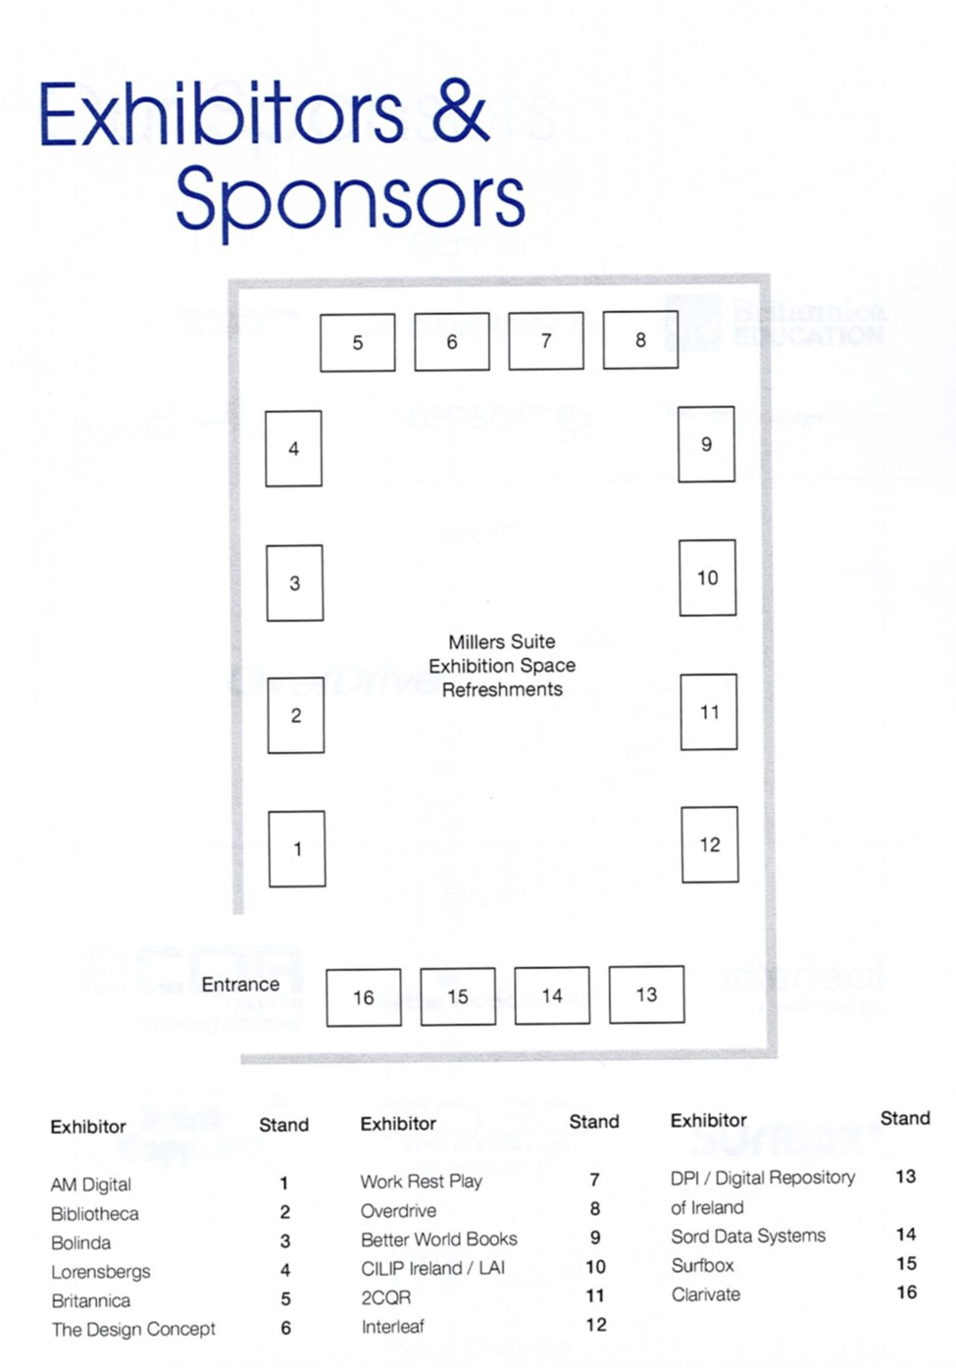
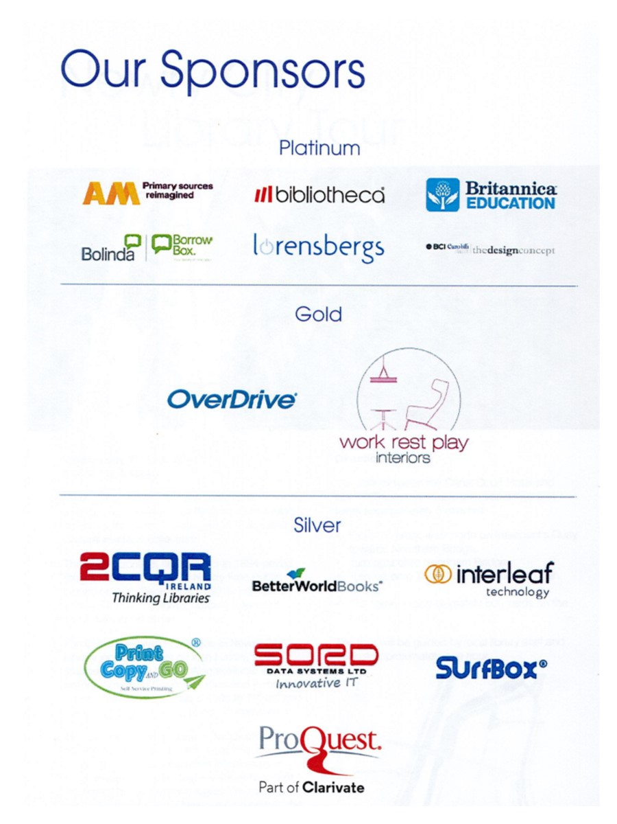
$$$

Slide 17
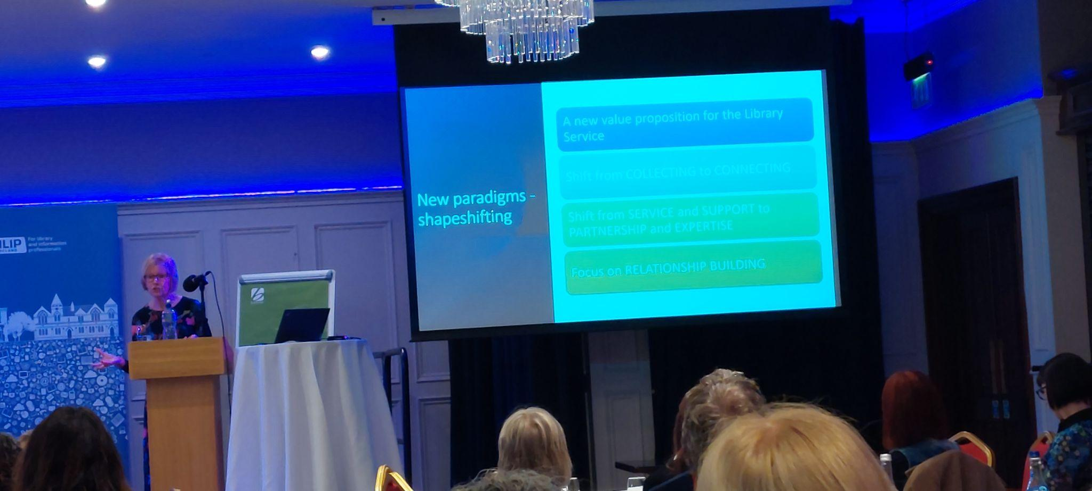
Keynote II
A New Chapter: University of Ulster Library Services Reimagined
Janet Peden
Director of Library Services, Ulster University

Slide 18
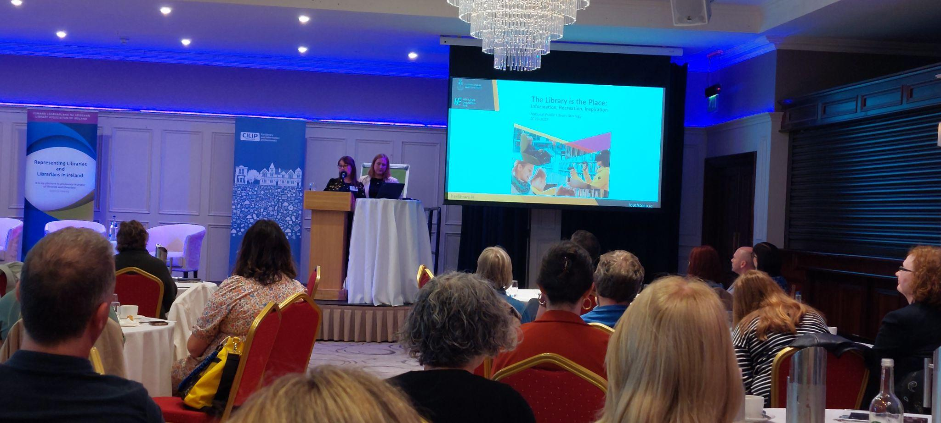
Plenary:
Baby Talk: Neonatal Intensive Care Reading Project
Leona Burgess, Louth Library Service Executive Librarian
&
Ruth O’Rourke, Our Lady of Lourdes' Hospital Library Executive Librarian

Slide 19
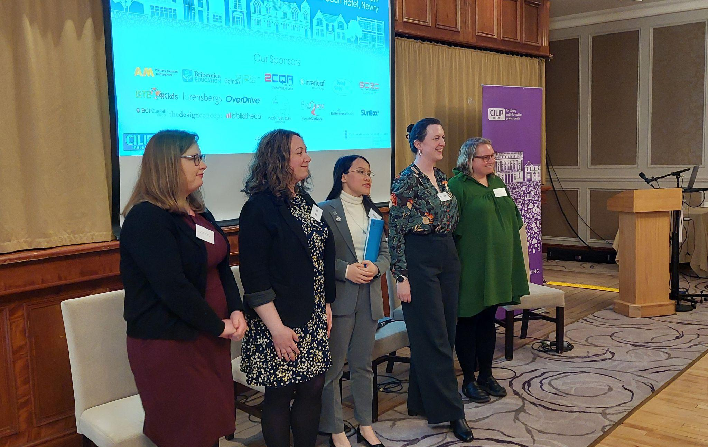
New Professionals Panel
Halie Kerns, USA
Dr. Aine Warren Kannan, Ireland
Ashley Kong, Hong Kong
Clare Hartweig, Ireland
Meghan Lenahan, USA

Slide 20
Day 2
The Digital Repository of Ireland: Providing long-term preservation of humanities, cultural heritage and social sciences digital data across the island of Ireland Dr Maeve O'Brien, Digital Repository of Ireland
Futures Literacy Workshop 1: A rapid introduction to the concept of futures literacy and the role of scenarios in futures studies Ben Lee, Director, Shared Intelligence
How libraries can leverage AI: A focus on practical and approachable uses of machine learning Daniel van Strein, Machine Learning Librarian, Hugging Face

Slide 21
Plenary:
Building a Decolonised Future Through Irish Libraries.
Louise Cooke-Escapil, Dublin Business School

Slide 22
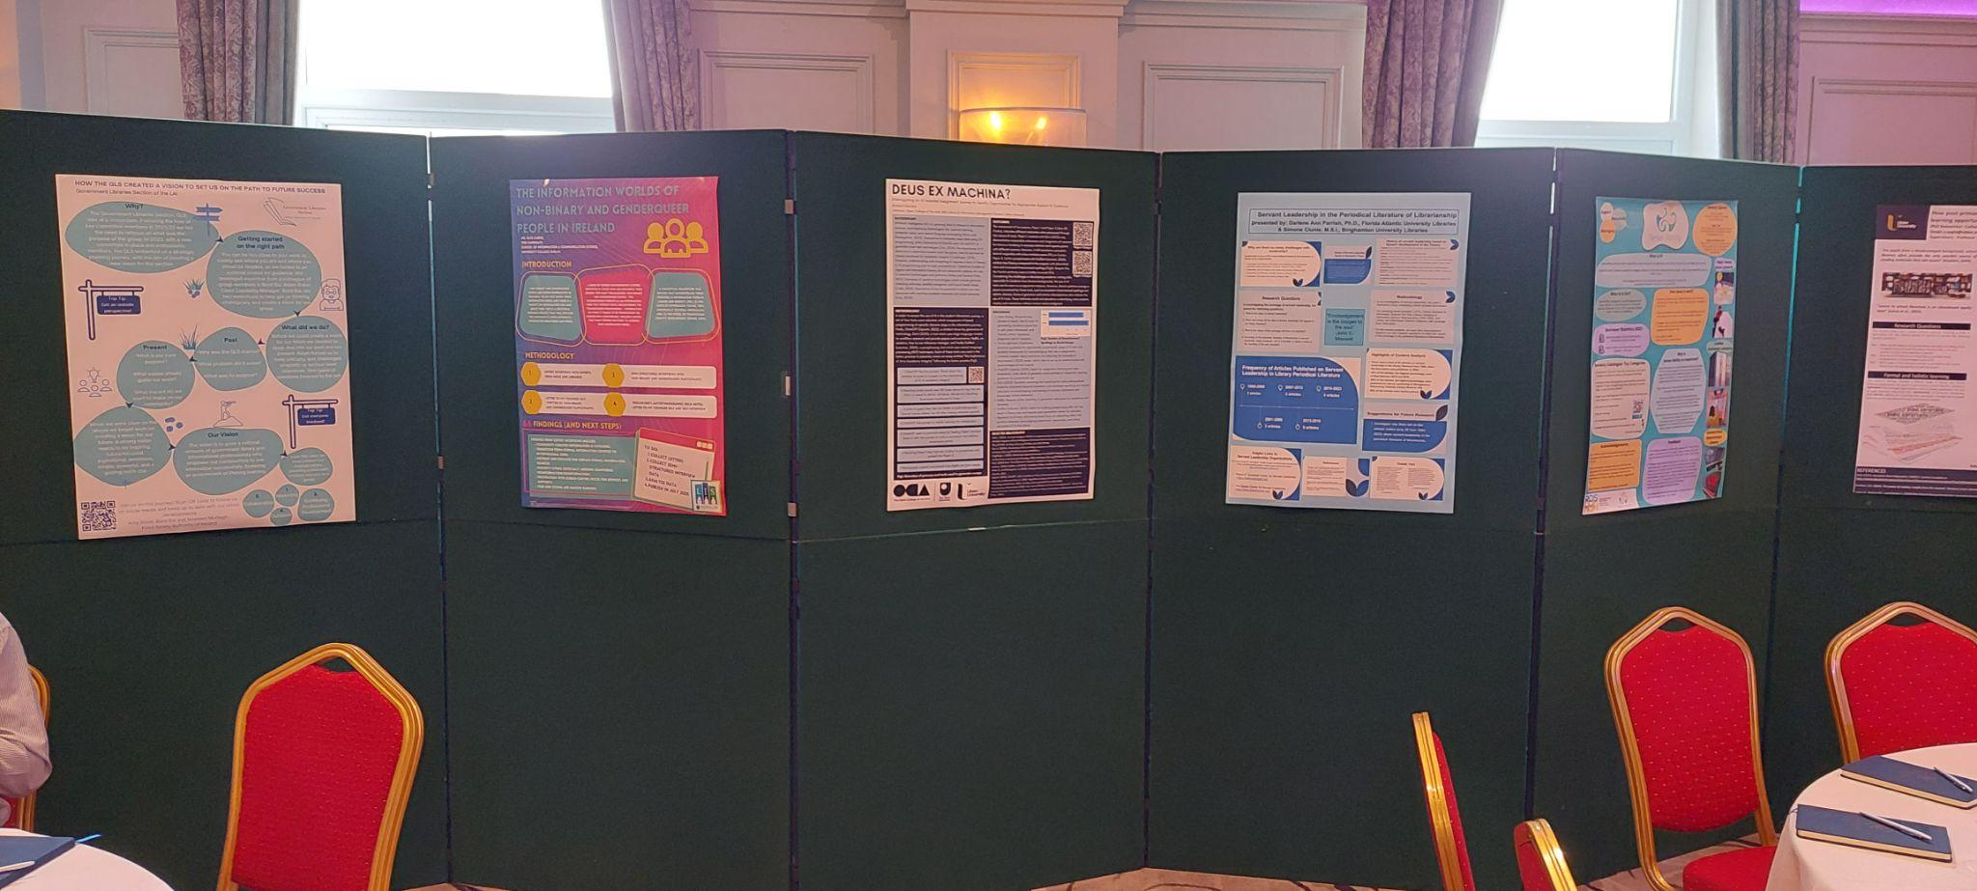
POSTER DISPLAY
How post-primary school libraries create and support learning opportunities for pupils in disadvantaged areas of NI. By PhD researcher Cathal Coyle, School of Education, Ulster University.
Deus ex machina? Interrogating on AI Assisted Assignment Journey to Identify Opportunities for Appropriate Support and Guidance. By Richard Cleverly, Librarian, Open College of the Arts.
Sense-ability: Sensory Spaces in Public Libraries. By Michelle Keane, Roscommon County Council.
PG6009: A module re-imagined. By Ronan Madden and Ben Williamson University College Cork Library.
The Information Worlds of Non-binary and Genderqueer People in Ireland. By Faye Carrie, PhD Candidate, School of Information and Communication Studies, University College Dublin.
Digital Literacy for all: Reflections on creating a short course in digital literacy. By Ann Byrne, Hibernia College, Dublin.
Belfast 135 – 135 years of Belfast Central Library. By Libraries NI.
Servant Leadership in the Periodical Literature of Librarianship. By Dr. Darlene Parrish, FAU & Simone Clunie, Binghamton University.

Slide 23
SIMILAR CONCERNS
SERVICES/TRENDS
01
02
STAFFING
LIBRARIES
BUDGETS
PLANNING
03
04

Slide 24
Connecting the Global Library
Libraries NI
Libraries exist in all countries & we are connected
What make regional services special–inspiration
Similar issues, local challenges
Build personal and institutional support networks
Serendipitous interactions, potential for collaborations
Promote Binghamton scholarship on an global scale!

Slide 25
THANKS!
Questions?
Please keep this slide for attribution

