Slide 1
The Processing Manual
as a Tool for Diversity, Equity, and Inclusion
SAA’s ARCHIVES*RECORDS Conference 2022
August 27, 2022
Kate McNally & Maggie McNeely
(she/her) ( she/they )
Notes:
Kate

Slide 2
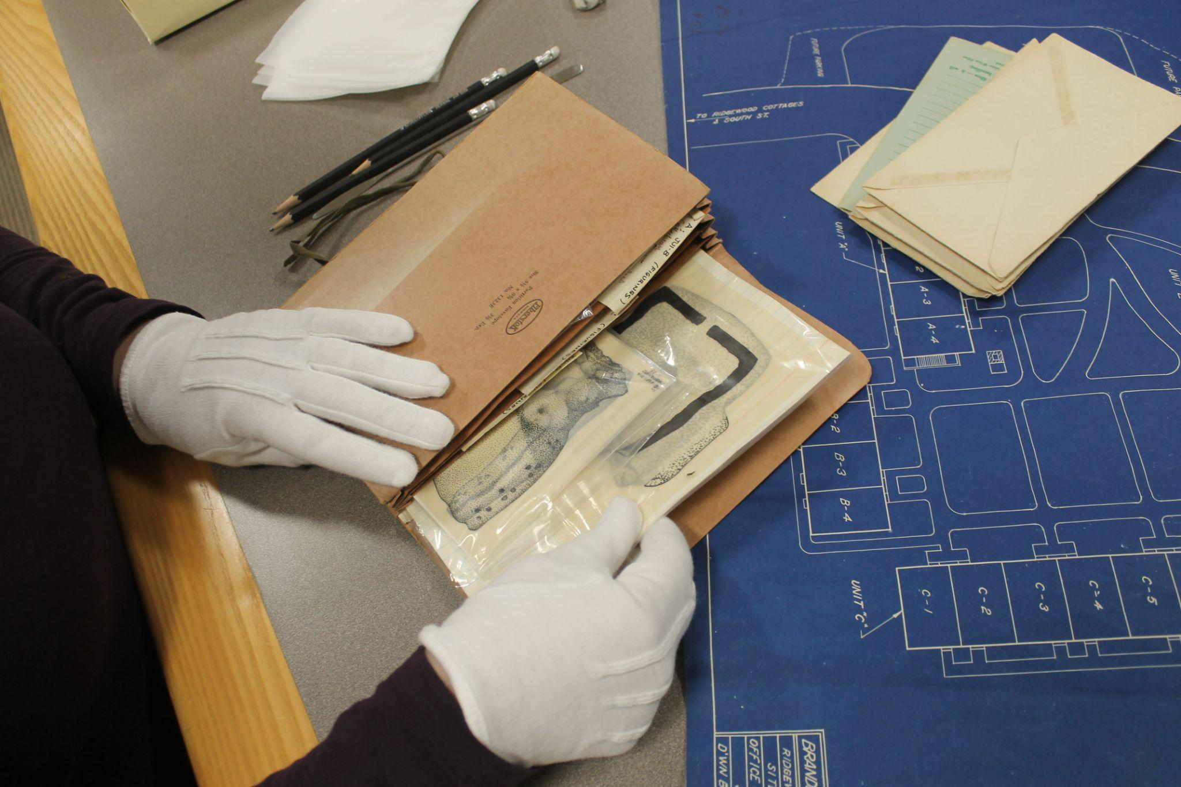
Robert D. Farber University Archives &
Special Collections PROCESSING MANUAL
Created by archives staff of Brandeis University: May 2020 to December 2021
https://tinyurl.com/bdfmvr87
Notes:
Maggie

Slide 3
Reparative Archival Work
“When archivists and their institutions acknowledge the marginalization or absence of the oppressed they must respond through establishing a reparative archive that engenders inclusivity. Reparative archival work does not pretend to ignore the imperialist, racist, homophobic, sexist, ableist, and other discriminatory traditions of mainstream archives, but instead acknowledges these failures and engages in conscious actions toward a wholeness that may seem to be an exercise in futility but in actuality is an ethical imperative for all within traditional archival spaces”
-- Lae’l Hughes-Watkins, Moving Toward a Reparative Archive: A Roadmap for a Holistic Approach to Disrupting Homogenous Histories in Academic Repositories and Creating Inclusive Spaces for Marginalized Voices, 2018
Notes:
Kate

Slide 4
Defining our Terms
Social Justice
“… social justice is both a process and a goal. The goal of social justice is full and equal participation of all groups in a society that is mutually shaped to meet their needs. Social justice includes a vision of society in which the distribution of resources is equitable and all members are psychologically and physically safe and secure.” (Lee Ann Bell, Theoretical Foundations for Social Justice Education, 2013, p. 21)
Anti-oppressive Archival Work
“Anti-Oppression work seeks to recognize the oppression that exists in our society and attempts to mitigate its effects and eventually equalize the power imbalance in our communities.” (Anti-Violence Project, Univ. of Victoria, BC)
Notes:
Kate

Slide 5
SAA Core Values Statement & Code of Ethics
SAA Core Values Statement and Code of Ethics
Expand access and usage opportunities for users, and potential users, of archival records.
Develop and follow professional standards that promote transparency and mitigate harm.
Respect the diversity found in humanity and advocate for archival collections to reflect that rich complexity.
Notes:
Maggie

Slide 6
The Manual’s Goals for DEIA Practices
Use MPLP processes to increase access to collections
Increase transparency around archival practice and decision-making
Provide accurate description while mitigating harm
Responsibly maintain privacy and confidentiality
Acknowledge creators, complex provenance, and lift up marginalized voices
Notes:
Kate

Slide 7
Goal 1:
Use MPLP Processes to Increase Access to Collections
So how do we create a system for implementing MPLP/ and extensible processing and workflows, while also developing better practices in anti-oppressive work?
We applied MPLP to targeted steps of processing, while adding DEIA-focused tasks to other parts of the workflow:
Increased work done during accessioning
Do less physical preservation, arrangement, and detailed inventory work
Provide support for extensible/ iterative processing by creating worksheets to track work
Created a Levels of Processing Matrix and a Levels of Processing Decision-Making Chart
Notes:
Maggie

Slide 8
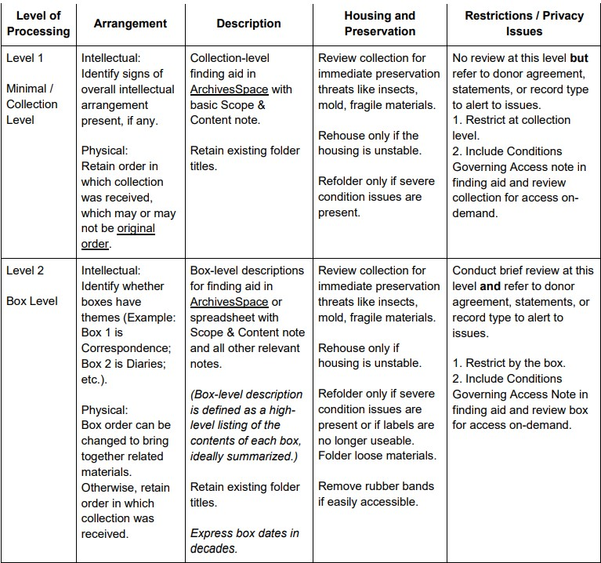
Levels of Processing Matrix
Notes:
Kate?

Slide 9
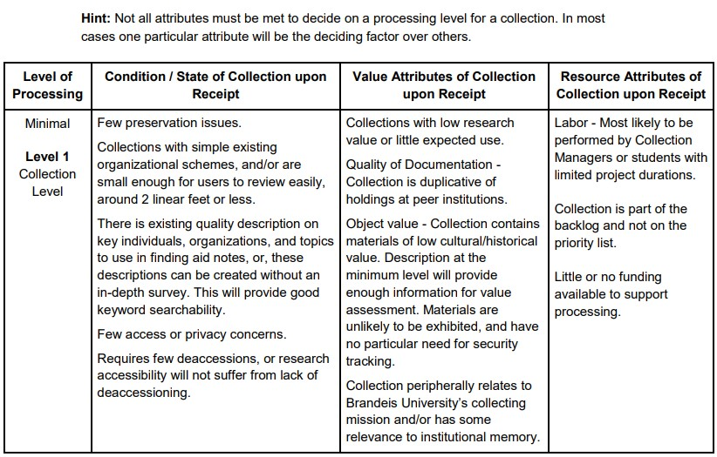
Levels of Processing Decision-Making Chart
Notes:
Kate?

Slide 10
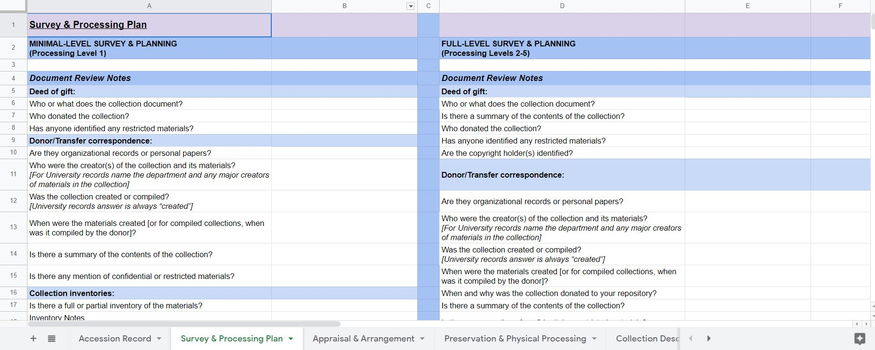
Processing Worksheet
Notes:
Kate

Slide 11
Goal 2:
Increase Transparency Around Archival Practice
and Decision-Making
“The [archival] profession preaches the merits of accountability through good records to any who will listen..how accountable are archivists willing to be through keeping good records about themselves about what they do and making these records readily available?”
(Terry Cook in Jennifer Douglas, “Toward More Honest Description,” The American Archivist, 2016)
Notes:
Kate

Slide 12
Goal 2:
Increase Transparency Around Archival Practice
and Decision-Making
DACS 7.1.8 recommends use of the Processing Information Note, but Brandeis had previously not required its use in finding aids.
Our manual now requires use of the Processing Information Note to record the following:
Previous processing work
Changes to the physical arrangement
Restrictions work performed
Research into complex provenance
Appraisal actions taken
The presence of devised vs. existing titles
Notes:
Kate

Slide 13
Goal 3:
Provide Accurate Description While Mitigating Harm
Increase our use of descriptive notes (including the Processing Information Note and Custodial History Note)
Focus on the language, voice, and style of description as described in the Archives for Black Lives in Philadelphia: Anti-Racist Description Resources
Prioritize honesty over neutrality in language
Have care in how we describe people and the records of people’s lives, seek out community-based sources of information
Notes:
Kate:

Slide 14
Goal 4:
Responsibly Maintain Privacy and Confidentiality
Privacy, consent and protection of the identities and strategies of activists represented in archival collections
Protection of student’s identities and political freedom in University Archives
Named individuals have named themselves
FERPA (Family Educational Rights & Privacy Act)
Beyond FERPA: Use Policy on University Photographs with Students
Notes:
Maggie

Slide 15
Use Policy on University Photographs with Students
1. Photos created more than 40 years ago may be used in any manner not prohibited by copyright law.
2. Photos taken 40 years ago until today may be available for public use or publication not prohibited by copyright law only if the following is true:
a. It is clear from the image that it is a posed publicity photo, or,
b. Individual students cannot be easily identified in the photograph, or,
c. The content of the photo does not require consideration for privacy*, or,
d. Permission from all living individuals in the image has been obtained.”
Notes:
Maggie

Slide 16
Goal 4:
Responsibly Maintain Privacy and Confidentiality
New practices in manual:
Early and iterative restrictions work
Minimal, moderate, maximum level restrictions review workflows
Detailed written screening criteria
Adding a clear detailed and PUBLIC restrictions note
Whether a review has been conducted
Whether or not restrictions have been identified
Notes:
Maggie:

Slide 17
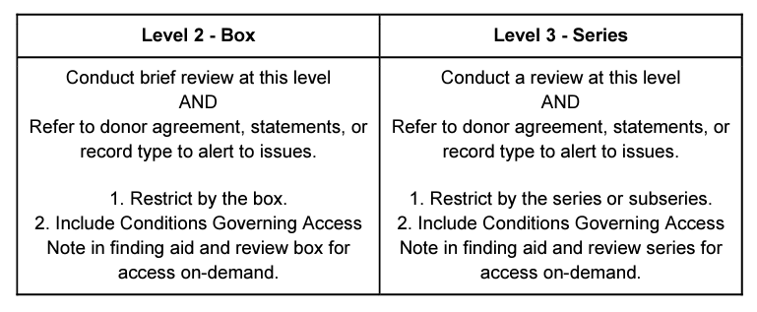
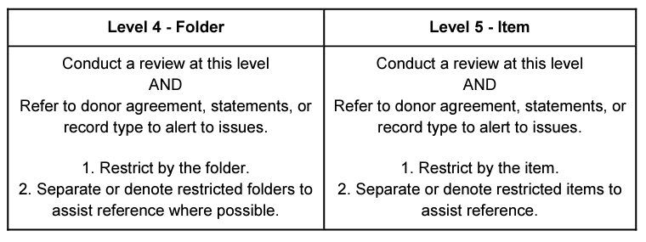
Moderate Restriction
Review:
Maximum Restriction Review:

Slide 18
Goal 5:
Acknowledge Creators, Complex Provenance, and
Lift Up Marginalized Voices
How do we define and respond to Provenance?
The manual asks us to examine the whole context surrounding a collection, and to expand our narration to include:
Creation of the collection AND the materials within
Original or previous use of the materials
Appropriation / loss of the materials by a collector / creator
Compilation of the materials
Donation to our institution
Notes:
Kate:

Slide 19
Goal 5:
Acknowledge Creators, Complex Provenance, and
Lift Up Marginalized Voices
Examples of complex provenance:
Collections created by a particular community, but compiled by an outside individual
Abandoned student work compiled by a professor or academic department
An organizational merger which transfers ownership of one organization’s records to a second entity
A collection of materials collected from various sources around a specific subject
Legacy collections for which there is limited provenance information, or the information has been found to be false or incomplete
Notes:
Kate

Slide 20
Goal 5:
Acknowledge Creators, Complex Provenance,
and Lift Up Marginalized Voices
New practices in our manual:
Provenance and custodial history should be more robust and extensive
Expand our expression of provenance to include all aspects of content creation, not just how the collection itself was created and donated
Repurpose the Custodial History Note to include this expanded provenance as a public note
Notes:
Maggie

Slide 21
Revisited Custodial History for
The Gordon Fellman Papers
Notes:
Maggie: Mention the problems this collection caused

Slide 22
Immediate Impacts of the Processing Manual
Implementation of MPLP/ extensible processing
Provides reasoned and consistent parameters for MPLP decisions
New focus on narrative notes fields
The collection and sharing of more extensive information about the materials during accessioning and throughout processing
Requires us to revisit lack of documentation for previous collections
Automatically made our archival work more transparent and more accountable to our user community
Notes:
Kate

Slide 23
Sources
Antracoli, Alexis A., et al. “Archives for Black Lives in Philadelphia: Anti-Racist Description Resources.” Archives For Black Lives, 2019, archivesforblacklives.wordpress.com/.
“Inclusive Description.” Inclusive Description | Society of American Archivists, Society of American Archivists, www2.archivists.org/groups/description-section/inclusive-description.
“SCRC Statement on Potentially Harmful Language in Archival Description and Cataloging.” Temple University Libraries | SCRC Statement on Potentially Harmful, Temple University Libraries, 2018, library.temple.edu/policies/scrc-statement-on-potentially-harmful-language-in-archival-description-and-cataloging.
Okun, Tema. “WHITE SUPREMACY CULTURE: Characteristics.” Showing Up for Racial Justice - SURJ, 2021, www.showingupforracialjustice.org/white-supremacy-culture-characteristics.html.
Caswell, Michelle. Identifying & Dismantling White Supremacy in Archives. 2016, gracenbrilmyer.com/dismantling_whiteSupremacy_archives_WHOLE.pdf.
Wood, Stacy, Kathy Carbone, Marika Cifor, Anne Gilliland, and Ricardo Punzalan. “Mobilizing Records: Re-Framing Archival Description to Support Human Rights.” Archival Science 14, no. 3-4 (2014): 397-419, doi.org/10.1007/s10502-014-9233-1.
Ramirez, Mario H. “Being Assumed Not to Be: A Critique of Whiteness as an Archival Imperative.” The American Archivist 78, no. 2, (Fall/Winter 2015): 339-356, doi.org/10.17723/0360-9081.78.2.339
Notes:
Kate:

Slide 24
Sources (continued)
Light, Michelle, and Tom Hyry. “Colophons and Annotations: New Directions for the Finding Aid,” American Archivist 65, no. 2 (2002): 216-230, doi.org/10.17723/aarc.65.2.l3h27j5x8716586q.
Hughes-Watkins, Lae’l. “Moving Toward a Reparative Archive: A Roadmap for a Holistic Approach to Disrupting Homogenous Histories in Academic Repositories and Creating Inclusive Spaces for Marginalized Voices,” Journal of Contemporary Archival Studies. 5.6. (2018), https://elischolar.library.yale.edu/jcas/vol5/iss1/6
Douglas, Jennifer. “Toward More Honest Description.” American Archivist. 79:1 (Spring/Summer 2016): 26-55, doi.org/10.17723/0360-9081.79.1.26.
Caswell, Michelle, and Marika Cifor. “From Human Rights to Feminist Ethics: Radical Empathy in the Archives.” Archivaria. 81 (Spring 2016), pp. 23-43. https://archivaria.ca/archivar/index.php/archivaria/article/view/13557.
Cifor, Marika. “Aligning Bodies: Collecting, Arranging, and Describing Hatred for a Critical Queer Archives.” Library Trends 64, no. 4 (2016): 756-775, https://muse.jhu.edu/.
Drake, Jarrett M. “RadTech Meets RadArch: Towards A New Principle for Archives and Archival Description.” Paper presented at the Radcliff e Workshop on Technology & Archival Processing, April 2016, Cambridge, MA, https://medium.com/on-archivy/radtech-meets-radarch-towards-a-new-principle-for-archives-andarchival-description-568f133e4325.
Notes:
Kate

Slide 25
Revisiting the goals and practices we selected from the SAA Core Values Statement and Code of Ethics:
Expand access and usage opportunities for users, and potential users, of archival records.
Develop and follow professional standards that promote transparency and mitigate harm.
Respect the diversity found in humanity and advocate for archival collections to reflect that rich complexity.

Slide 26
Manual link: https://tinyurl.com/bdfmvr87
Contact Us:
Kate McNally: kmcnally@brandeis.edu
Kathryn.Mcnally@tufts.edu
Maggie McNeely: mmcneely@binghamton.edu

